Slide 1
Level Green Presbyterian Church
February 18, 2024

Slide 2
PRELUDE
A time to prepare
our hearts and minds
to worship the Lord.

Slide 3
CALL TO
WORSHIP

Slide 4
Leader:
In You, Lord my God, I put my trust.
People:
I trust in You; do not let me be put to shame.

Slide 5
Leader:
Show me Your ways, Lord,
People:
Teach me Your paths.

Slide 6
Leader:
Guide me in Your truth and teach me,
All:
For You are God my Savior.

Slide 8
Hymn #256
CCLI# 245077

Slide 9
On a hill far away
stood an old rugged cross,
The emblem of suffering and shame;
And I love that old cross
where the dearest and best
For a world of lost sinners was slain.

Slide 10
So I’ll cherish the old rugged cross,
‘Til my trophies at last I lay down;
I will cling to the old rugged cross,
And exchange it some day for a crown.

Slide 11
O that old rugged cross,
so despised by the world,
Has a wondrous attraction for me;
For the dear Lamb of God
left His glory above
To bear it to dark Calvary.

Slide 12
So I’ll cherish the old rugged cross,
‘Til my trophies at last I lay down:
I will cling to the old rugged cross,
And exchange it some day for a crown.

Slide 13
In the old rugged cross,
stained with blood so divine,
A wondrous beauty I see;
For ‘twas on that old cross
Jesus suffered and died
To pardon and sanctify me.

Slide 14
So I’ll cherish the old rugged cross,
‘Til my trophies at last I lay down:
I will cling to the old rugged cross,
And exchange it some day for a crown.

Slide 15
To the old rugged cross
I will ever be true,
Its shame and reproach gladly bear;
Then He’ll call me some day
to my home far away,
Where His glory forever I’ll share.

Slide 16
So I’ll cherish the old rugged cross,
‘Til my trophies at last I lay down:
I will cling to the old rugged cross,
And exchange it some day for a crown.

Slide 17
The Apostles’ Creed

Slide 18
I BELIEVE in God the Father Almighty, Maker of heaven and earth,
And in Jesus Christ
his only Son our Lord;
who was conceived by the Holy Ghost, born of the Virgin Mary,
suffered under Pontius Pilate,
was crucified, dead, and buried;
he descended into hell;

Slide 19
the third day
he rose again from the dead;
he ascended into heaven,
and sitteth on the right hand of God
the Father Almighty;
from thence he shall come to judge
the quick and the dead.

Slide 20
I believe in the Holy Ghost;
the holy catholic Church;
the communion of saints;
the forgiveness of sins;
the resurrection of the body;
and the life everlasting.
Amen.

Slide 21
Prayer of Confession

Slide 22
Eternal God, You are our help and our salvation; for You we should wait all day long. You call us to a time of examination and preparation, but we resist, full of our own agendas. You alone know how impatient we are – with others, with ourselves, and with You. Have mercy on us, O God. Slow our pace. Lift our eyes to see that You wait to help us. We pray in the name of the Beloved Son Jesus Christ. Amen.

Slide 24
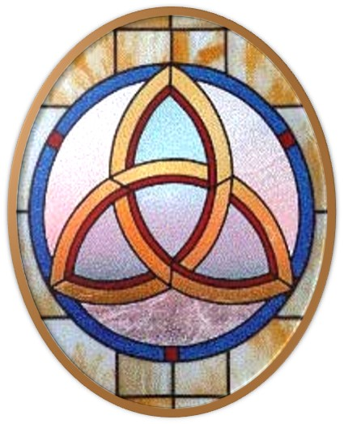
Gloria Patri
Hymn #142
CCLI #245077

Slide 25
Glory be to the Father
and to the Son
and to the Holy Ghost,
as it was in the beginning
is now and ever shall be,
world without end.
Amen, Amen.

Slide 28
I Come To The Cross

Slide 31
Hymn #382
CCLI #245077

Slide 32
Praise God,
From whom all blessings flow;
Praise Him,
All creatures here below;
Praise Him above,
Ye heavenly host;
Praise Father, Son,
And Holy Ghost. Amen

Slide 34
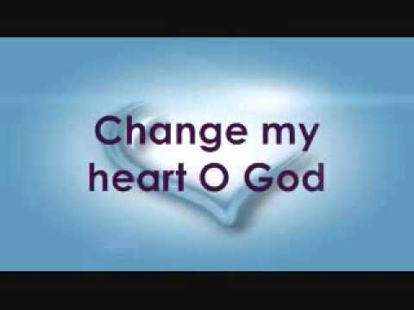
Praise Book
CCLI# 245077

Slide 35
Change my heart, O God,
Make it ever true;
Change my heart, O God,
May I be like You.
Change my heart, O God,
Make it ever true;
Change my heart, O God,
May I be like You.

Slide 36
You are the Potter,
I am the clay;
Mold me and make me,
This is what I pray.
Change my heart, O God,
Make it ever true;
Change my heart, O God,
May I be like You.

Slide 38
Leviticus 19:11-18 (NIV)

Slide 39
¹¹“‘Do not steal. “‘Do not lie. “‘Do not deceive one another. ¹²“‘Do not swear falsely by my name and so profane the name of your God. I am the Lord. ¹³“‘Do not defraud or rob your neighbor. “‘Do not hold back the wages of a hired worker overnight. ¹⁴“‘Do not curse the deaf or put a stumbling block in front of the blind, but fear your God. I am the Lord. ¹⁵“‘Do not pervert justice; do not show partiality to the poor or favoritism to the great, but judge your neighbor fairly. ¹⁶“‘Do not go about spreading slander among your people.

Slide 40
“‘Do not do anything that endangers your neighbor’s life. I am the Lord. ¹⁷“‘Do not hate a fellow Israelite in your heart. Rebuke your neighbor frankly so you will not share in their guilt. ¹⁸“‘Do not seek revenge or bear a grudge against anyone among your people, but love your neighbor as yourself. I am the Lord.

Slide 41
Matthew 5:43-48 (NIV)

Slide 42
⁴³“You have heard that it was said, ‘Love your neighbor and hate your enemy.’ ⁴⁴But I tell you, love your enemies and pray for those who persecute you, ⁴⁵that you may be children of your Father in heaven. He causes his sun to rise on the evil and the good, and sends rain on the righteous and the unrighteous. ⁴⁶If you love those who love you, what reward will you get? Are not even the tax collectors doing that? ⁴⁷And if you greet only your own people, what are you doing more than others? Do not even pagans do that? ⁴⁸Be perfect, therefore, as your heavenly Father is perfect.

Slide 44
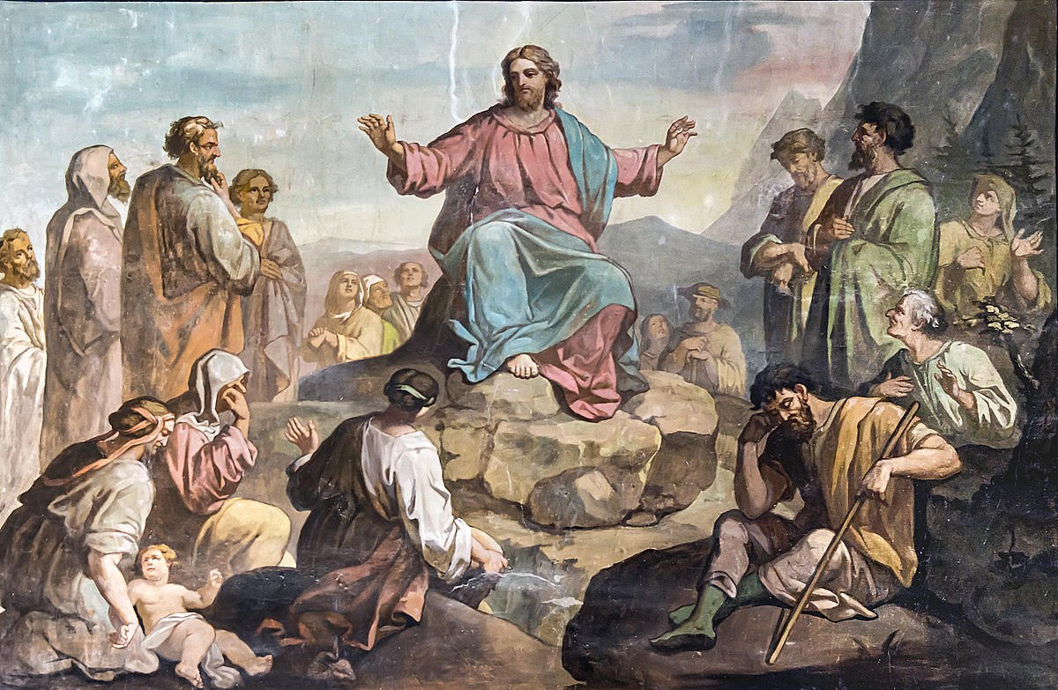
Honoring One Another

Slide 45
Hymn #591
CCLI# 245077

Slide 46
I am weak but Thou art strong;
Jesus, keep me from all wrong;
I’ll be satisfied as long
As I walk, let me walk closer to Thee.

Slide 47
Through this world of toil and snares,
If I falter, Lord, who cares?
Who with me my burden shares?
None but Thee, dear Lord, none but Thee.

Slide 48
When my feeble life is o’er,
Time for me will be no more;
Guide me gently, safely o’er
To Thy kingdom shore, to Thy shore.

Slide 49
Just a closer walk with Thee,
Grant it, Jesus, is my plea,
Daily walking close to Thee,
Let it be, dear Lord, let it be.

Slide 50
BENEDICTION

Slide 51
POSTLUDE
Have a
good week!

