Slide 1
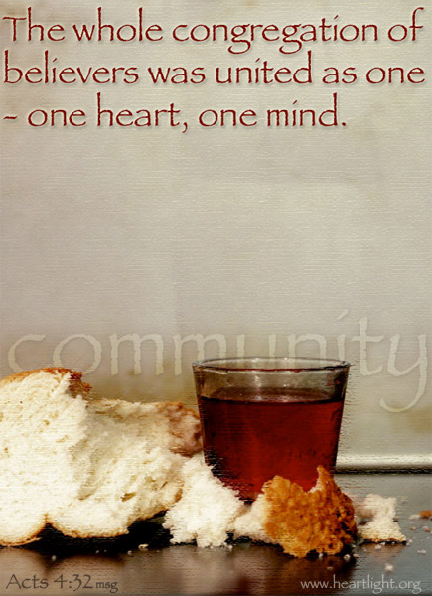
Level Green Presbyterian Church
February 4, 2024

Slide 2
PRELUDE
A time to prepare
our hearts and minds
to worship the Lord.

Slide 3
CALL
TO WORSHIP

Slide 4
Leader:
How good it is to sing praises to our God,
People:
How pleasant and fitting to praise Him!

Slide 5
Leader:
Great is our Lord and mighty in power;
People:
His understanding has no limit.

Slide 6
Leader:
The Lord sustains the humble
All:
But casts the wicked to the ground.

Slide 8
Be Thou My Vision
Hymn #468
CCLI# 245077

Slide 9
Be Thou my Vision,
O lord of my heart;
Nought be all else to me,
Save that Thou art
Thou my best thought,
By day or by night,
Waking or sleeping,
Thy presence my light.

Slide 10
Be Thou my Wisdom,
And Thou my true Word;
I ever with Thee
And Thou with me, Lord;
Thou my great Father,
I Thy true son;
Thou in me dwelling,
And I with Thee one.

Slide 11
Riches I heed not,
Nor man’s empty praise,
Thou mine inheritance,
Now and always:
Thou and Thou only,
First in my heart,
High King of heaven,
My Treasure Thou art.

Slide 12
High King of heaven,
My victory won,
May I reach heaven’s joys,
O bright heaven’s Sun!
Heart of my own heart,
Whatever befall,
Still be my Vision,
O Ruler of all.

Slide 13
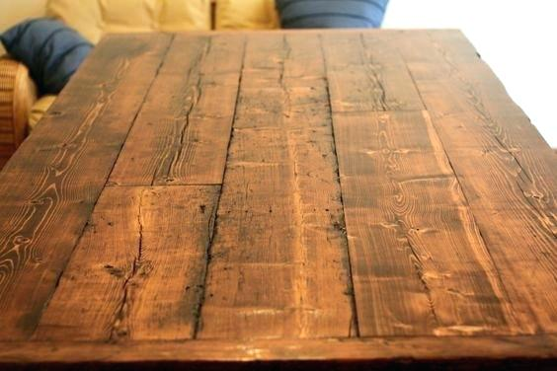

Slide 14
I BELIEVE in God the Father Almighty, Maker of heaven and earth,
And in Jesus Christ
his only Son our Lord;
who was conceived by the Holy Ghost, born of the Virgin Mary,
suffered under Pontius Pilate,
was crucified, dead, and buried;
he descended into hell;

Slide 15
the third day
he rose again from the dead;
he ascended into heaven,
and sitteth on the right hand of God
the Father Almighty;
from thence he shall come to judge
the quick and the dead.

Slide 16
I believe in the Holy Ghost;
the holy catholic Church;
the communion of saints;
the forgiveness of sins;
the resurrection of the body;
and the life everlasting.
Amen.

Slide 17
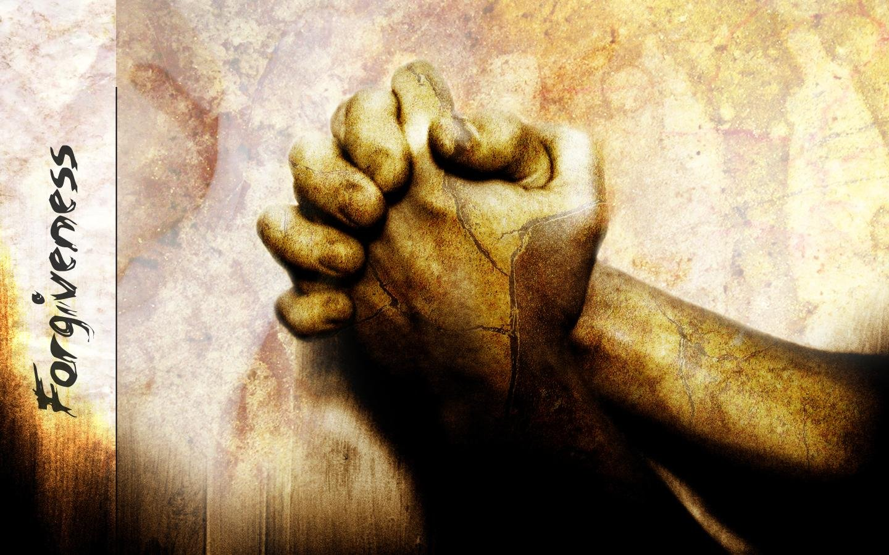
Prayer of Confession

Slide 18
Great God, we confess our weariness. We grow faint with our busyness. We have no energy to help the powerless. We look for strength and find exhaustion. We do not wait for You. Merciful God, forgive us, and lead us back to You, for in You our strength is renewed. Fill our voices with Your praise, that all might hear. We pray in the powerful name of our Lord Jesus Christ. Amen.

Slide 20
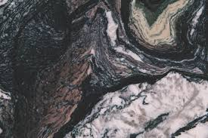
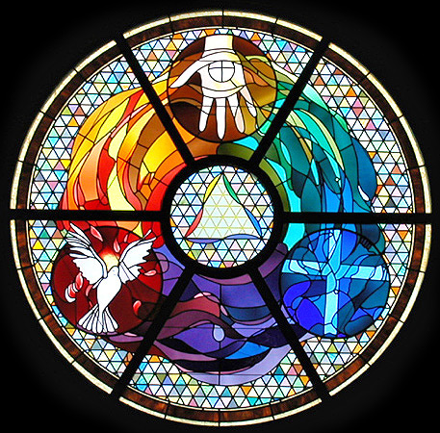
Gloria Patri
Hymn #142
CCLI #245077

Slide 21
Glory be to the Father
and to the Son
and to the Holy Ghost,
as it was in the beginning
is now and ever shall be,
world without end.
Amen, Amen.

Slide 24
Bread of Life

Slide 25
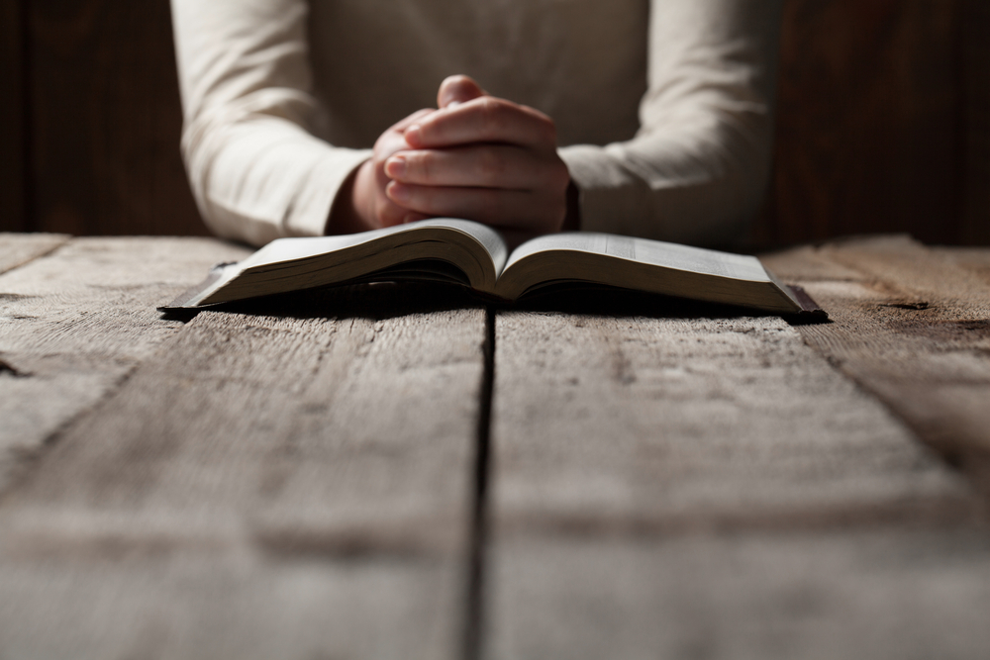

Slide 27
Hymn #382
CCLI #245077

Slide 28
Praise God,
From whom all blessings flow;
Praise Him,
All creatures here below;
Praise Him above,
Ye heavenly host;
Praise Father, Son,
And Holy Ghost. Amen

Slide 30
Deuteronomy 15:1-6 (NIV)

Slide 31
At the end of every seven years you must cancel debts. ²This is how it is to be done: Every creditor shall cancel any loan they have made to a fellow Israelite. They shall not require payment from anyone among their own people, because the Lord’s time for canceling debts has been proclaimed. ³You may require payment from a foreigner, but you must cancel any debt your fellow Israelite owes you. ⁴However, there need be no poor people among you, for in the land the Lord your God is giving you to possess as your inheritance, he will richly bless you,

Slide 32
⁵if only you fully obey the Lord your God and are careful to follow all these commands I am giving you today. ⁶For the Lord your God will bless you as he has promised, and you will lend to many nations but will borrow from none. You will rule over many nations but none will rule over you.

Slide 33
Acts 4:31-37 (NIV)

Slide 34
³¹After they prayed, the place where they were meeting was shaken. And they were all filled with the Holy Spirit and spoke the word of God boldly. ³²All the believers were one in heart and mind. No one claimed that any of their possessions was their own, but they shared everything they had. ³³With great power the apostles continued to testify to the resurrection of the Lord Jesus. And God’s grace was so powerfully at work in them all ³⁴that there were no needy persons among them.

Slide 35
For from time to time those who owned land or houses sold them, brought the money from the sales ³⁵and put it at the apostles’ feet, and it was distributed to anyone who had need. ³⁶Joseph, a Levite from Cyprus, whom the apostles called Barnabas (which means “son of encouragement”), ³⁷sold a field he owned and brought the money and put it at the apostles’ feet.

Slide 37
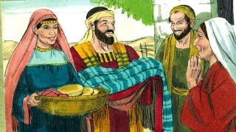
Serving One Another

Slide 39
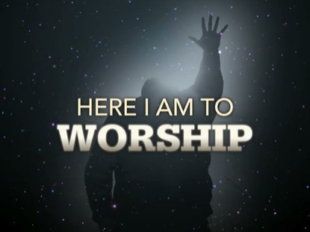
Praise Song #
CCLI# 245077

Slide 40
Light of the world, You stepped down into darkness,
Opened my eyes, let me see.
Beauty that made this heart adore You,
Hope of a life spent with You.

Slide 41
So, here I am to worship,
Here I am to bow down,
Here I am to say that You're my God.
You're altogether lovely,
Altogether worthy,
Altogether wonderful to me.

Slide 42
King of all days, oh so highly exalted,
Glorious in heaven above.
Humbly You came to the earth You created,
All for love's sake became poor.

Slide 43
So, here I am to worship,
Here I am to bow down,
Here I am to say that You're my God.
You're altogether lovely,
Altogether worthy,
Altogether wonderful to me.

Slide 44
And I'll never know how much it cost
To see my sin upon that cross.
And I'll never know how much it cost
To see my sin upon that cross.

Slide 45
So, here I am to worship,
Here I am to bow down,
Here I am to say that You're my God.
You're altogether lovely,
Altogether worthy,
Altogether wonderful to me.

Slide 46
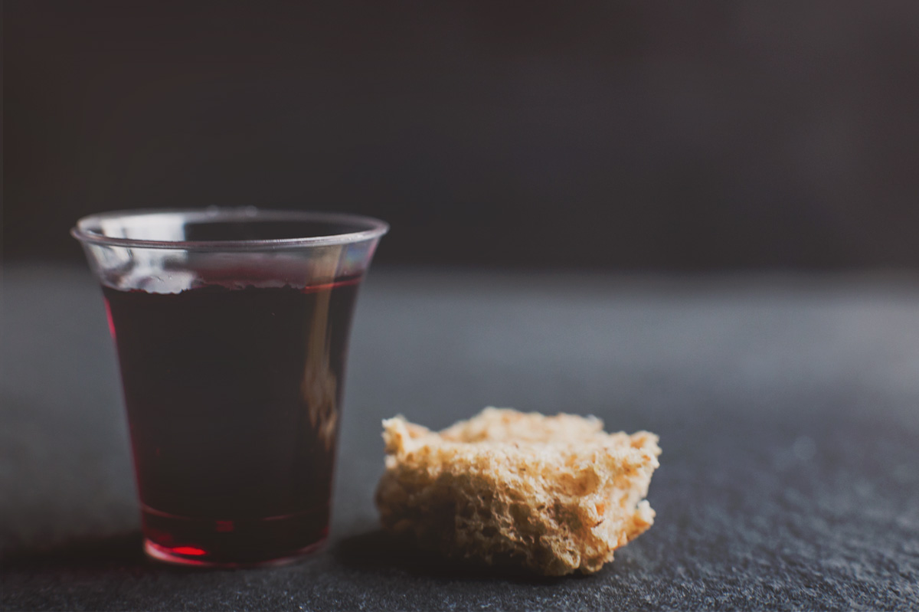
THE SACRAMENT OF THE LORD’S SUPPER
Just As I AM, Without One Plea
CCLI# 245077

Slide 47
Hymn #458
CCLI# 245077

Slide 48
Take my life and let it be Consecrated, Lord, to Thee:
Take my hands and let them move
At the impulse of Thy love,
At the impulse of Thy love.

Slide 49
Take my feet and let them be
Swift and beautiful for Thee;
Take my voice and let me sing
Always, only, for my King,
Always, only for my King.

Slide 50
Take my lips and let them be
Filled with messages for Thee;
Take my silver and my gold,
Not a mite would I withhold,
Not a mite would I withhold.

Slide 51
Take my love, my God, I pour
At Thy feet its treasure store;
Take myself and I will be
Ever, only, all for Thee,
Ever, only, all for Thee.

Slide 52
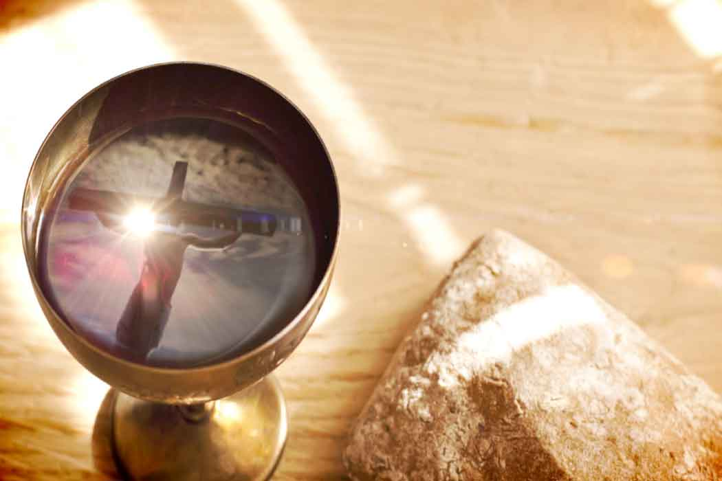
BENEDICTION

Slide 53
POSTLUDE
Have a
good week!

