Slide 1
Level Green Presbyterian Church
January 7, 2024

Slide 2
PRELUDE
A time to prepare
our hearts and minds
to worship the Lord.

Slide 3
CALL TO
WORSHIP

Slide 4
Leader:
The voice of the Lord is over the waters;
People:
The Lord thunders over the mighty waters.

Slide 5
Leader:
The Lord sits enthroned over the flood;
People:
The Lord is enthroned as King forever.

Slide 6
Leader:
The Lord gives strength to His people;
All:
The Lord blesses His people with peace.

Slide 8
Hymn #595
CCLI# 245077

Slide 9
Lead on, O King eternal,
The day of march has come;
Henceforth in fields of conquest,
Thy tents shall be our home.
Through days of preparation,
Thy grace has made us strong,
And now, O King eternal,
We lift our battle song.

Slide 10
Lead on, O King eternal,
Till sin’s fierce war shall cease,
And holiness shall whisper,
The sweet amen of peace. For not with swords’ loud clashing,
Nor roll of stirring drums,
With deeds of love and mercy
The heavenly kingdom comes.

Slide 11
Lead on, O King eternal,
We follow not with fears,
For gladness breaks like morning,
Where’er Thy face appears.
Thy cross is lifted o’er us,
We journey in its light;
The crown awaits the conquest:
Lead on, O God of might.

Slide 12
The Apostles’ Creed

Slide 13
I BELIEVE in God the Father Almighty, Maker of heaven and earth,
And in Jesus Christ
his only Son our Lord;
who was conceived by the Holy Ghost, born of the Virgin Mary,
suffered under Pontius Pilate,
was crucified, dead, and buried;
he descended into hell;

Slide 14
the third day
he rose again from the dead;
he ascended into heaven,
and sitteth on the right hand of God
the Father Almighty;
from thence he shall come to judge
the quick and the dead.

Slide 15
I believe in the Holy Ghost;
the holy catholic Church;
the communion of saints;
the forgiveness of sins;
the resurrection of the body;
and the life everlasting.
Amen.

Slide 16
Prayer of Confession

Slide 17
God of blessing, You have come to us in Jesus Christ, fulfilling Your Word through the prophets. But we lose interest quickly, and our thoughts are turned to our own problems. We languish, looking for easy answers, distracted by the false promises of the loud voices around us. We do not listen for Your voice calling us home from our wanderings. Call us still, O God. Gather us from our far places. Show us Your mercy and remind us that in You we have life abundant. We pray in the name of Jesus Christ who makes all things new. Amen.

Slide 19
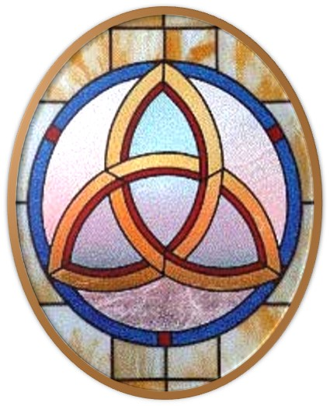
Gloria Patri
Hymn #142
CCLI #245077

Slide 20
Glory be to the Father
and to the Son
and to the Holy Ghost,
as it was in the beginning
is now and ever shall be,
world without end.
Amen, Amen.

Slide 23
My All In All

Slide 25
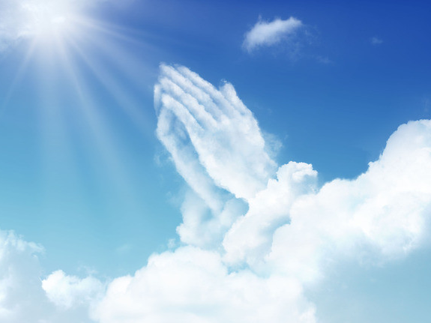

Slide 27
Hymn #382
CCLI #245077

Slide 28
Praise God,
From whom all blessings flow;
Praise Him,
All creatures here below;
Praise Him above,
Ye heavenly host;
Praise Father, Son,
And Holy Ghost. Amen

Slide 30
1 Kings 3:7-14 (NIV)

Slide 31
⁷“Now, Lord my God, you have made your servant king in place of my father David. But I am only a little child and do not know how to carry out my duties. ⁸Your servant is here among the people you have chosen, a great people, too numerous to count or number. ⁹So give your servant a discerning heart to govern your people and to distinguish between right and wrong. For who is able to govern this great people of yours?” ¹⁰The Lord was pleased that Solomon had asked for this. ¹¹So God said to him, “Since you have asked for this and not for

Slide 32
long life or wealth for yourself, nor have asked for the death of your enemies but for discernment in administering justice, ¹²I will do what you have asked. I will give you a wise and discerning heart, so that there will never have been anyone like you, nor will there ever be. ¹³Moreover, I will give you what you have not asked for—both wealth and honor—so that in your lifetime you will have no equal among kings. ¹⁴And if you walk in obedience to me and keep my decrees and commands as David your father did, I will give you a long life.”

Slide 33
Ephesians 3:14-21 (NIV)

Slide 34
¹⁴For this reason I kneel before the Father, ¹⁵from whom every family in heaven and on earth derives its name. ¹⁶I pray that out of his glorious riches he may strengthen you with power through his Spirit in your inner being, ¹⁷so that Christ may dwell in your hearts through faith. And I pray that you, being rooted and established in love, ¹⁸may have power, together with all the Lord’s holy people, to grasp how wide and long and high and deep is the love of Christ, ¹⁹and to know this love that surpasses knowledge— that you

Slide 35
may be filled to the measure of all the fullness of God. ²⁰Now to him who is able to do immeasurably more than all we ask or imagine, according to his power that is at work within us, ²¹to him be glory in the church and in Christ Jesus throughout all generations, for ever and ever! Amen.

Slide 37
Back to Normal

Slide 38
Praise Book
CCLI# 245077

Slide 39
My Jesus, my Saviour,
Lord, there is none like You;
All my days I want to praise
The wonders of Your mighty love.
My comfort, my shelter,
Tower of refuge and strength;
Let ev’ry breath, all that I am,
Never cease to worship You.

Slide 40
Shout to the Lord,
All the earth, let us sing.
Power and majesty, praise to the King.
Mountains bow down
And the seas will roar
At the sound of Your name.

Slide 41
I sing for joy
At the work of Your hands,
Forever I’ll love You,
Forever I’ll stand,
Nothing compares
To the promise I have in You.

Slide 42
My Jesus, my Saviour,
Lord, there is none like You;
All my days I want to praise
The wonders of Your mighty love.
My comfort, my shelter,
Tower of refuge and strength;
Let ev’ry breath, all that I am,
Never cease to worship You.

Slide 43
Shout to the Lord,
All the earth, let us sing.
Power and majesty, praise to the King.
Mountains bow down
And the seas will roar
At the sound of Your name.

Slide 44
I sing for joy
At the work of Your hands,
Forever I’ll love You,
Forever I’ll stand,
Nothing compares
To the promise I have in You.

Slide 45
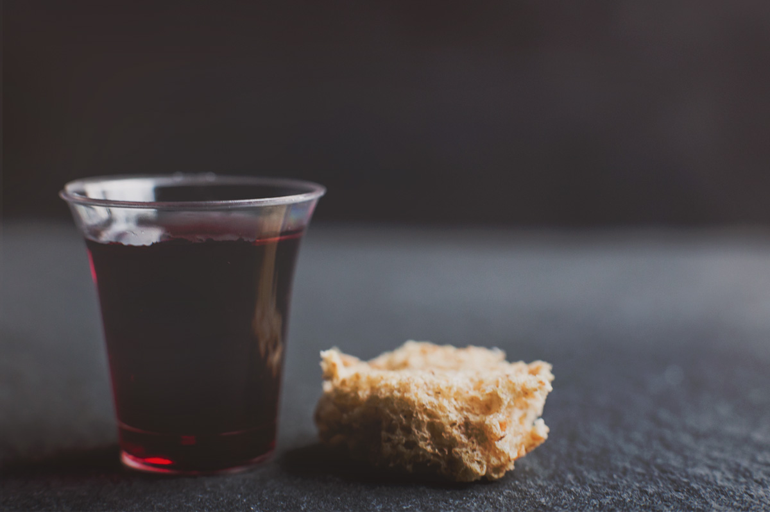
THE SACRAMENT OF THE LORD’S SUPPER
Just As I AM, Without One Plea
CCLI# 245077

Slide 47
He leadeth me, O blessed thought!
O words with heavenly comfort fraught!
Whate’er I do, where’er I be,
Still ’tis God’s hand that leadeth me.
He leadeth me, He leadeth me,
By His own hand He leadeth me;
His faithful follower I would be,
For by His hand He leadeth me.

Slide 48
Lord, I would clasp Thy hand in mine,
Nor ever murmur nor repine;
Content whatever lot I see,
Since ’tis my God that leadeth me.
He leadeth me, He leadeth me,
By His own hand He leadeth me;
His faithful follower I would be,
For by His hand He leadeth me.

Slide 49
And when my task on earth is done,
When by Thy grace the victory’s won,
Even death’s cold wave I will not flee,
Still God through Jordan leadeth me.
He leadeth me, He leadeth me,
By His own hand He leadeth me;
His faithful follower I would be,
For by His hand He leadeth me.

Slide 50
BENEDICTION

Slide 51
POSTLUDE
Have a
good week!

