Slide 1
Level Green Presbyterian Church
March 17, 2024

Slide 2
PRELUDE
A time to prepare
our hearts and minds
to worship the Lord.

Slide 3
CALL TO
WORSHIP

Slide 4
Leader:
I seek You with all my heart;
People:
Do not let me stray from Your commands.

Slide 5
Leader:
I have hidden Your word in my heart;
People:
That I might not sin against You.

Slide 6
Leader:
Praise be to You, Lord;
All:
Teach me Your decrees.

Slide 8
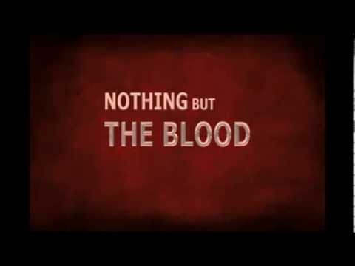
Hymn #266
CCLI# 245077

Slide 9
What can wash away my sin? Nothing but the blood of Jesus;
What can make me whole again?
Nothing but the blood of Jesus.

Slide 10
O! precious is the flow
That makes me white as snow;
No other fount I know,
Nothing but the blood of Jesus.

Slide 11
For my pardon this I see
Nothing but the blood of Jesus;
For my cleansing this my plea
Nothing but the blood of Jesus.

Slide 12
O! precious is the flow
That makes me white as snow;
No other fount I know,
Nothing but the blood of Jesus.

Slide 13
Nothing can for sin atone
Nothing but the blood of Jesus;
Naught of good that I have done
Nothing but the blood of Jesus.

Slide 14
O! precious is the flow
That makes me white as snow;
No other fount I know,
Nothing but the blood of Jesus.

Slide 15
This is all my hope and peace
Nothing but the blood of Jesus:
This is all my righteousness
Nothing but the blood of Jesus.

Slide 16
O! precious is the flow
That makes me white as snow;
No other fount I know,
Nothing but the blood of Jesus.

Slide 17
The Apostles’ Creed

Slide 18
I BELIEVE in God the Father Almighty, Maker of heaven and earth,
And in Jesus Christ
his only Son our Lord;
who was conceived by the Holy Ghost, born of the Virgin Mary,
suffered under Pontius Pilate,
was crucified, dead, and buried;
he descended into hell;

Slide 19
the third day
he rose again from the dead;
he ascended into heaven,
and sitteth on the right hand of God
the Father Almighty;
from thence he shall come to judge
the quick and the dead.

Slide 20
I believe in the Holy Ghost;
the holy catholic Church;
the communion of saints;
the forgiveness of sins;
the resurrection of the body;
and the life everlasting.
Amen.

Slide 21
Prayer of Confession

Slide 22
Gracious and Loving God, our hearts are wandering and distracted. You invite us to serve and love You now, but we refuse because we have places to be and things to do. Our excuses blind us to Your call. The urgent and temporary crowd out what You consider truly important and eternal. Forgive our lack of conviction, discernment, and purpose. Restore to us the joy of serving and loving You. May our lives give You glory and honor. We pray through Christ our Lord. Amen.

Slide 24
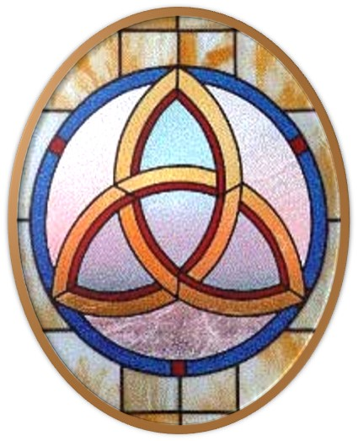
Gloria Patri
Hymn #142
CCLI #245077

Slide 25
Glory be to the Father
and to the Son
and to the Holy Ghost,
as it was in the beginning
is now and ever shall be,
world without end.
Amen, Amen.

Slide 28
Where Are The Shepherds Now

Slide 31
Hymn #382
CCLI #245077

Slide 32
Praise God,
From whom all blessings flow;
Praise Him,
All creatures here below;
Praise Him above,
Ye heavenly host;
Praise Father, Son,
And Holy Ghost. Amen

Slide 34
Praise Book
CCLI# 245077

Slide 35
Open the eyes of my heart, Lord,
Open the eyes of my heart;
I want to see You,
I want to see You.

Slide 36
Open the eyes of my heart, Lord,
Open the eyes of my heart;
I want to see You,
I want to see You.

Slide 37
To see You high and lifted up,
Shining in the light of Your glory,
Pour out Your pow’r and love;
As we sing holy, holy, holy.

Slide 38
Open the eyes of my heart, Lord,
Open the eyes of my heart;
I want to see You,
I want to see You.

Slide 39
Open the eyes of my heart, Lord,
Open the eyes of my heart;
I want to see You,
I want to see You.

Slide 40
To see You high and lifted up,
Shining in the light of Your glory,
Pour out Your pow’r and love;
As we sing holy, holy, holy.

Slide 41
Holy, holy, holy,
Holy, holy, holy;
Holy, holy, holy,
I want to see You.

Slide 42
Holy, holy, holy,
Holy, holy, holy;
Holy, holy, holy,
I want to see You.

Slide 44
Deuteronomy 17:1-7 (NIV)

Slide 45
Do not sacrifice to the Lord your God an ox or a sheep that has any defect or flaw in it, for that would be detestable to him. ²If a man or woman living among you in one of the towns the Lord gives you is found doing evil in the eyes of the Lord your God in violation of his covenant, ³and contrary to my command has worshiped other gods, bowing down to them or to the sun or the moon or the stars in the sky, ⁴and this has been brought to your attention, then you must investigate it thoroughly. If it is true and it has been proved

Slide 46
that this detestable thing has been done in Israel, ⁵take the man or woman who has done this evil deed to your city gate and stone that person to death. ⁶On the testimony of two or three witnesses a person is to be put to death, but no one is to be put to death on the testimony of only one witness. ⁷The hands of the witnesses must be the first in putting that person to death, and then the hands of all the people. You must purge the evil from among you.

Slide 47
John 7:53-8:11 (NIV)

Slide 48
⁵³Then they all went home,
¹but Jesus went to the Mount of Olives. ²At dawn he appeared again in the temple courts, where all the people gathered around him, and he sat down to teach them. ³The teachers of the law and the Pharisees brought in a woman caught in adultery. They made her stand before the group ⁴and said to Jesus, “Teacher, this woman was caught in the act of adultery. ⁵In the Law Moses commanded us to stone such women. Now what do you say?”

Slide 49
⁶They were using this question as a trap, in order to have a basis for accusing him. But Jesus bent down and started to write on the ground with his finger. ⁷When they kept on questioning him, he straightened up and said to them, “Let any one of you who is without sin be the first to throw a stone at her.” ⁸Again he stooped down and wrote on the ground. ⁹At this, those who heard began to go away one at a time, the older ones first, until only Jesus was left, with the woman still standing there.

Slide 50
¹⁰Jesus straightened up and asked her, “Woman, where are they? Has no one condemned you?” ¹¹“No one, sir,” she said. “Then neither do I condemn you,” Jesus declared. “Go now and leave your life of sin.”

Slide 52
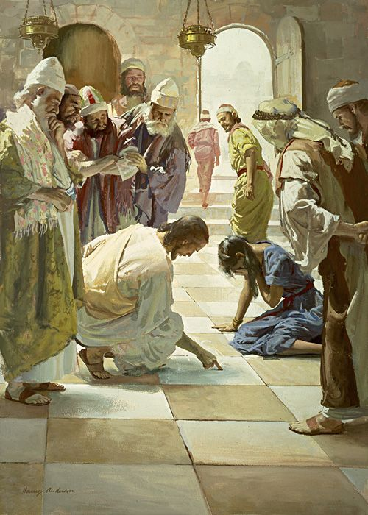
Building Up One Another

Slide 53
Hymn #87
CCLI# 245077

Slide 54
What a fellowship, what a joy divine,
Leaning on the everlasting arms;
What a blessedness,
what a peace is mine,
Leaning on the everlasting arms.

Slide 55
Leaning, leaning,
Safe and secure from all alarms;
Leaning, leaning,
Leaning on the everlasting arms.

Slide 56
O how sweet to walk
in this pilgrim way,
Leaning on the everlasting arms;
O how bright the path
grows from day to day,
Leaning on the everlasting arms.

Slide 57
Leaning, leaning,
Safe and secure from all alarms;
Leaning, leaning,
Leaning on the everlasting arms.

Slide 58
What have I to dread,
what have I to fear,
Leaning on the everlasting arms?
I have blessed peace
with my Lord so near,
Leaning on the everlasting arms.

Slide 59
Leaning, leaning,
Safe and secure from all alarms;
Leaning, leaning,
Leaning on the everlasting arms.

Slide 60
BENEDICTION

Slide 61
POSTLUDE
Have a
good week!

