Slide 1
Level Green Presbyterian Church
April 14, 2024

Slide 2
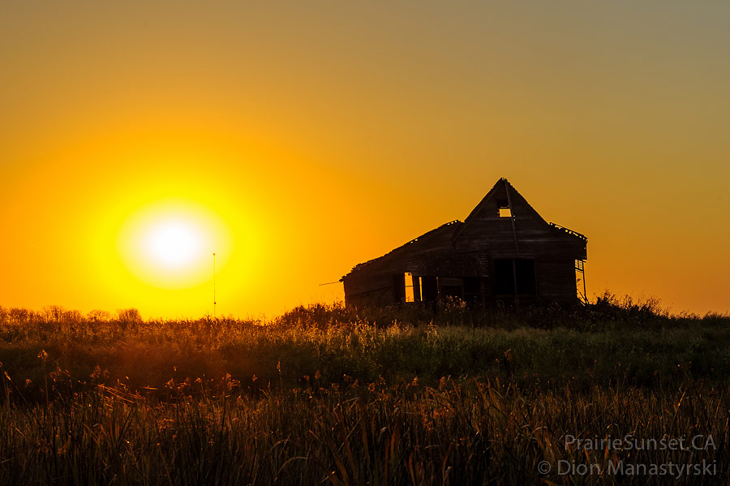
PRELUDE
A time to prepare
our hearts and minds
to worship the Lord.

Slide 3
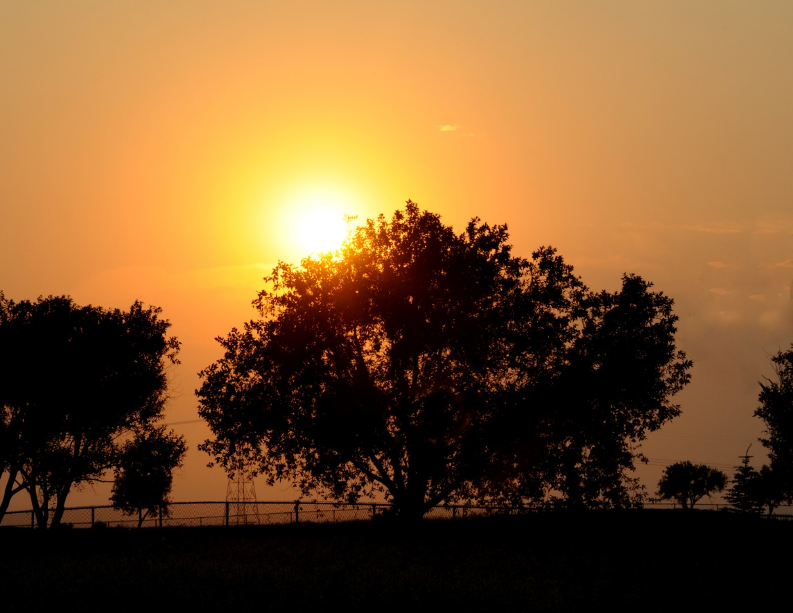
CALL TO
WORSHIP

Slide 4
Leader:
I waited patiently for the Lord;
People:
He turned to me and heard my cry.

Slide 5
Leader:
He lifted me out of the slimy pit,
People:
Out of the mud and mire;

Slide 6
Leader:
He set my feet on a rock
All:
And gave me a firm place to stand.

Slide 8
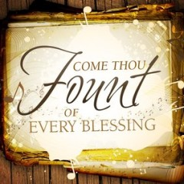
Hymn #318
CCLI# 245077

Slide 9
Come, Thou Fount of every blessing,
Tune my heart to sing Thy grace;
Streams of mercy, never ceasing,
Call for songs of loudest praise.
Teach me some melodious sonnet,
Sung by flaming tongues above;
Praise the mount! I'm fixed upon it,
Mount of Thy redeeming love.

Slide 10
This my glad commemoration
That ‘til now I’ve safely come;
And I hope, by Thy good pleasure,
Safely to arrive at home.
Jesus sought me when a stranger,
Wandering from the fold of God;
He, to rescue me from danger,
Interposed His precious blood.

Slide 11
O to grace how great a debtor
Daily I’m constrained to be!
Let Thy goodness, like a fetter,
Bind my wandering heart to Thee:
Prone to wander, Lord, I feel it,
Prone to leave the God I love:
Here’s my heart, O take and seal it,
Seal it for Thy courts above.

Slide 13
I BELIEVE in God the Father Almighty, Maker of heaven and earth,
And in Jesus Christ
his only Son our Lord;
who was conceived by the Holy Ghost, born of the Virgin Mary,
suffered under Pontius Pilate,
was crucified, dead, and buried;
he descended into hell;

Slide 14
the third day
he rose again from the dead;
he ascended into heaven,
and sitteth on the right hand of God
the Father Almighty;
from thence he shall come to judge
the quick and the dead.

Slide 15
I believe in the Holy Ghost;
the holy catholic Church;
the communion of saints;
the forgiveness of sins;
the resurrection of the body;
and the life everlasting.
Amen.

Slide 16
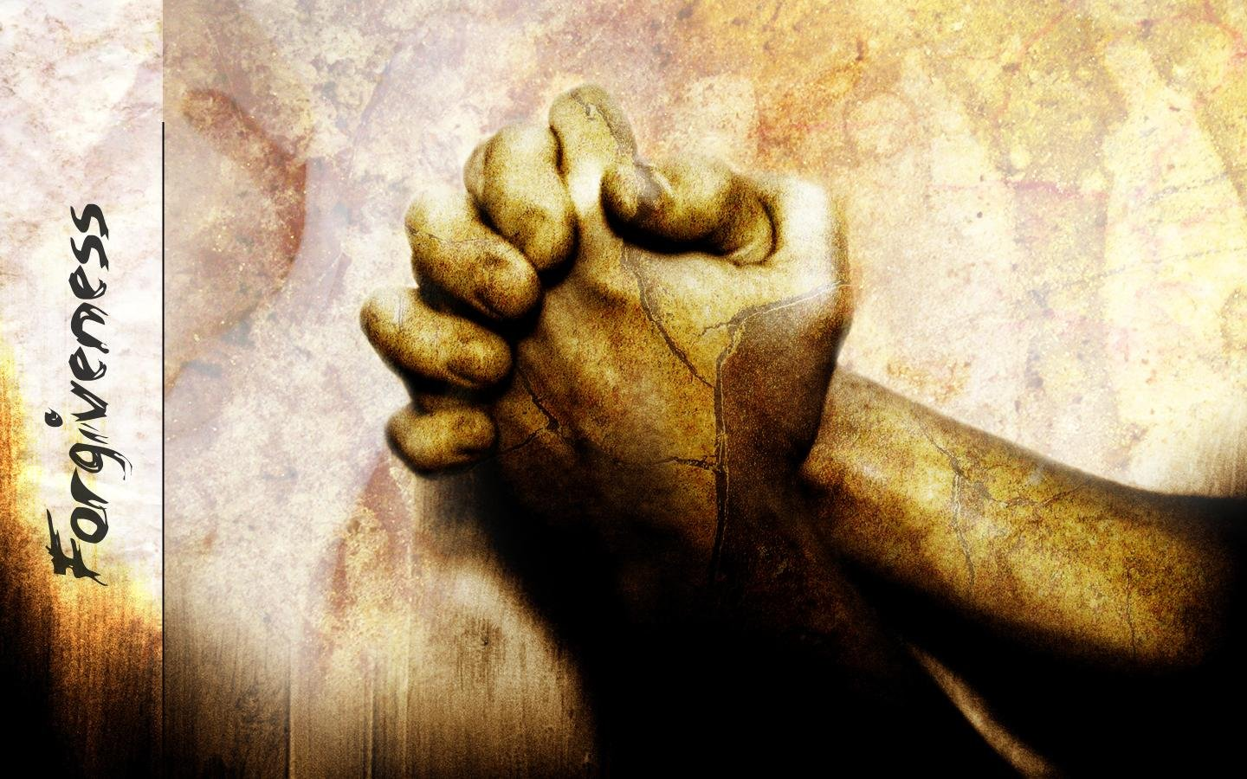
Prayer of Confession

Slide 17
Loving and eternal God, Your Son Jesus came as King to rescue and redeem us. By grace through faith, You adopt us into Your family. Yet often we ignore Your call to serve. We make light of Your invitation to us. Our attention to You is scattered. Our affection for You is fickle. Forgive us for our stubbornness, disobedience, and pride. Renew us so we may love You faithfully. May we hear Your call and respond with joy to the glory and honor of Your holy name. Through Jesus Christ we pray. Amen.

Slide 19
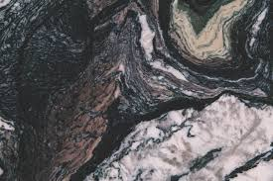
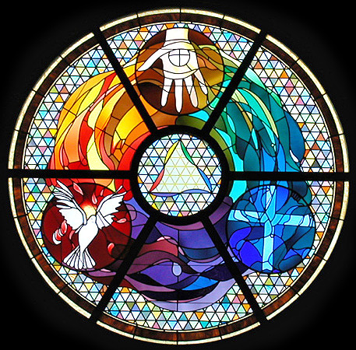
Gloria Patri
Hymn #142
CCLI #245077

Slide 20
Glory be to the Father
and to the Son
and to the Holy Ghost,
as it was in the beginning
is now and ever shall be,
world without end.
Amen, Amen.

Slide 23
Jesus Is the Answer

Slide 24
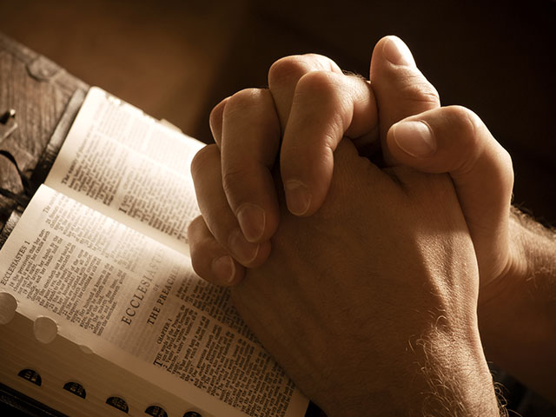

Slide 26
Hymn #382
CCLI #245077

Slide 27
Praise God,
From whom all blessings flow;
Praise Him,
All creatures here below;
Praise Him above,
Ye heavenly host;
Praise Father, Son,
And Holy Ghost. Amen

Slide 29
Praise Book
CCLI# 245077

Slide 30
All I once held dear,
Built my life upon,
All this world reveres, And wars to own,
All I once thought gain
I have counted loss;
Spent and worthless now,
Compared to this.

Slide 31
Knowing You, Jesus, knowing you, there is no greater thing.
You’re my all, You’re the best,
You’re my joy, my righteousness,
And I love You, Lord.

Slide 32
Now my heart’s desire
is to know You more,
To be found in You,
And known as Yours,
To possess by faith
what I could not earn;
All surpassing gift of righteousness.

Slide 33
Knowing You, Jesus, knowing you, there is no greater thing.
You’re my all, You’re the best,
You’re my joy, my righteousness,
And I love You, Lord.

Slide 34
Oh to know the pow’r
of Your risen life,
And to know You in Your sufferings,
To become like You
in Your death, my Lord;
So with You to live, and never die.

Slide 35
Knowing You, Jesus, knowing you, there is no greater thing.
You’re my all, You’re the best,
You’re my joy, my righteousness,
And I love You, Lord.

Slide 37
Jeremiah 23:16-24 (NIV)

Slide 38
¹⁶This is what the Lord Almighty says: “Do not listen to what the prophets are prophesying to you; they fill you with false hopes. They speak visions from their own minds, not from the mouth of the Lord. ¹⁷They keep saying to those who despise me, ‘The Lord says: You will have peace.’ And to all who follow the stubbornness of their hearts they say, ‘No harm will come to you.’ ¹⁸But which of them has stood in the council of the Lord to see or to hear his word? Who has listened and heard his word? ¹⁹See, the storm of the Lord will

Slide 39
burst out in wrath, a whirlwind swirling down on the heads of the wicked. ²⁰The anger of the Lord will not turn back until he fully accomplishes the purposes of his heart. In days to come you will understand it clearly. ²¹I did not send these prophets, yet they have run with their message; I did not speak to them, yet they have prophesied. ²²But if they had stood in my council, they would have proclaimed my words to my people and would have turned them from their evil ways and from their evil deeds.

Slide 40
²³“Am I only a God nearby,” declares the Lord, “and not a God far away? ²⁴Who can hide in secret places so that I cannot see them?” declares the Lord. “Do not I fill heaven and earth?” declares the Lord.

Slide 41
Matthew 7:13-29 (NIV)

Slide 42
¹³“Enter through the narrow gate. For wide is the gate and broad is the road that leads to destruction, and many enter through it. ¹⁴But small is the gate and narrow the road that leads to life, and only a few find it. ¹⁵“Watch out for false prophets. They come to you in sheep’s clothing, but inwardly they are ferocious wolves. ¹⁶By their fruit you will recognize them. Do people pick grapes from thornbushes, or figs from thistles? ¹⁷Likewise, every good tree bears good fruit, but a bad tree bears bad fruit. ¹⁸A good tree cannot

Slide 43
bear bad fruit, and a bad tree cannot bear good fruit. ¹⁹Every tree that does not bear good fruit is cut down and thrown into the fire. ²⁰Thus, by their fruit you will recognize them. ²¹“Not everyone who says to me, ‘Lord, Lord,’ will enter the kingdom of heaven, but only the one who does the will of my Father who is in heaven. ²²Many will say to me on that day, ‘Lord, Lord, did we not prophesy in your name and in your name drive out demons and in your name perform many miracles?’ ²³Then I will tell them plainly, ‘I never knew you.

Slide 44
Away from me, you evildoers!’ ²⁴“Therefore everyone who hears these words of mine and puts them into practice is like a wise man who built his house on the rock. ²⁵The rain came down, the streams rose, and the winds blew and beat against that house; yet it did not fall, because it had its foundation on the rock. ²⁶But everyone who hears these words of mine and does not put them into practice is like a foolish man who built his house on sand. ²⁷The rain came down, the streams rose, and the winds blew and beat against that house,

Slide 45
and it fell with a great crash.” ²⁸When Jesus had finished saying these things, the crowds were amazed at his teaching, ²⁹because he taught as one who had authority, and not as their teachers of the law.

Slide 47
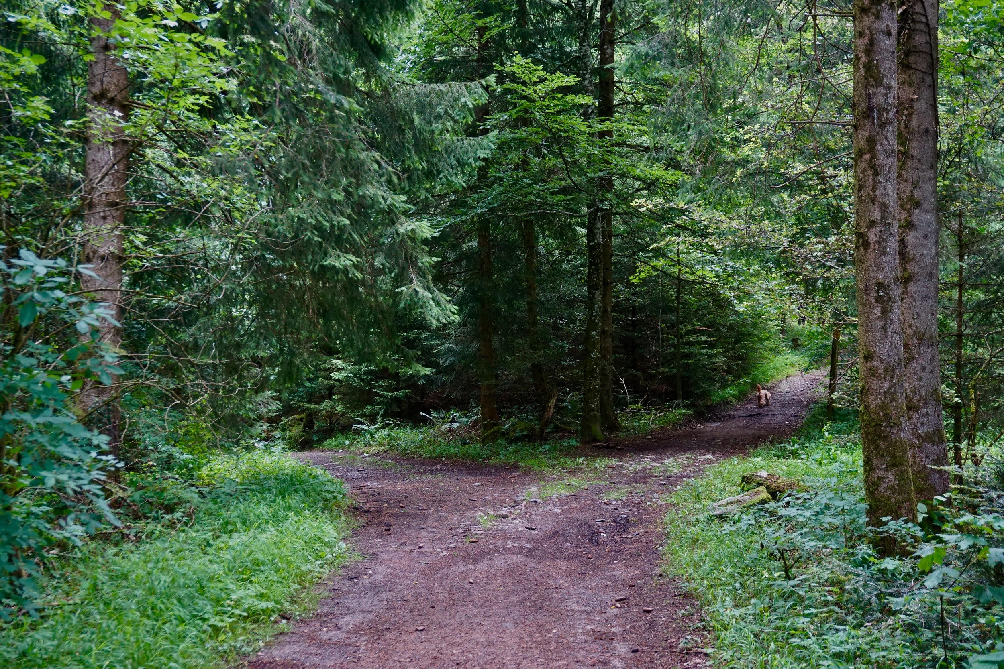
A Life Grounded in Jesus

Slide 48
Hymn #92
CCLI# 245077

Slide 49
My hope is built on nothing less
Than Jesus’ blood and righteousness;
I dare not trust the sweetest frame,
But wholly lean on Jesus’ name.

Slide 50
On Christ, the solid Rock, I stand;
All other ground is sinking sand,
All other ground is sinking sand.

Slide 51
When darkness veils His lovely face,
I rest on His unchanging grace:
In every high and stormy gale,
My anchor holds within the veil.

Slide 52
On Christ, the solid Rock, I stand;
All other ground is sinking sand,
All other ground is sinking sand.

Slide 53
His oath, His covenant, His blood,
Support me in the whelming flood;
When all around my soul gives way,
He then is all my hope and stay.

Slide 54
On Christ, the solid Rock, I stand;
All other ground is sinking sand,
All other ground is sinking sand.

Slide 55
When He shall come with trumpet sound,
O may I then in Him be found;
Dressed in His righteousness alone,
Faultless to stand before the throne.

Slide 56
On Christ, the solid Rock, I stand;
All other ground is sinking sand,
All other ground is sinking sand.

Slide 57
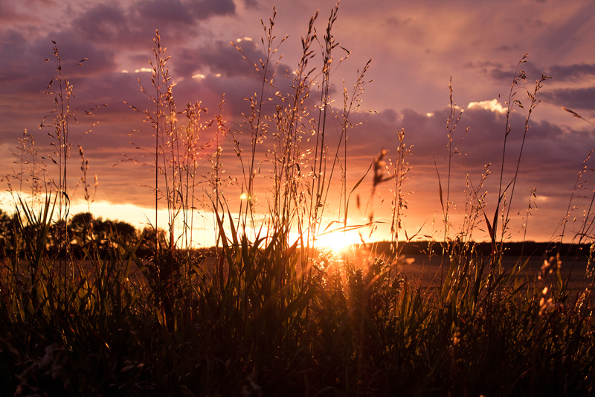
BENEDICTION

Slide 58
POSTLUDE
Have a
good week!

