Slide 1
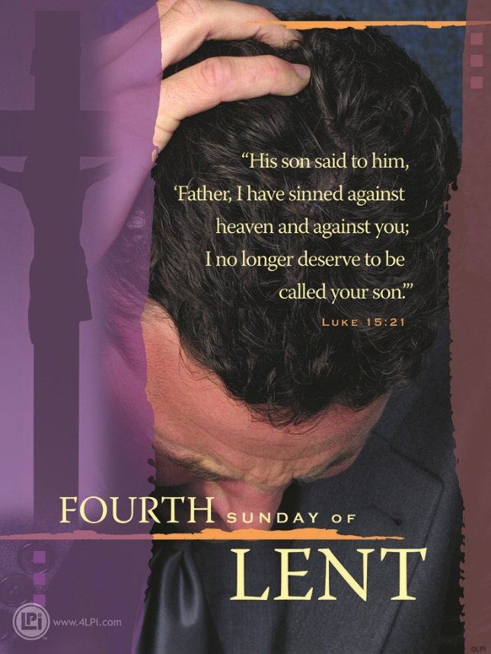
Level Green Presbyterian Church
March 10, 2024

Slide 2
PRELUDE
A time to prepare
our hearts and minds
to worship the Lord.

Slide 3
CALL TO
WORSHIP

Slide 4
Leader:
Give thanks to the Lord, for He is good;
People:
His love endures forever.

Slide 5
Leader:
Let the redeemed of the Lord tell their story —
People:
Those He redeemed from the hand of the foe,

Slide 6
Leader:
Those He gathered from the lands,
All:
From east and west, from north and south.

Slide 8
Hymn #273
CCLI# 245077

Slide 9
I hear the Savior say,
“Thy strength indeed is small!
Child of weakness watch and pray.
Find in me thine in all.”

Slide 10
Jesus paid it all,
All to Him I owe;
Sin had left a crimson stain
He washed it white as snow.

Slide 11
For nothing good have I
Where by Thy grace to claim
I will wash my garments white
In the blood of Calvary's Lamb.

Slide 12
Jesus paid it all,
All to Him I owe;
Sin had left a crimson stain
He washed it white as snow.

Slide 13
And when before the throne
I stand in him complete,
“Jesus died my soul to save,”
My lips shall still repeat.

Slide 14
Jesus paid it all,
All to Him I owe;
Sin had left a crimson stain
He washed it white as snow.

Slide 15
The Apostles’ Creed

Slide 16
I BELIEVE in God the Father Almighty, Maker of heaven and earth,
And in Jesus Christ
his only Son our Lord;
who was conceived by the Holy Ghost, born of the Virgin Mary,
suffered under Pontius Pilate,
was crucified, dead, and buried;
he descended into hell;

Slide 17
the third day
he rose again from the dead;
he ascended into heaven,
and sitteth on the right hand of God
the Father Almighty;
from thence he shall come to judge
the quick and the dead.

Slide 18
I believe in the Holy Ghost;
the holy catholic Church;
the communion of saints;
the forgiveness of sins;
the resurrection of the body;
and the life everlasting.
Amen.

Slide 19
Prayer of Confession

Slide 20
Heavenly Father, the Gospel of Jesus Christ is life to those who call upon His name. Yet, there are still so many who do not believe and even more who have not truly heard. Your Great Commission calls us to share Jesus with our hurting world. Yet, we confess that we miss countless opportunities to bring God’s loving message of salvation to others. Forgive us for shying away from the joy of this privilege. Renew in us a heart for the lost. Fill us with Your Spirit, Lord. Open our eyes to creative ways of taking that next step to bless others with the hope of Christ. We pray this in name of Jesus Christ. Amen.

Slide 22
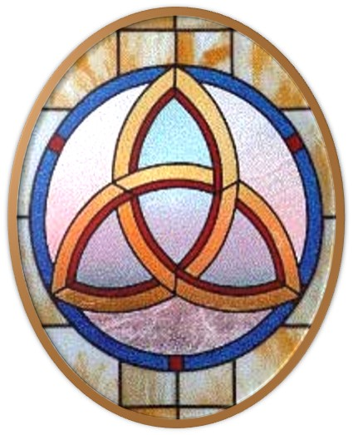
Gloria Patri
Hymn #142
CCLI #245077

Slide 23
Glory be to the Father
and to the Son
and to the Holy Ghost,
as it was in the beginning
is now and ever shall be,
world without end.
Amen, Amen.

Slide 26
Behold Calvary’s Lamb

Slide 29
Hymn #382
CCLI #245077

Slide 30
Praise God,
From whom all blessings flow;
Praise Him,
All creatures here below;
Praise Him above,
Ye heavenly host;
Praise Father, Son,
And Holy Ghost. Amen

Slide 32
Praise Songs #30
CCLI# 245077

Slide 33
I will sing of the mercies of the Lord forever.
I will sing, I will sing.
I will sing of the mercies of the Lord forever.
I will sing of the mercies of the Lord.

Slide 34
With my mouth will I make known
Thy faithfulness, Thy faithfulness.
With my mouth will I make known
Thy faithfulness to all generations.

Slide 35
I will sing of the mercies of the Lord forever.
I will sing, I will sing.
I will sing of the mercies of the Lord forever.
I will sing of the mercies of the Lord.

Slide 37
Ezekiel 36:33-38 (NIV)

Slide 38
³³“‘This is what the Sovereign Lord says: On the day I cleanse you from all your sins, I will resettle your towns, and the ruins will be rebuilt. ³⁴The desolate land will be cultivated instead of lying desolate in the sight of all who pass through it. ³⁵They will say, “This land that was laid waste has become like the garden of Eden; the cities that were lying in ruins, desolate and destroyed, are now fortified and inhabited.” ³⁶Then the nations around you that remain will know that I the Lord have rebuilt what was destroyed and have replanted

Slide 39
what was desolate. I the Lord have spoken, and I will do it.’ ³⁷“This is what the Sovereign Lord says: Once again I will yield to Israel’s plea and do this for them: I will make their people as numerous as sheep, ³⁸as numerous as the flocks for offerings at Jerusalem during her appointed festivals. So will the ruined cities be filled with flocks of people. Then they will know that I am the Lord.”

Slide 40
Hebrews 10:19-25 (NIV)

Slide 41
¹⁹Therefore, brothers and sisters, since we have confidence to enter the Most Holy Place by the blood of Jesus, ²⁰by a new and living way opened for us through the curtain, that is, his body, ²¹and since we have a great priest over the house of God, ²²let us draw near to God with a sincere heart and with the full assurance that faith brings, having our hearts sprinkled to cleanse us from a guilty conscience and having our bodies washed with pure water. ²³Let us hold unswervingly to the hope we profess, for he who promised is

Slide 42
faithful. ²⁴And let us consider how we may spur one another on toward love and good deeds, ²⁵not giving up meeting together, as some are in the habit of doing, but encouraging one another—and all the more as you see the Day approaching.

Slide 44
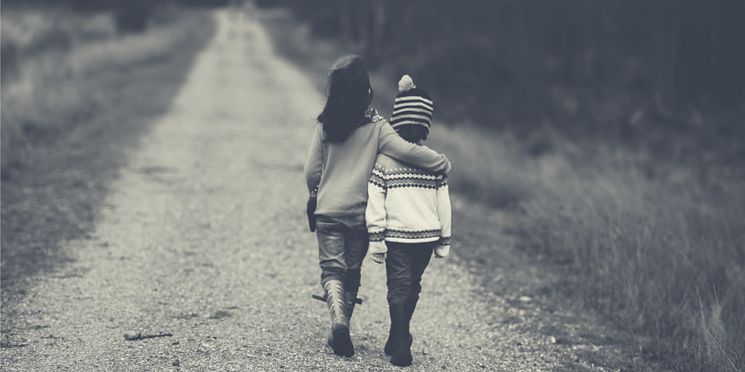
Encouraging One Another

Slide 45
Hymn #98
CCLI# 245077

Slide 46
Great is Thy faithfulness,
O God my Father!
There is no shadow of turning with Thee;
Thou changest not,
Thy compassions, they fail not:
As Thou hast been Thou forever wilt be.

Slide 47
Great is Thy faithfulness,
Great is Thy faithfulness,
Morning by morning new mercies I see;
All I have needed
Thy hand hath provided
Great is Thy faithfulness, Lord unto me!

Slide 48
Summer and winter,
and spring-time and harvest,
Sun, moon, and stars
in their courses above,
Join with all nature in manifold witness
To Thy great faithfulness,
mercy, and love.

Slide 49
Great is Thy faithfulness,
Great is Thy faithfulness,
Morning by morning new mercies I see;
All I have needed
Thy hand hath provided
Great is Thy faithfulness, Lord unto me!

Slide 50
Pardon for sin and a peace that endureth,
Thine own dear presence
to cheer and to guide,
Strength for today
and bright hope for tomorrow,
Blessings all mine,
with ten thousands beside!

Slide 51
Great is Thy faithfulness,
Great is Thy faithfulness,
Morning by morning new mercies I see;
All I have needed
Thy hand hath provided
Great is Thy faithfulness, Lord unto me!

Slide 52
BENEDICTION

Slide 53
POSTLUDE
Have a
good week!

