Slide 1
Level Green Presbyterian Church

Slide 2
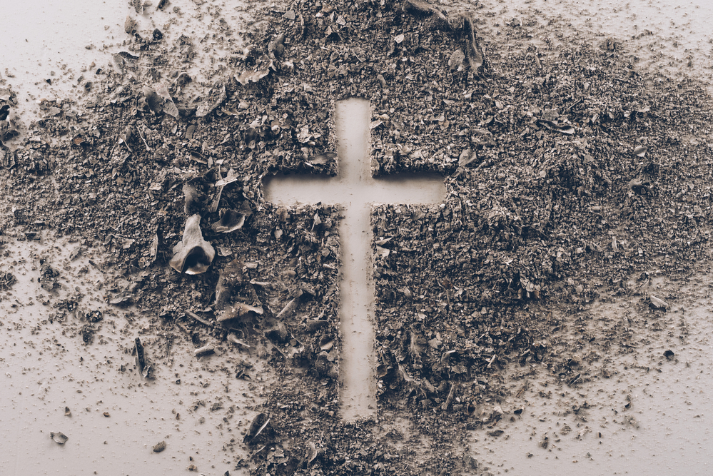
PRELUDE
A time to prepare
our hearts and minds
to worship the Lord.

Slide 3
Level Green Presbyterian Church

Slide 4
CALL TO
WORSHIP

Slide 5
Leader:
Have mercy on me, O God, according to Your unfailing love;
People:
According to Your great compassion blot out my transgressions.

Slide 6
Leader:
Wash away all my iniquity and cleanse me from my sin.
People:
For I know my transgressions, and my sin is always before me.

Slide 7
Leader:
Against You, You only, have I sinned and done what is evil in Your sight;
All:
Surely I was sinful at birth, sinful from the time my mother conceived me.

Slide 9
Hymn #251
CCLI# 245077

Slide 10
In the cross of Christ I glory,
Towering o’er the wrecks of time;
All the light of sacred story
Gathers round its head sublime.

Slide 11
When the woes of life o’er-take me,
Hopes deceive, and fears annoy,
Never shall the cross forsake me:
Lo! it glows with peace and joy.

Slide 12
When the sun of bliss is beaming
Light and love upon my way,
From the cross the radiance streaming
Adds more luster to the day.

Slide 13
Bane and blessing, pain and pleasure,
By the cross are sanctified;
Peace is there that knows no measure,
Joys that through all time abide.

Slide 14
The Nicene’ Creed

Slide 15
We believe in one God, the Father, the Almighty, maker of heaven and earth, of all that is, seen and unseen. We believe in one Lord, Jesus Christ, the only Son of God, eternally begotten of the Father, God from God, Light from Light, true God from true God, begotten, not made, of one Being with the Father; through him all things were made.

Slide 16
For us and for our salvation he came down from heaven, was incarnate of the Holy Spirit and the Virgin Mary and became truly human. For our sake he was crucified under Pontius Pilate; he suffered death and was buried. On the third day he rose again in accordance with the Scriptures; he ascended into heaven and is seated at the right hand of the Father.

Slide 17
He will come again in glory to judge the living and the dead, and his kingdom will have no end. We believe in the Holy Spirit, the Lord, the giver of life, who proceeds from the Father and the Son, who with the Father and the Son is worshiped and glorified, who has spoken through the prophets. We believe in one holy catholic and apostolic Church.

Slide 18
We acknowledge one baptism for the forgiveness of sins. We look for the resurrection of the dead, and the life of the world to come. Amen.

Slide 19
Prayer of Confession

Slide 20
Holy God, we are afraid to open our hearts to You, for we do not want to lose face. Yet You know us intimately because You have created us. You know how often we try to impress others. We may fool them, but we never fool You. Forgive us and free us from our prideful ways. Invite us to observe a holy Lent, that we may live in an honest relationship with You. We pray in the name of our merciful Savior Jesus Christ. Amen.

Slide 22
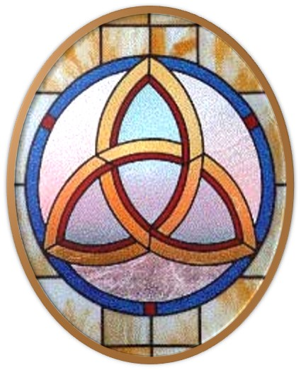
Gloria Patri
Hymn #142
CCLI #245077

Slide 23
Glory be to the Father
and to the Son
and to the Holy Ghost,
as it was in the beginning
is now and ever shall be,
world without end.
Amen, Amen.

Slide 26
Broken and Spilled Out

Slide 28
Hymn #382
CCLI #245077

Slide 29
Praise God,
From whom all blessings flow;
Praise Him,
All creatures here below;
Praise Him above,
Ye heavenly host;
Praise Father, Son,
And Holy Ghost. Amen

Slide 31
Genesis 50:15-21 (NIV)

Slide 32
¹⁵When Joseph’s brothers saw that their father was dead, they said, “What if Joseph holds a grudge against us and pays us back for all the wrongs we did to him?” ¹⁶So they sent word to Joseph, saying, “Your father left these instructions before he died: ¹⁷‘This is what you are to say to Joseph: I ask you to forgive your brothers the sins and the wrongs they committed in treating you so badly.’ Now please forgive the sins of the servants of the God of your father.” When their message came to him, Joseph wept.

Slide 33
¹⁸His brothers then came and threw themselves down before him. “We are your slaves,” they said. ¹⁹But Joseph said to them, “Don’t be afraid. Am I in the place of God? ²⁰You intended to harm me, but God intended it for good to accomplish what is now being done, the saving of many lives. ²¹So then, don’t be afraid. I will provide for you and your children.” And he reassured them and spoke kindly to them.

Slide 34
Romans 12:9-21 (NIV)

Slide 35
⁹Love must be sincere. Hate what is evil; cling to what is good. ¹⁰Be devoted to one another in love. Honor one another above yourselves. ¹¹Never be lacking in zeal, but keep your spiritual fervor, serving the Lord. ¹²Be joyful in hope, patient in affliction, faithful in prayer. ¹³Share with the Lord’s people who are in need. Practice hospitality. ¹⁴Bless those who persecute you; bless and do not curse. ¹⁵Rejoice with those who rejoice; mourn with those who mourn. ¹⁶Live in harmony with one another. Do not be proud, but be willing to associate with

Slide 36
people of low position. Do not be conceited. ¹⁷Do not repay anyone evil for evil. Be careful to do what is right in the eyes of everyone. ¹⁸If it is possible, as far as it depends on you, live at peace with everyone. ¹⁹Do not take revenge, my dear friends, but leave room for God’s wrath, for it is written: “It is mine to avenge; I will repay,” says the Lord. ²⁰On the contrary: “If your enemy is hungry, feed him; if he is thirsty, give him something to drink. In doing this, you will heap burning coals on his head.” ²¹Do not be overcome by evil, but overcome evil with good.

Slide 38
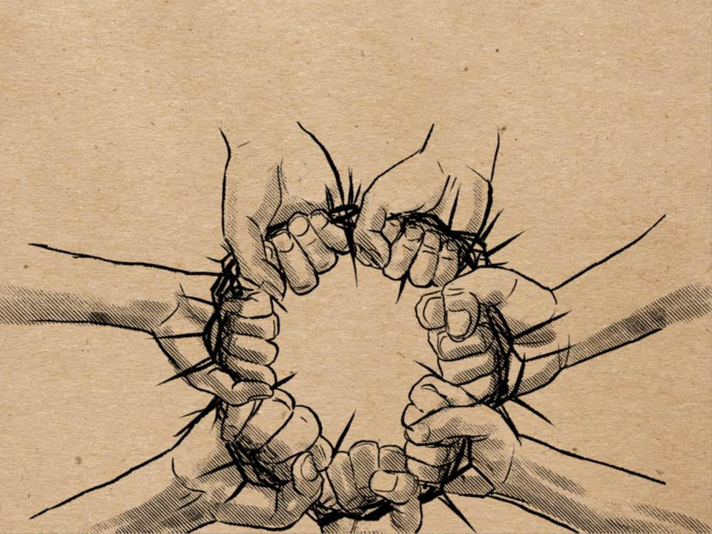
Forgiving One Another (Part 2)

Slide 39
Praise Book
CCLI#245077

Slide 40
Open our eyes, Lord,
We want to see Jesus,
To reach out and touch Him,
And say that we love Him.
Open our ears, Lord,
And help us to listen.
Open our eyes, Lord,
We want to see Jesus.

Slide 41
Open our eyes, Lord,
We want to see Jesus,
To reach out and touch Him,
And say that we love Him.
Open our ears, Lord,
And help us to listen.
Open our eyes, Lord,
We want to see Jesus.

Slide 42
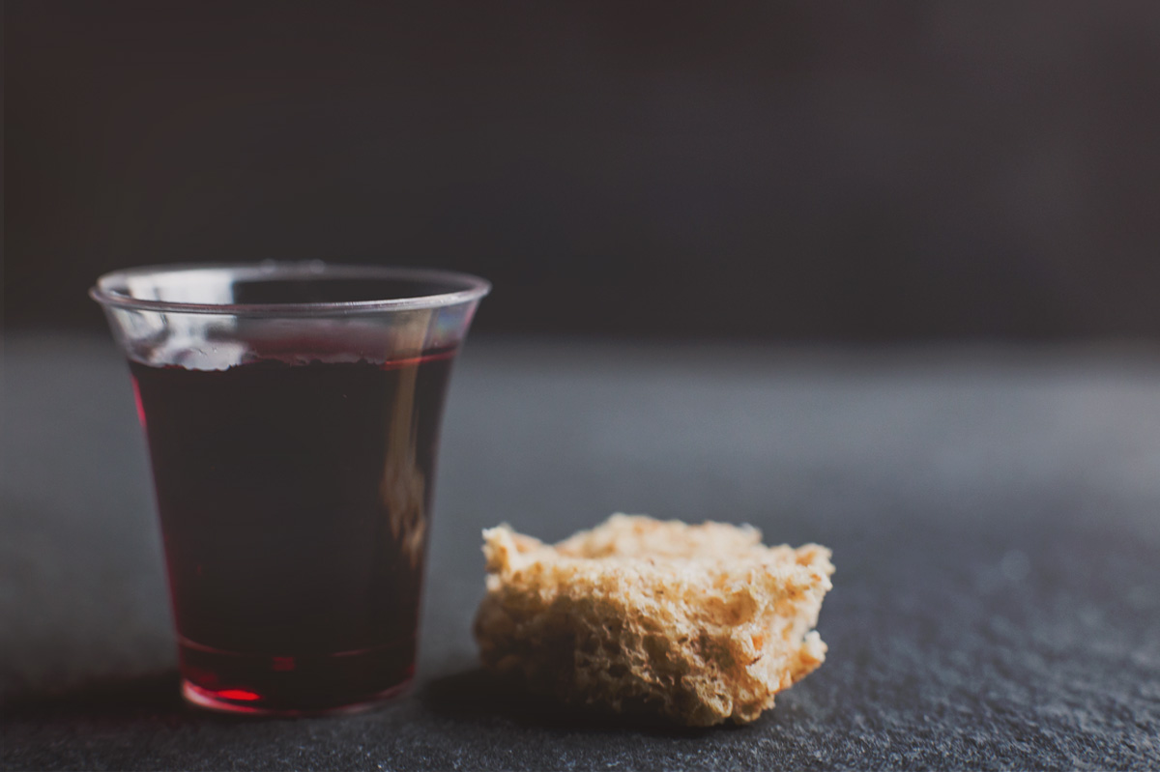
THE SACRAMENT OF THE LORD’S SUPPER
check the bulletin for info

Slide 43
Hymn #500
CCLI# 245077

Slide 44
Abide with me fast falls the eventide;
The darkness deepens Lord, with me abide;
When other helpers fail and comforts flee,
Help of the helpless, O abide with me.

Slide 45
Swift to its close ebbs out life’s little day;
Earth’s joys grow dim, its glories pass away;
Change and decay in all around I see;
O Thou who changest not, abide with me.

Slide 46
I need Thy presence every passing hour;
What but Thy grace can foil the tempter’s power?
Who like Thyself my guide and stay can be?
Through cloud and sunshine, O abide with me.

Slide 47
I fear no foe, with Thee at hand to bless;
Ills have no weight and tears no bitterness;
Where is death’s string? where, grave, thy victory?
I triumph still if Thou abide with me.

Slide 48
Hold Thou Thy cross before my closing eyes;
Shine thru the gloom and point me to the skies;
Heaven’s morning breaks and earth’s vain shadows flee;
In life, in death, O Lord, abide with me.

Slide 49
BENEDICTION

Slide 50
POSTLUDE
Have a
good week!

