Slide 1
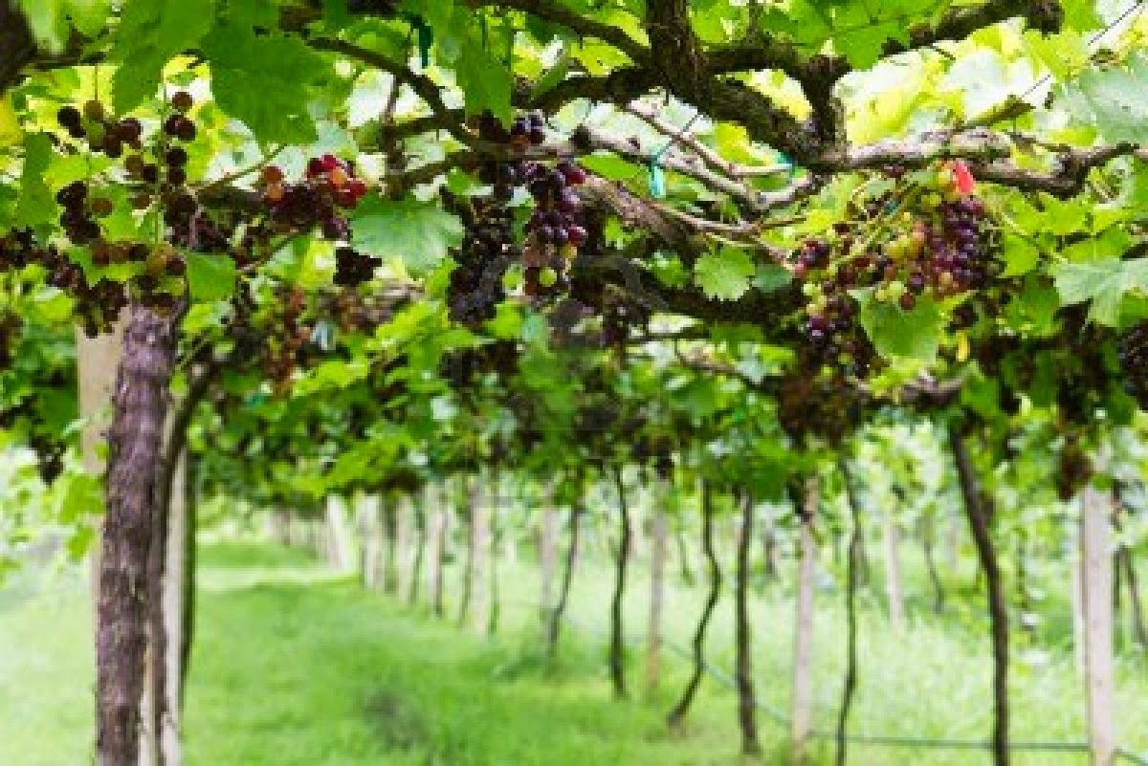
Level Green Presbyterian Church
April 28, 2024

Slide 2
PRELUDE
A time to prepare
our hearts and minds
to worship the Lord.

Slide 3
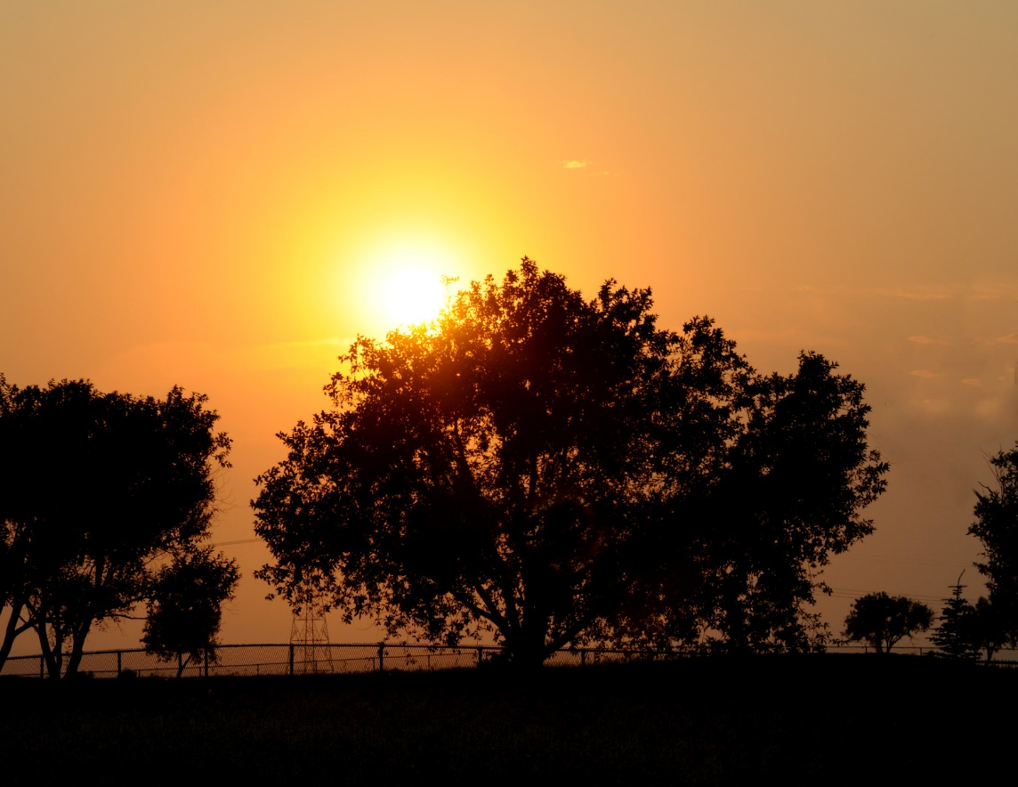
CALL TO
WORSHIP

Slide 4
Leader:
All the ends of the earth
People:
Will remember and turn to the Lord,

Slide 5
Leader:
And all the families of the nations
People:
Will bow down before Him,

Slide 6
Leader:
For dominion belongs to the Lord
All:
And He rules over the nations.

Slide 8
Hymn #325
CCLI# 245077

Slide 9
All hail the power of Jesus’ name!
Let angels prostrate fall;
Bring forth the royal diadem,
And crown Him Lord of all;
Bring forth the royal diadem,
And crown Him Lord of all!

Slide 10
Ye chosen seed of Israel’s race,
Ye ransomed from the fall,
Hail Him who saves you by His grace,
And crown Him Lord of all;
Hail Him who saves you by His grace,
And crown Him Lord of all!

Slide 11
Let every kindred, every tribe,
On this terrestrial ball,
To Him all majesty ascribe,
And crown Him Lord of all;
To Him all majesty ascribe,
And crown Him Lord of all!

Slide 12
O that with yonder sacred throng
We at His feet may fall!
We’ll join the everlasting song,
And crown Him Lord of all;
We’ll join the everlasting song,
And crown Him Lord of all!

Slide 14
I BELIEVE in God the Father Almighty, Maker of heaven and earth,
And in Jesus Christ
his only Son our Lord;
who was conceived by the Holy Ghost, born of the Virgin Mary,
suffered under Pontius Pilate,
was crucified, dead, and buried;
he descended into hell;

Slide 15
the third day
he rose again from the dead;
he ascended into heaven,
and sitteth on the right hand of God
the Father Almighty;
from thence he shall come to judge
the quick and the dead.

Slide 16
I believe in the Holy Ghost;
the holy catholic Church;
the communion of saints;
the forgiveness of sins;
the resurrection of the body;
and the life everlasting.
Amen.

Slide 17
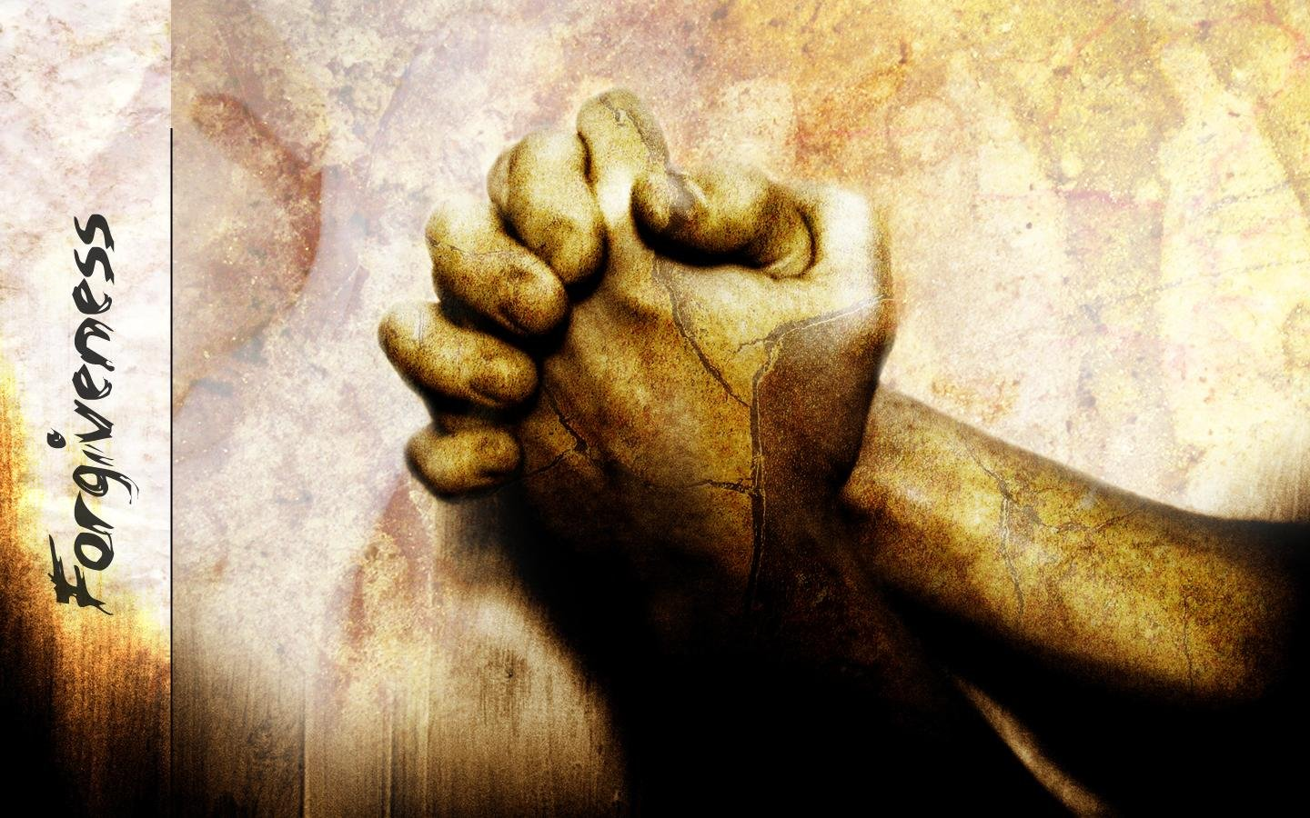
Prayer of Confession

Slide 18
Risen Christ, You are the vine; apart from You we can do nothing. We live as if this were not true: we entwine ourselves in our own business rather than branching out toward others; because we do not ground ourselves in You, we wither. Lord Jesus, forgive us. Restore us to Your abiding love, that we may bear fruit worthy of our calling. We pray through Jesus Christ our Lord. Amen.

Slide 20
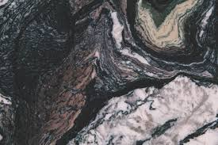
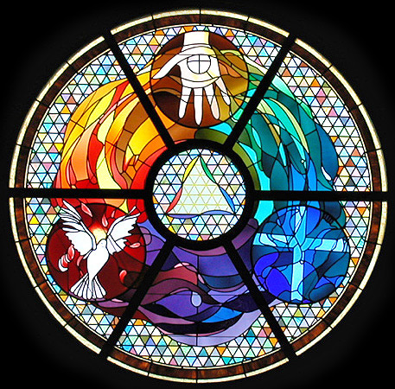
Gloria Patri
Hymn #142
CCLI #245077

Slide 21
Glory be to the Father
and to the Son
and to the Holy Ghost,
as it was in the beginning
is now and ever shall be,
world without end.
Amen, Amen.

Slide 24
Promised Land

Slide 25
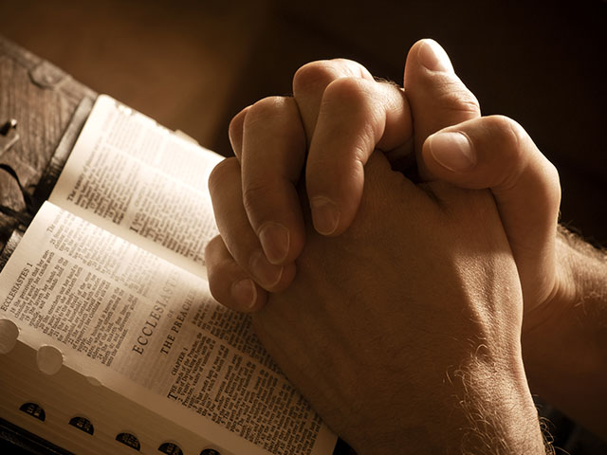

Slide 27
Hymn #382
CCLI #245077

Slide 28
Praise God,
From whom all blessings flow;
Praise Him,
All creatures here below;
Praise Him above,
Ye heavenly host;
Praise Father, Son,
And Holy Ghost. Amen

Slide 30
Praise Book
CCLI# 245077

Slide 31
Ev’ryone needs compassion,
Love that’s never failing.
Let mercy fall on me.
Ev’ryone needs forgiveness,
the kindness of a Saviour.
The hope of nations.

Slide 32
Saviour, He can move the mountains.
My God is mighty to save.
He is mighty to save.
Forever, Author of salvation.
He rose and conquered the grave.
Jesus conquered the grave.

Slide 33
So take me as You find me,
All my fears and failures.
Fill my life again.
I give my life to follow,
Ev’rything I believe in.
Now I surrender.

Slide 34
Saviour, He can move the mountains.
My God is mighty to save.
He is mighty to save.
Forever, Author of salvation.
He rose and conquered the grave.
Jesus conquered the grave.

Slide 35
Shine your light,
And let the whole world see.
We’re singing
For the glory of the risen King. Jesus.
Shine your light,
And let the whole world see.
We’re singing
For the glory of the risen King.

Slide 36
Saviour, He can move the mountains.
My God is mighty to save.
He is mighty to save.
Forever, Author of salvation.
He rose and conquered the grave.
Jesus conquered the grave.

Slide 37
Shine your light,
And let the whole world see.
We’re singing
For the glory of the risen King. Jesus.
Shine your light,
And let the whole world see.
We’re singing
For the glory of the risen King.

Slide 39
Exodus 19:1-6 (NIV)

Slide 40
On the first day of the third month after the Israelites left Egypt—on that very day—they came to the Desert of Sinai. ²After they set out from Rephidim, they entered the Desert of Sinai, and Israel camped there in the desert in front of the mountain. ³Then Moses went up to God, and the Lord called to him from the mountain and said, “This is what you are to say to the descendants of Jacob and what you are to tell the people of Israel: ⁴ ‘You yourselves have seen what I did to Egypt, and how I carried you on eagles’ wings and brought

Slide 41
you to myself. ⁵Now if you obey me fully and keep my covenant, then out of all nations you will be my treasured possession. Although the whole earth is mine, ⁶you will be for me a kingdom of priests and a holy nation.’ These are the words you are to speak to the Israelites.”

Slide 42
John
15:1-11 (NIV)

Slide 43
“I am the true vine, and my Father is the gardener. ²He cuts off every branch in me that bears no fruit, while every branch that does bear fruit he prunes so that it will be even more fruitful. ³You are already clean because of the word I have spoken to you. ⁴Remain in me, as I also remain in you. No branch can bear fruit by itself; it must remain in the vine. Neither can you bear fruit unless you remain in me. ⁵“I am the vine; you are the branches. If you remain in me and I in you, you will bear much fruit; apart from me you can do nothing.

Slide 44
⁶If you do not remain in me, you are like a branch that is thrown away and withers; such branches are picked up, thrown into the fire and burned. ⁷If you remain in me and my words remain in you, ask whatever you wish, and it will be done for you. ⁸This is to my Father’s glory, that you bear much fruit, showing yourselves to be my disciples. ⁹“As the Father has loved me, so have I loved you. Now remain in my love. ¹⁰If you keep my commands, you will remain in my love, just as I have kept my Father’s commands and remain

Slide 45
in his love. ¹¹I have told you this so that my joy may be in you and that your joy may be complete.

Slide 47
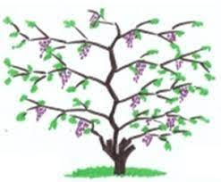
Being A Fruitful Disciple

Slide 48
Hymn #454
CCLI# 245077

Slide 49
When we walk with the Lord
In the light of His Word,
What a glory He sheds on our way!
While we do His good will,
He abides with us still,
And with all who trust and obey.

Slide 50
Trust and obey,
For there’s no other way
To be happy in Jesus,
But to trust and obey.

Slide 51
Not a shadow can rise,
Not a cloud in the skies,
But His smile quickly drives it away;
Not a doubt or a fear,
Not a sigh or a tear,
Can remain when we trust and obey.

Slide 52
Trust and obey,
For there’s no other way
To be happy in Jesus,
But to trust and obey.

Slide 53
Not a burden we bear,
Not a sorrow we share,
But our toil He doth richly repay;
Not a grief or a loss,
Not a frown or a cross,
But is blest if we trust and obey.

Slide 54
Trust and obey,
For there’s no other way
To be happy in Jesus,
But to trust and obey.

Slide 55
Then in fellowship sweet
We will sit at His feet,
Or we’ll walk by His side in the way;
What He says we will do,
Where He sends we will go,
Never fear, only trust and obey.

Slide 56
Trust and obey,
For there’s no other way
To be happy in Jesus,
But to trust and obey.

Slide 57
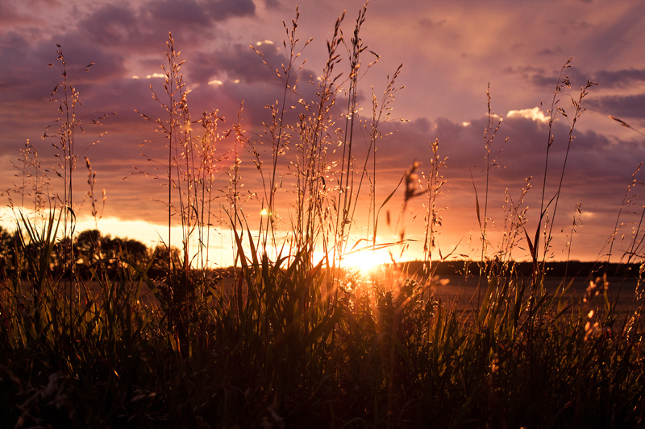
BENEDICTION

Slide 58
POSTLUDE
Have a
good week!

