Slide 1
Level Green Presbyterian Church
March 31, 2024

Slide 2
PRELUDE
A time to prepare
our hearts and minds
to worship the Lord.

Slide 3
CALL TO
WORSHIP

Slide 4
Leader:
Shouts of joy and victory resound in the tents of the righteous:
People:
The Lord’s right hand has done mighty things!

Slide 5
Leader:
The Lord’s right hand is lifted high;
People:
The Lord’s right hand has done mighty things!

Slide 6
Leader:
I will not die but live,
All:
And will proclaim what the Lord has done.

Slide 8
Hymn #289
CCLI# 245077

Slide 9
Christ the Lord is risen today,
Alleluia!
Sons of men and angels say:
Alleluia!
Raise your joys and triumphs high,
Alleluia!
Sing ye heavens, and earth reply:
Alleluia!

Slide 10
Lives again our glorious King,
Alleluia!
Where, O death, is now thy sting?
Alleluia!
Dying once, He all doth save,
Alleluia!
Where thy victory, O grave?
Alleluia!

Slide 11
Love’s redeeming work is done,
Alleluia!
Fought the fight, the battle won,
Alleluia!
Death in vain forbids Him rise,
Alleluia!
Christ has opened paradise,
Alleluia!

Slide 12
Sing we to our God above,
Alleluia!
Praise eternal as His love;
Alleluia!
Praise Him, all ye heavenly host,
Alleluia!
Father, Son, and Holy Ghost,
Alleluia!

Slide 13
The Apostles’ Creed

Slide 14
I BELIEVE in God the Father Almighty, Maker of heaven and earth,
And in Jesus Christ
his only Son our Lord;
who was conceived by the Holy Ghost, born of the Virgin Mary,
suffered under Pontius Pilate,
was crucified, dead, and buried;
he descended into hell;

Slide 15
the third day
he rose again from the dead;
he ascended into heaven,
and sitteth on the right hand of God
the Father Almighty;
from thence he shall come to judge
the quick and the dead.

Slide 16
I believe in the Holy Ghost;
the holy catholic Church;
the communion of saints;
the forgiveness of sins;
the resurrection of the body;
and the life everlasting.
Amen.

Slide 17
Prayer of Confession

Slide 18
God of new life, it is the first day of the week and we have come; it is the day that defines us and we have come. We have come to sing our alleluias, but we secretly wonder, “How can this be true?” O God, forgive our skepticism. Overwhelm us with the power of Your love that conquers sin and death. Send us to go and tell the Good News of the resurrection of Jesus Christ. We pray in His name. Amen.

Slide 20
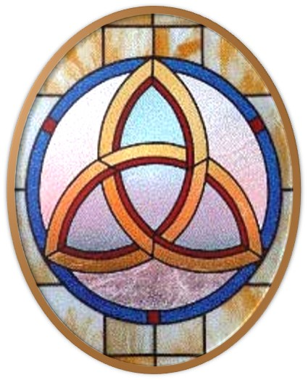
Gloria Patri
Hymn #142
CCLI #245077

Slide 21
Glory be to the Father
and to the Son
and to the Holy Ghost,
as it was in the beginning
is now and ever shall be,
world without end.
Amen, Amen.

Slide 24
No More Night

Slide 27
The Day for Rejoicing

Slide 28
Hymn #382
CCLI #245077

Slide 29
Praise God,
From whom all blessings flow;
Praise Him,
All creatures here below;
Praise Him above,
Ye heavenly host;
Praise Father, Son,
And Holy Ghost. Amen

Slide 31
Praise Book
CCLI# 245077

Slide 32
Majesty, worship His majesty.
Unto Jesus be all glory, honor,
and praise.
Majesty, kingdom authority
Flow from His throne unto His own;
His anthem raise.

Slide 33
So exalt, lift up on high the name
of Jesus.
Magnify, come glorify Christ Jesus,
the King.
Majesty, worship His majesty;
Jesus who died, now glorified,
King of all kings.

Slide 35
Job 19:23-27 (NIV)

Slide 36
²³“Oh, that my words were recorded, that they were written on a scroll, ²⁴that they were inscribed with an iron tool on lead, or engraved in rock forever! ²⁵I know that my redeemer lives, and that in the end he will stand on the earth. ²⁶And after my skin has been destroyed, yet in my flesh I will see God; ²⁷I myself will see him with my own eyes—I, and not another. How my heart yearns within me!

Slide 37
Mark 16:1-8 (NIV)

Slide 38
When the Sabbath was over, Mary Magdalene, Mary the mother of James, and Salome bought spices so that they might go to anoint Jesus’ body. ²Very early on the first day of the week, just after sunrise, they were on their way to the tomb ³and they asked each other, “Who will roll the stone away from the entrance of the tomb?” ⁴But when they looked up, they saw that the stone, which was very large, had been rolled away. ⁵As they entered the tomb, they saw a young man dressed in a white robe sitting on the right

Slide 39
side, and they were alarmed. ⁶“Don’t be alarmed,” he said. “You are looking for Jesus the Nazarene, who was crucified. He has risen! He is not here. See the place where they laid him. ⁷But go, tell his disciples and Peter, ‘He is going ahead of you into Galilee. There you will see him, just as he told you.’” ⁸Trembling and bewildered, the women went out and fled from the tomb. They said nothing to anyone, because they were afraid.

Slide 41
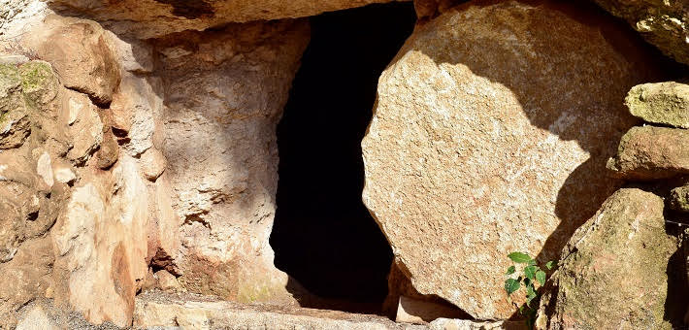
Only the Beginning

Slide 42
Hymn #291
CCLI# 245077

Slide 43
Thine is the glory,
Risen, conquering Son;
Endless is the victory
Thou o’er death hast won.
Angels in bright raiment
Rolled the stone away,
Kept the folded grave clothes
Where thy body lay

Slide 44
Thine is the glory,
Risen, conquering Son;
Endless is the victory
Thou o’er death hast won.

Slide 45
Lo! Jesus meets us,
Risen from the tomb;
Lovingly He greets us,
Scatters fear and gloom.
Let His church with gladness
Hymns of triumph sing,
For her Lord now liveth:
Death hast lost its sting.

Slide 46
Thine is the glory,
Risen, conquering Son;
Endless is the victory
Thou o’er death hast won.

Slide 47
No more we doubt Thee,
Glorious Prince of life!
Life is naught without Thee:
Aid us in our strife.
Make us more than conquerors, Through Thy deathless love:
Bring us safe through Jordan
To Thy home above.

Slide 48
Thine is the glory,
Risen, conquering Son;
Endless is the victory
Thou o’er death hast won.

Slide 49
BENEDICTION

Slide 50
POSTLUDE
Have a
good week!

