Slide 1
Level Green Presbyterian Church
February 25, 2024

Slide 2
PRELUDE
A time to prepare
our hearts and minds
to worship the Lord.

Slide 3
CALL TO
WORSHIP

Slide 4
Leader:
All the ends of the earth
People:
Will remember and turn to the LORD,

Slide 5
Leader:
And all the families of the nations
People:
Will bow down before Him,

Slide 6
Leader:
For dominion belongs to the LORD
All:
And He rules over the nations.

Slide 8
Hymn #1
CCLI# 245077

Slide 9
For the beauty of the earth,
For the glory of the skies,
For the love which from our birth
Over and around us lies:
Lord of all,
To Thee we raise
This our hymn of grateful praise.

Slide 10
For the wonder of each hour
Of the day and of the night,
Hill and vale and tree and flower,
Sun and moon and stars of light:
Lord of all,
To Thee we raise
This our hymn of grateful praise.

Slide 11
For the joy of human love,
Brother, sister, parent, child;
Friends on earth and friends above;
For all gentle thoughts and mild:
Lord of all,
To Thee we raise
This our hymn of grateful praise.

Slide 12
For Thy Church that evermore
Lifteth holy hands above,
Offering up on every shore
Her pure sacrifice of love:
Lord of all,
To Thee we raise
This our hymn of grateful praise.

Slide 13
For Thyself, best gift divine,
To our race so freely given;
For that great, great love of Thine,
Peace on earth and joy in heaven:
Lord of all,
To Thee we raise
This our hymn of grateful praise.

Slide 14
The Apostles’ Creed

Slide 15
I BELIEVE in God the Father Almighty, Maker of heaven and earth,
And in Jesus Christ
his only Son our Lord;
who was conceived by the Holy Ghost, born of the Virgin Mary,
suffered under Pontius Pilate,
was crucified, dead, and buried;
he descended into hell;

Slide 16
the third day
he rose again from the dead;
he ascended into heaven,
and sitteth on the right hand of God
the Father Almighty;
from thence he shall come to judge
the quick and the dead.

Slide 17
I believe in the Holy Ghost;
the holy catholic Church;
the communion of saints;
the forgiveness of sins;
the resurrection of the body;
and the life everlasting.
Amen.

Slide 18
Prayer of Confession

Slide 19
Faithful God, You call us to trust in Your promises. In Jesus Christ, You call us to take up our cross and follow, as He invited His disciples. We are quick to make excuses, afraid of the unknown, afraid of the hard work of discipleship. We are cautious; embarrassed to share the Good News. Forgive us, we pray. Give us the courage that comes from knowing that You walk with us. We pray in the name of our faithful Savior Jesus Christ. Amen.

Slide 21
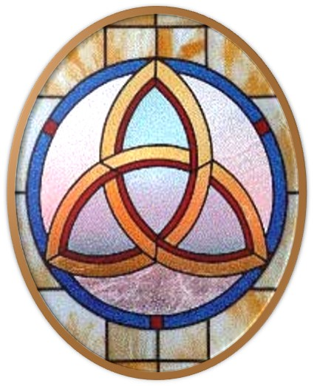
Gloria Patri
Hymn #142
CCLI #245077

Slide 22
Glory be to the Father
and to the Son
and to the Holy Ghost,
as it was in the beginning
is now and ever shall be,
world without end.
Amen, Amen.

Slide 25
When I Survey The
Wondrous Cross

Slide 28
Hymn #382
CCLI #245077

Slide 29
Praise God,
From whom all blessings flow;
Praise Him,
All creatures here below;
Praise Him above,
Ye heavenly host;
Praise Father, Son,
And Holy Ghost. Amen

Slide 31
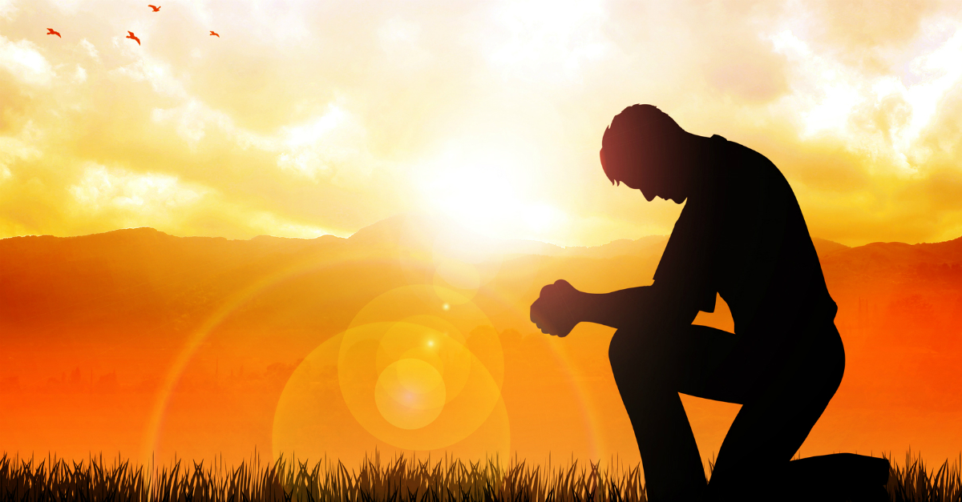
Come Let Us Worship and Bow Down
Praise Book
CCLI# 245077

Slide 32
Come, let us worship and bow down,
Let us kneel before the Lord,
our God, our Maker.
Come, let us worship and bow down,
let us kneel before the Lord,
our God and Maker.

Slide 33
For He is our God,
and we are the people of His pasture,
and the sheep of His hand,
just the sheep of His Hand.

Slide 35
Isaiah 49:1-7 (NIV)

Slide 36
Listen to me, you islands; hear this, you distant nations: Before I was born the Lord called me; from my mother’s womb he has spoken my name. ²He made my mouth like a sharpened sword, in the shadow of his hand he hid me; he made me into a polished arrow and concealed me in his quiver. ³He said to me, “You are my servant, Israel, in whom I will display my splendor.” ⁴But I said, “I have labored in vain; I have spent my strength for nothing at all. Yet what is due me is in the Lord’s hand, and my reward is with my God.”

Slide 37
⁵And now the Lord says— he who formed me in the womb to be his servant to bring Jacob back to him and gather Israel to himself, for I am honored in the eyes of the Lord and my God has been my strength— ⁶he says: “It is too small a thing for you to be my servant to restore the tribes of Jacob and bring back those of Israel I have kept. I will also make you a light for the Gentiles, that my salvation may reach to the ends of the earth.”

Slide 38
⁷This is what the Lord says— the Redeemer and Holy One of Israel— to him who was despised and abhorred by the nation, to the servant of rulers: “Kings will see you and stand up, princes will see and bow down, because of the Lord, who is faithful, the Holy One of Israel, who has chosen you.”

Slide 39
Ephesians
6:10-20 (NIV)

Slide 40
¹⁰Finally, be strong in the Lord and in his mighty power. ¹¹Put on the full armor of God, so that you can take your stand against the devil’s schemes. ¹²For our struggle is not against flesh and blood, but against the rulers, against the authorities, against the powers of this dark world and against the spiritual forces of evil in the heavenly realms. ¹³Therefore put on the full armor of God, so that when the day of evil comes, you may be able to stand your ground, and after you have done everything, to stand.

Slide 41
¹⁴Stand firm then, with the belt of truth buckled around your waist, with the breastplate of righteousness in place, ¹⁵and with your feet fitted with the readiness that comes from the gospel of peace. ¹⁶In addition to all this, take up the shield of faith, with which you can extinguish all the flaming arrows of the evil one. ¹⁷Take the helmet of salvation and the sword of the Spirit, which is the word of God.

Slide 42
¹⁸And pray in the Spirit on all occasions with all kinds of prayers and requests. With this in mind, be alert and always keep on praying for all the Lord’s people. ¹⁹Pray also for me, that whenever I speak, words may be given me so that I will fearlessly make known the mystery of the gospel, ²⁰for which I am an ambassador in chains. Pray that I may declare it fearlessly, as I should.

Slide 44
Praying For One Another

Slide 45
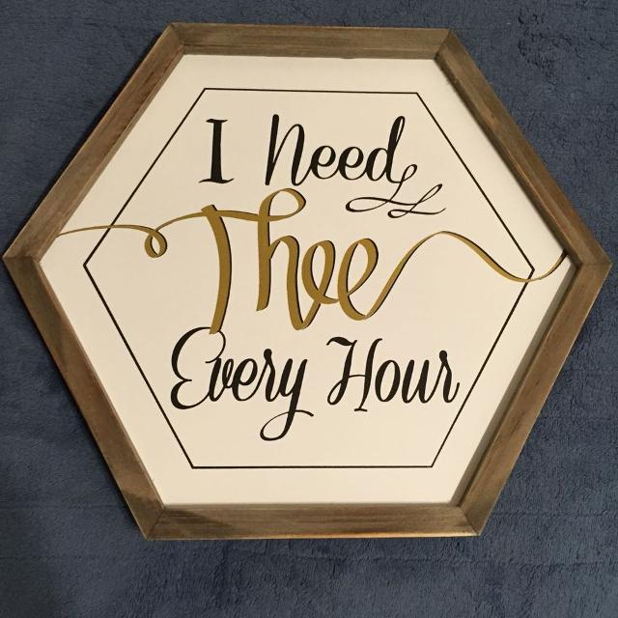
Hymn #443
CCLI# 245077

Slide 46
I need Thee every hour,
Most gracious Lord;
No tender voice like Thine,
Can peace afford.

Slide 47
I need Thee,
O I need Thee;
Every hour I need Thee!
O bless me now, My Savior
I come to Thee.

Slide 48
I need Thee every hour,
Stay Thou near by;
Temptations lose their power
When Thou art nigh.

Slide 49
I need Thee,
O I need Thee;
Every hour I need Thee!
O bless me now, My Savior
I come to Thee.

Slide 50
I need Thee every hour,
In joy or pain;
Come quickly, and abide,
Or life is vain.

Slide 51
I need Thee,
O I need Thee;
Every hour I need Thee!
O bless me now, My Savior
I come to Thee.

Slide 52
I need Thee every hour,
Teach me Thy will,
And Thy rich promises,
In me fulfill.

Slide 53
I need Thee,
O I need Thee;
Every hour I need Thee!
O bless me now, My Savior
I come to Thee.

Slide 54
BENEDICTION

Slide 55
POSTLUDE
Have a
good week!

