Slide 1
Level Green Presbyterian Church
April 7, 2024

Slide 2
PRELUDE
A time to prepare
our hearts and minds
to worship the Lord.

Slide 3
CALL
TO WORSHIP

Slide 4
Leader:
But you, Lord, are a shield around me,
People:
My glory, the One who lifts my head high.

Slide 5
Leader:
I call out to the Lord,
People:
And He answers me from His holy mountain.

Slide 6
Leader:
From the Lord comes deliverance.
All:
May Your blessing be on Your people.

Slide 8
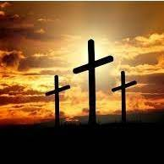
Christ Arose
Hymn #298
CCLI# 245077

Slide 9
Low in the grave He lay,
Jesus, my Savior!
Waiting the coming day,
Jesus, my Lord!

Slide 10
Up from the grave He arose,
With a mighty triumph o’er His foes;
He arose a victor from the dark domain,
And He lives forever
with His saints to reign;
He arose! He Arose!
Hallelujah! Christ arose!

Slide 11
Vainly they watched His bed,
Jesus, my Savior!
Vainly they sealed the dead,
Jesus, my Lord!

Slide 12
Up from the grave He arose,
With a mighty triumph o’er His foes;
He arose a victor from the dark domain,
And He lives forever
with His saints to reign;
He arose! He Arose!
Hallelujah! Christ arose!

Slide 13
Death could not keep his prey,
Jesus, my Savior!
He tore the bars away,
Jesus, my Lord!

Slide 14
Up from the grave He arose,
With a mighty triumph o’er His foes;
He arose a victor from the dark domain,
And He lives forever
with His saints to reign;
He arose! He Arose!
Hallelujah! Christ arose!

Slide 15
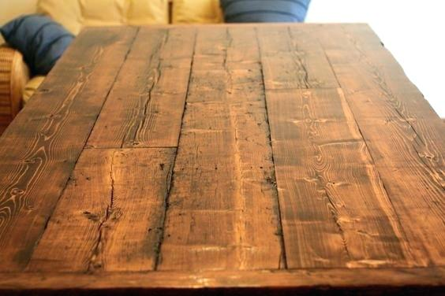

Slide 16
I BELIEVE in God the Father Almighty, Maker of heaven and earth,
And in Jesus Christ
his only Son our Lord;
who was conceived by the Holy Ghost, born of the Virgin Mary,
suffered under Pontius Pilate,
was crucified, dead, and buried;
he descended into hell;

Slide 17
the third day
he rose again from the dead;
he ascended into heaven,
and sitteth on the right hand of God
the Father Almighty;
from thence he shall come to judge
the quick and the dead.

Slide 18
I believe in the Holy Ghost;
the holy catholic Church;
the communion of saints;
the forgiveness of sins;
the resurrection of the body;
and the life everlasting.
Amen.

Slide 19
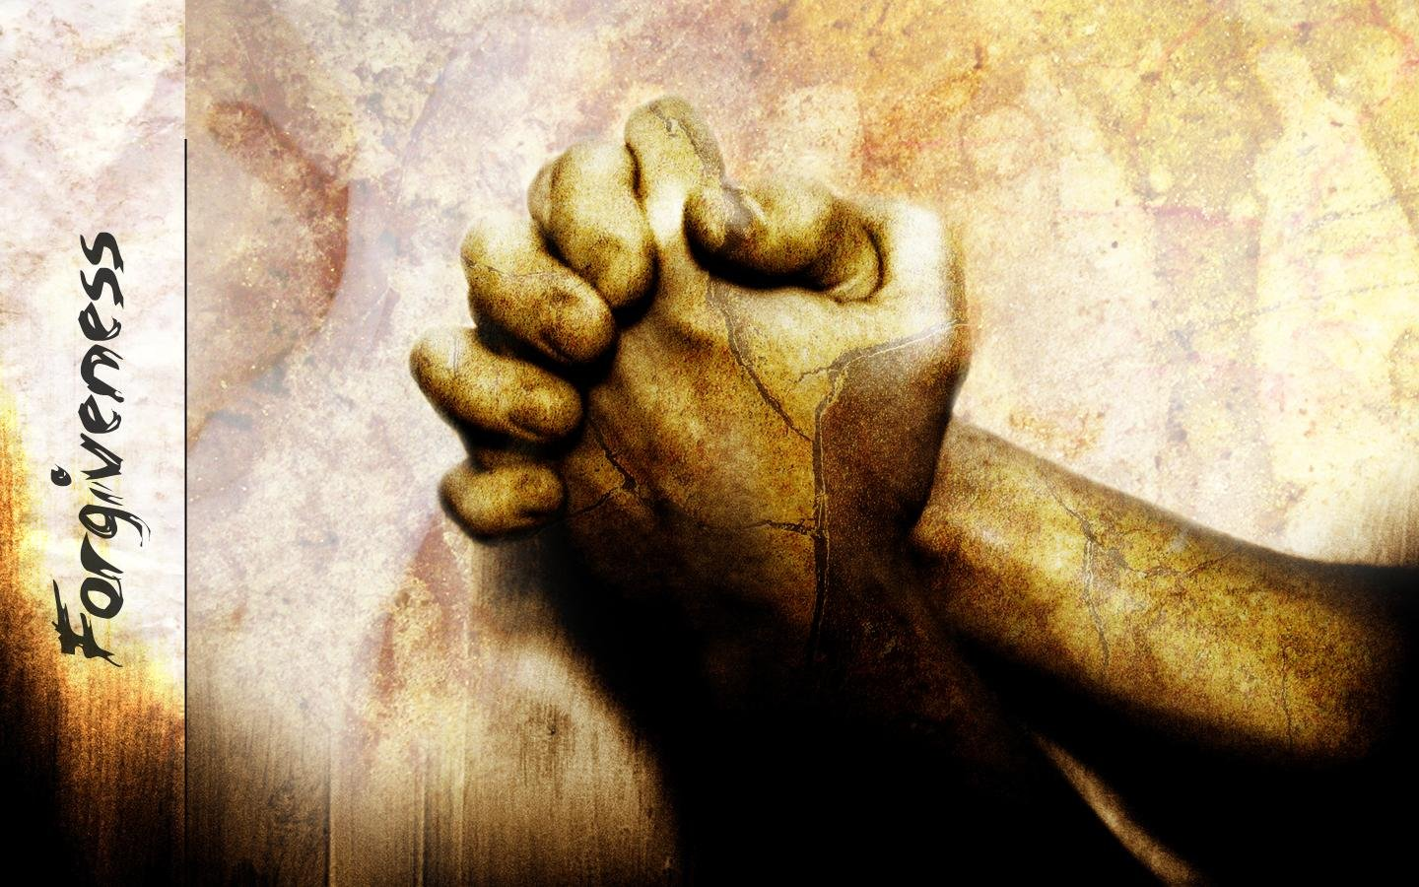
Prayer of Confession

Slide 20
O God, You are light, and in You there is no darkness at all. We call ourselves children of light, but sometimes we act otherwise: we love ourselves more than others, we manipulate others to get our own way, and then pretend to be innocent. We deceive ourselves, and the truth is not in us. Shine Your light into our dark places. Bring the truth to our lips. In Your faithfulness, receive our confession and forgive us. We pray in the name of our Risen Savior Jesus Christ. Amen.

Slide 22
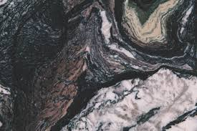
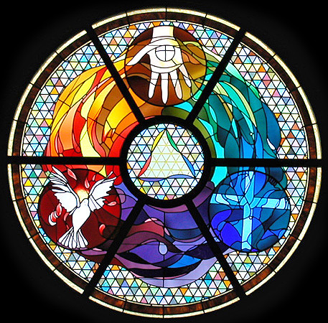
Gloria Patri
Hymn #142
CCLI #245077

Slide 23
Glory be to the Father
and to the Son
and to the Holy Ghost,
as it was in the beginning
is now and ever shall be,
world without end.
Amen, Amen.

Slide 26
Praise the Lord

Slide 27
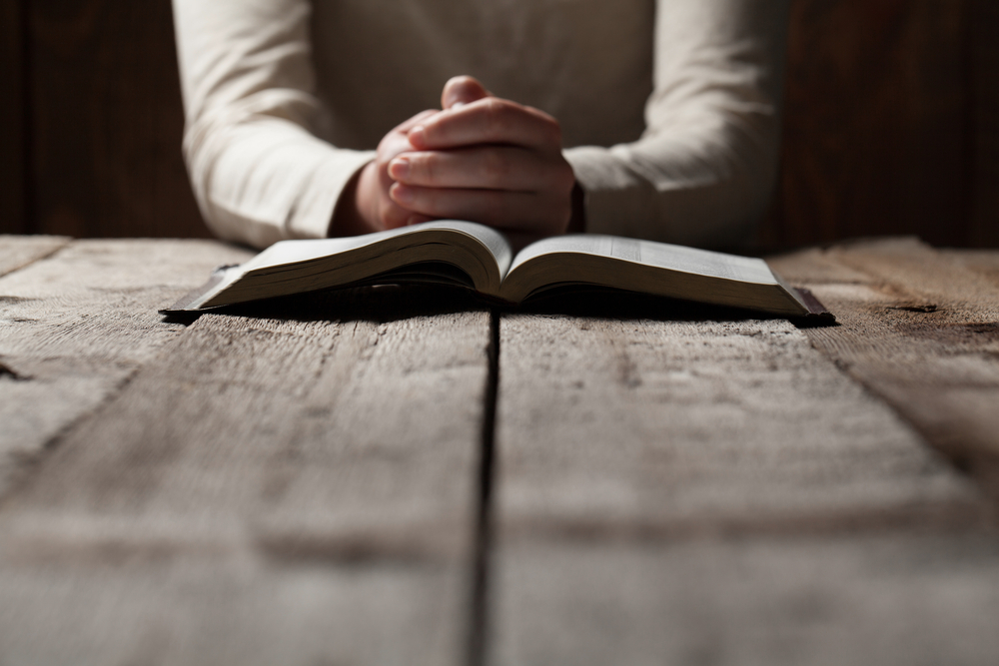

Slide 29
Hymn #382
CCLI #245077

Slide 30
Praise God,
From whom all blessings flow;
Praise Him,
All creatures here below;
Praise Him above,
Ye heavenly host;
Praise Father, Son,
And Holy Ghost. Amen

Slide 32
Hosea 10:12-13 (NIV)

Slide 33
12 Sow righteousness for yourselves, reap the fruit of unfailing love, and break up your unplowed ground; for it is time to seek the Lord, until he comes and showers his righteousness on you. 13 But you have planted wickedness, you have reaped evil, you have eaten the fruit of deception. Because you have depended on your own strength and on your many warriors,

Slide 34
Galatians 6:1-10 (NIV)

Slide 35
Brothers and sisters, if someone is caught in a sin, you who live by the Spirit should restore that person gently. But watch yourselves, or you also may be tempted. 2 Carry each other’s burdens, and in this way you will fulfill the law of Christ. 3 If anyone thinks they are something when they are not, they deceive themselves. 4 Each one should test their own actions. Then they can take pride in themselves alone, without comparing themselves to someone else, 5 for each one should carry their own load. 6 Nevertheless,

Slide 36
the one who receives instruction in the word should share all good things with their instructor. 7 Do not be deceived: God cannot be mocked. A man reaps what he sows. 8 Whoever sows to please their flesh, from the flesh will reap destruction; whoever sows to please the Spirit, from the Spirit will reap eternal life. 9 Let us not become weary in doing good, for at the proper time we will reap a harvest if we do not give up. 10 Therefore, as we have opportunity, let us do good to all people, especially to those who belong to the family of believers.

Slide 38
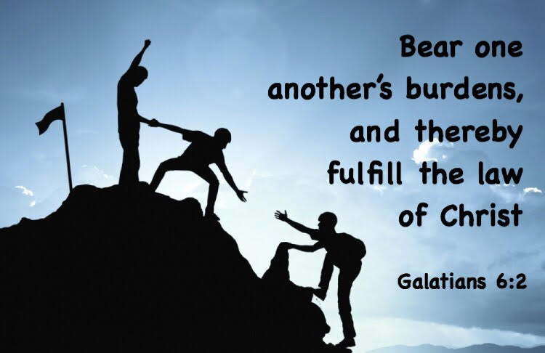
Being Devoted to One Another

Slide 39
Praise Book
CCLI#245077

Slide 40
Open our eyes, Lord,
We want to see Jesus,
To reach out and touch Him,
And say that we love Him.
Open our ears, Lord,
And help us to listen.
Open our eyes, Lord,
We want to see Jesus.

Slide 41
Open our eyes, Lord,
We want to see Jesus,
To reach out and touch Him,
And say that we love Him.
Open our ears, Lord,
And help us to listen.
Open our eyes, Lord,
We want to see Jesus.

Slide 42
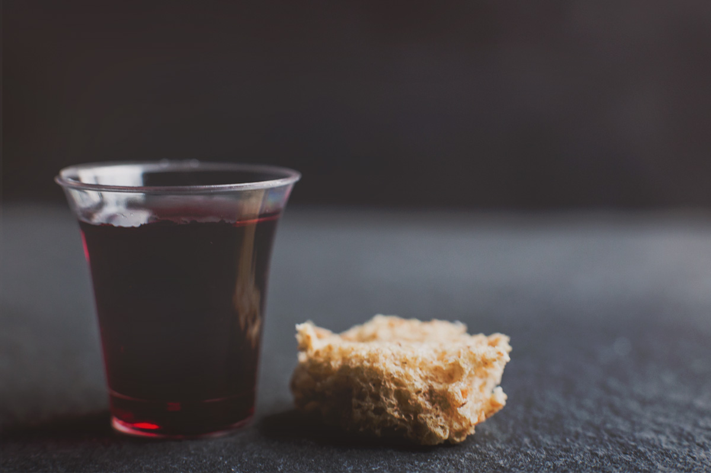
THE SACRAMENT OF THE LORD’S SUPPER
Just As I AM, Without One Plea
CCLI# 245077

Slide 43
Hymn #299
CCLI# 245077

Slide 44
I serve a risen Savior,
He’s in the world today;
I know that He is living,
Whatever men may say;
I see His hand of mercy,
I hear His voice of cheer,
And just the time I need Him
He’s always near.

Slide 45
He lives, He lives,
Christ Jesus lives today!
He walks with me and talks with me Along life’s narrow way.
He lives, He lives, salvation to impart!
You ask me how I know He lives?
He lives within my heart.

Slide 46
In all the world around me
I see His loving care,
And though my heart grows weary
I never will despair;
I know that He is leading
Through all the stormy blast,
The day of His appearing
Will come at last.

Slide 47
He lives, He lives,
Christ Jesus lives today!
He walks with me and talks with me Along life’s narrow way.
He lives, He lives, salvation to impart!
You ask me how I know He lives?
He lives within my heart.

Slide 48
Rejoice, rejoice, O Christian,
Lift up your voice and sing
Eternal hallelujahs
To Jesus Christ the King!
The Hope of all who seek Him,
The Help of all who find,
None other is so loving,
So good and kind.

Slide 49
He lives, He lives,
Christ Jesus lives today!
He walks with me and talks with me Along life’s narrow way.
He lives, He lives, salvation to impart!
You ask me how I know He lives?
He lives within my heart.

Slide 50
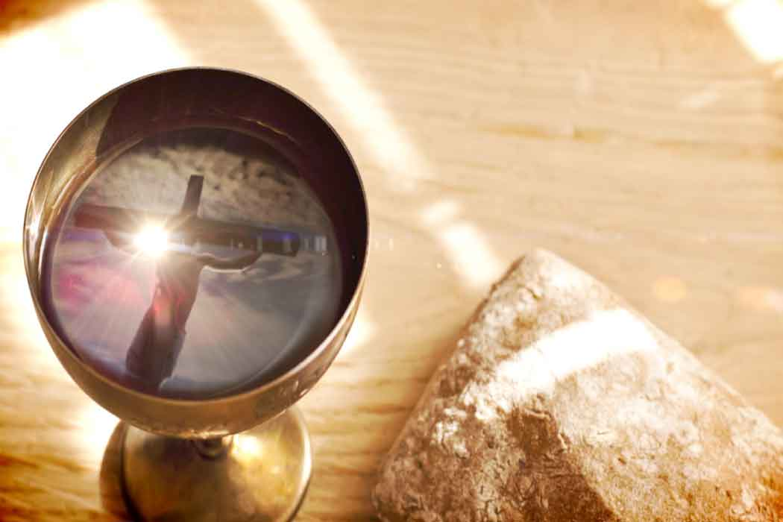
BENEDICTION

Slide 51
POSTLUDE
Have a
good week!

