Slide 1
Level Green Presbyterian Church
March 24, 2024

Slide 2
PRELUDE
A time to prepare
our hearts and minds
to worship the Lord.

Slide 3
CALL TO
WORSHIP

Slide 4
Leader:
Give thanks to the Lord, for He is good;
People:
His love endures forever.

Slide 5
Leader:
Blessed is He who comes in the name of the Lord.
People:
From the house of the Lord we bless You.

Slide 6
Leader:
The Lord is God,
All:
And He has made His light shine on us.

Slide 8
Hymn #248
CCLI# 245077

Slide 9
Hosanna, loud hosanna,
The little children sang;
Through pillared court and temple
The lovely anthem rang:
To Jesus, who had blessed them
Close folded to His breast,
The children sang their praises,
The simplest and the best.

Slide 10
From Olivet they followed,
A happy, joyous crowd,
Their large palm branches waving,
And singing clear and loud;
The Lord of men and angels
Rode on in simple joy,
And welcomed all the children:
Each little girl and boy.

Slide 11
“Hosanna in the highest!”
That ancient song we sing,
For Christ is our Redeemer,
The Lord of heaven our King;
O may we ever praise Him
With heart and life and voice,
And in His holy presence
Eternally rejoice!

Slide 12
The Apostles’ Creed

Slide 13
I BELIEVE in God the Father Almighty, Maker of heaven and earth,
And in Jesus Christ
his only Son our Lord;
who was conceived by the Holy Ghost, born of the Virgin Mary,
suffered under Pontius Pilate,
was crucified, dead, and buried;
he descended into hell;

Slide 14
the third day
he rose again from the dead;
he ascended into heaven,
and sitteth on the right hand of God
the Father Almighty;
from thence he shall come to judge
the quick and the dead.

Slide 15
I believe in the Holy Ghost;
the holy catholic Church;
the communion of saints;
the forgiveness of sins;
the resurrection of the body;
and the life everlasting.
Amen.

Slide 16
Prayer of Confession

Slide 17
God of mercy, You sent Jesus Christ to seek and save the lost. We confess that we have strayed from You and turned aside from Your way. We are misled by pride, for we see ourselves pure when we are stained, and great when we are small. We have failed in love, neglected justice, and ignored Your truth. Have mercy, O God, and forgive our sin. Return us to paths of righteousness through Jesus Christ, our Savior, we pray. Amen.

Slide 19
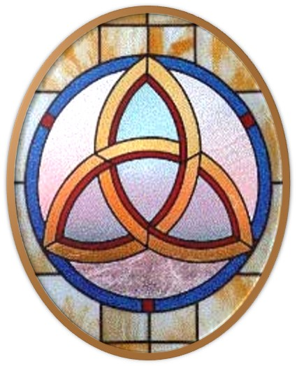
Gloria Patri
Hymn #142
CCLI #245077

Slide 20
Glory be to the Father
and to the Son
and to the Holy Ghost,
as it was in the beginning
is now and ever shall be,
world without end.
Amen, Amen.

Slide 23
Blessed Is He Who Comes

Slide 24
All glory, laud and honor to Thee, Redeemer King.
To whom the lips of children
made sweet hosannas ring!
The people of the Hebrews
with palms before Thee went;
Our praise and prayer and anthems before Thee we present.

Slide 25
Blessed Is He Who Comes

Slide 28
Hymn #382
CCLI #245077

Slide 29
Praise God,
From whom all blessings flow;
Praise Him,
All creatures here below;
Praise Him above,
Ye heavenly host;
Praise Father, Son,
And Holy Ghost. Amen

Slide 31
Hosanna, Hosanna

Slide 32
Zechariah 2:10-13 (NIV)

Slide 33
¹⁰“Shout and be glad, Daughter Zion. For I am coming, and I will live among you,” declares the Lord. ¹¹“Many nations will be joined with the Lord in that day and will become my people. I will live among you and you will know that the Lord Almighty has sent me to you. ¹²The Lord will inherit Judah as his portion in the holy land and will again choose Jerusalem. ¹³Be still before the Lord, all mankind, because he has roused himself from his holy dwelling.”

Slide 34
Mark 11:1-11 (NIV)

Slide 35
As they approached Jerusalem and came to Bethphage and Bethany at the Mount of Olives, Jesus sent two of his disciples, ²saying to them, “Go to the village ahead of you, and just as you enter it, you will find a colt tied there, which no one has ever ridden. Untie it and bring it here. ³If anyone asks you, ‘Why are you doing this?’ say, ‘The Lord needs it and will send it back here shortly.’” ⁴They went and found a colt outside in the street, tied at a doorway. As they untied it, ⁵some people standing there asked, “What are you doing,

Slide 36
untying that colt?” ⁶They answered as Jesus had told them to, and the people let them go. ⁷When they brought the colt to Jesus and threw their cloaks over it, he sat on it. ⁸Many people spread their cloaks on the road, while others spread branches they had cut in the fields. ⁹Those who went ahead and those who followed shouted, “Hosanna!” “Blessed is he who comes in the name of the Lord!” ¹⁰“Blessed is the coming kingdom of our father David!” “Hosanna in the highest heaven!”

Slide 37
¹¹Jesus entered Jerusalem and went into the temple courts. He looked around at everything, but since it was already late, he went out to Bethany with the Twelve.

Slide 39
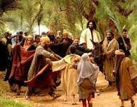
A Victory Celebration

Slide 40
Hymn #249
CCLI# 245077

Slide 41
All glory, laud, and honor
To Thee, Redeemer, King,
To whom the lips of children
Made sweet hosannas ring:
Thou art the King of Israel,
Thou David’s royal Son,
Who in the Lord’s name comest,
The King and blessed one!

Slide 42
The company of angels
Are praising Thee on high,
And mortal men and all things
Created make reply:
The people of the Hebrews
With palms before Thee went;
Our praise and prayer and anthems
Before Thee we present.

Slide 43
To Thee, before Thy passion,
They sang their hymns of praise;
To Thee, now high exalted,
Our melody we raise:
Thou didst accept their praises
Accept the praise we bring,
Who in all good delightest,
Thou good and gracious King!

Slide 44
BENEDICTION

Slide 45
POSTLUDE
Have a
good week!

