Slide 1
Level Green Presbyterian Church
April 21, 2024

Slide 2
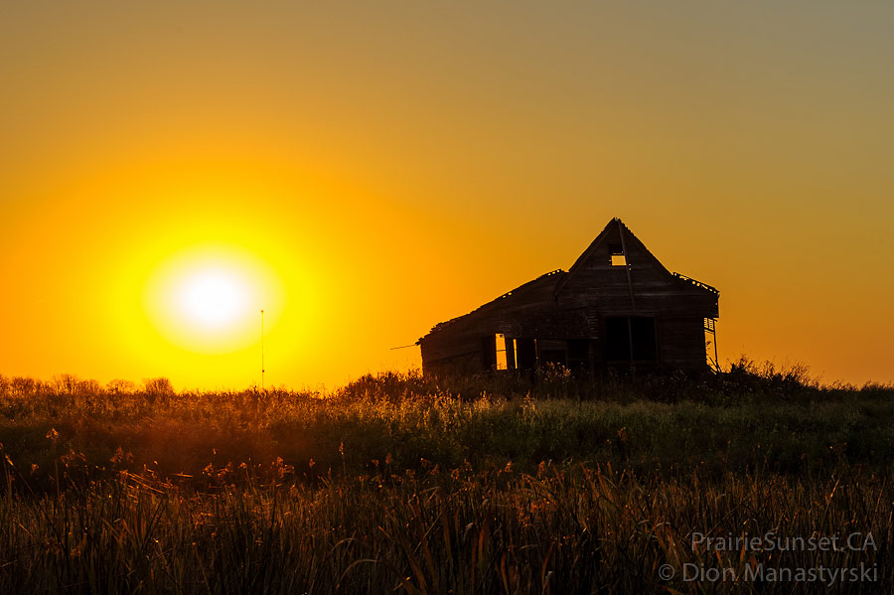
PRELUDE
A time to prepare
our hearts and minds
to worship the Lord.

Slide 3
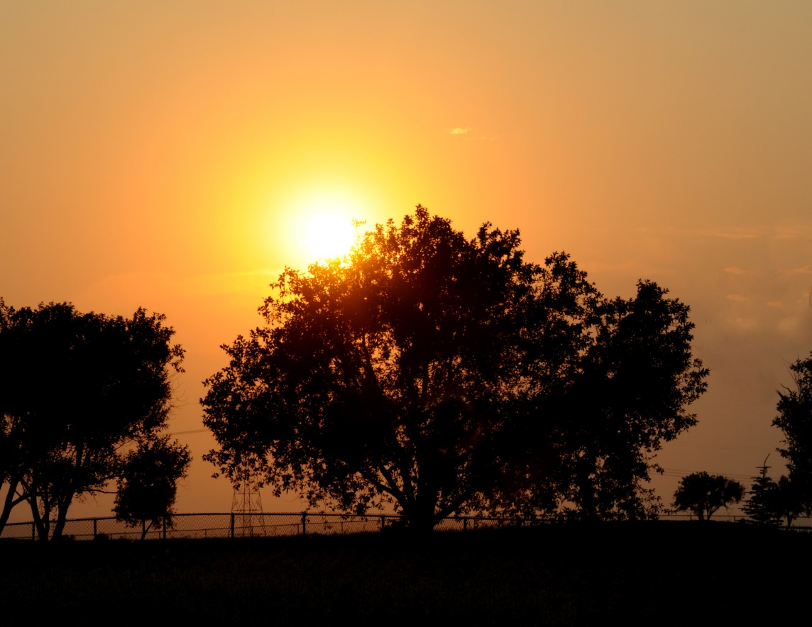
CALL TO
WORSHIP

Slide 4
Leader:
Hear us, Shepherd of Israel,
People:
Awaken Your might; come and save us.

Slide 5
Leader:
Return to us, God Almighty!
People:
Look down from heaven and see!

Slide 6
Leader:
Restore us, Lord God Almighty;
All:
Make Your face shine on us, that we may be saved.

Slide 8
Hymn #91
CCLI# 245077

Slide 9
‘Tis so sweet to trust in Jesus,
Just to take Him at His word,
Just to rest upon His promise,
Just to know, “Thus saith the Lord.”

Slide 10
Jesus, Jesus, How I trust Him!
How I've proved Him, o’er and o’er!
Jesus, Jesus, precious Jesus!
O for grace to trust Him more!

Slide 11
How I love to trust in Jesus,
Just to trust His cleansing blood,
Just in simple faith to plunge me
‘Neath the healing, cleansing flood!

Slide 12
Jesus, Jesus, How I trust Him!
How I've proved Him, o’er and o’er!
Jesus, Jesus, precious Jesus!
O for grace to trust Him more!

Slide 13
Yes, I’ve learned to trust in Jesus,
And from sin and self to cease,
Now from Jesus simply taking
Life and rest and joy and peace.

Slide 14
Jesus, Jesus, How I trust Him!
How I've proved Him, o’er and o’er!
Jesus, Jesus, precious Jesus!
O for grace to trust Him more!

Slide 15
I’m so glad I learned to trust Him,
Precious Jesus, Savior, Friend;
And I know that He is with me,
He’ll be with me to the end.

Slide 16
Jesus, Jesus, How I trust Him!
How I've proved Him, o’er and o’er!
Jesus, Jesus, precious Jesus!
O for grace to trust Him more!

Slide 18
I BELIEVE in God the Father Almighty, Maker of heaven and earth,
And in Jesus Christ
his only Son our Lord;
who was conceived by the Holy Ghost, born of the Virgin Mary,
suffered under Pontius Pilate,
was crucified, dead, and buried;
he descended into hell;

Slide 19
the third day
he rose again from the dead;
he ascended into heaven,
and sitteth on the right hand of God
the Father Almighty;
from thence he shall come to judge
the quick and the dead.

Slide 20
I believe in the Holy Ghost;
the holy catholic Church;
the communion of saints;
the forgiveness of sins;
the resurrection of the body;
and the life everlasting.
Amen.

Slide 21
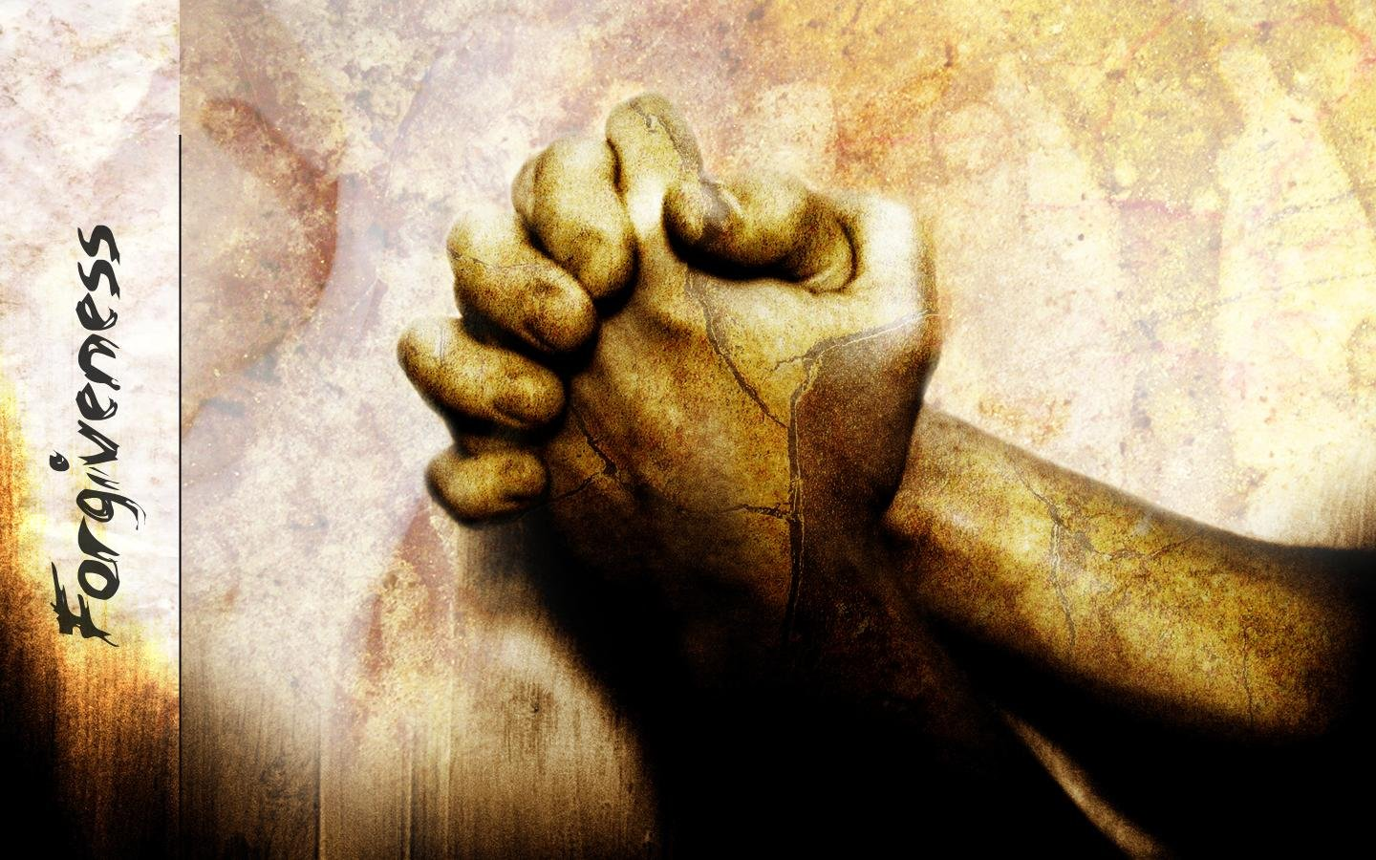
Prayer of Confession

Slide 22
Heavenly Father, we praise You for Your grace. Once dead in our sins, You extended Your merciful love to us and we are now made alive together in Christ. Yet we confess that we are still prone at times to follow the desires of our own flesh, and for this we are sorry. Please forgive our forgetfulness of Your gracious love. Since Christ died for us, He has been judged in our place and punished for our sins. May we now, in faith, fully identify with Christ's perfect righteousness, simply by trusting in Him. We gratefully pray this in Jesus' name. Amen.

Slide 24
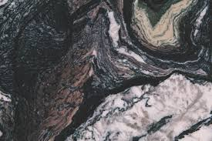
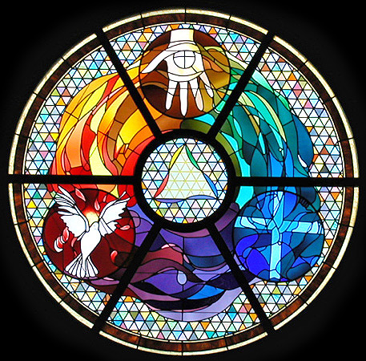
Gloria Patri
Hymn #142
CCLI #245077

Slide 25
Glory be to the Father
and to the Son
and to the Holy Ghost,
as it was in the beginning
is now and ever shall be,
world without end.
Amen, Amen.

Slide 28
Lord, Here Am I

Slide 29
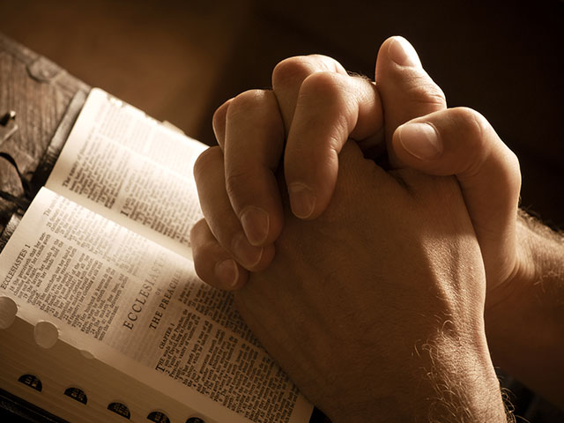

Slide 31
Hymn #382
CCLI #245077

Slide 32
Praise God,
From whom all blessings flow;
Praise Him,
All creatures here below;
Praise Him above,
Ye heavenly host;
Praise Father, Son,
And Holy Ghost. Amen

Slide 35
He leadeth me, O blessed thought!
O words with heavenly comfort fraught!
Whate’er I do, where’er I be,
Still ’tis God’s hand that leadeth me.
He leadeth, He leadeth me,
By His own hand He leadeth me;
His faithful follower I would be,
For by His hand He leadeth me.

Slide 36
Lord, I would clasp Thy hand in mine,
Nor ever murmur nor repine;
Content whatever lot I see,
Since ’tis my God that leadeth me.
He leadeth, He leadeth me,
By His own hand He leadeth me;
His faithful follower I would be,
For by His hand He leadeth me.

Slide 37
And when my task on earth is done,
When by Thy grace the victory’s won,
Even death’s cold wave I will not flee,
Still God through Jordan leadeth me.
He leadeth, He leadeth me,
By His own hand He leadeth me;
His faithful follower I would be,
For by His hand He leadeth me.

Slide 39
Psalm 23 (NIV)

Slide 40
The Lord is my shepherd, I lack nothing. ²He makes me lie down in green pastures, he leads me beside quiet waters, ³he refreshes my soul. He guides me along the right paths for his name’s sake. ⁴Even though I walk through the darkest valley, I will fear no evil, for you are with me; your rod and your staff, they comfort me. ⁵You prepare a table before me in the presence of my enemies. You anoint my head with oil; my cup overflows. ⁶Surely your goodness and love will follow me all the days of my life, and I will dwell in the house of the Lord forever.

Slide 41
John 14:6 (NIV)

Slide 42
⁶Jesus answered, “I am the way and the truth and the life. No one comes to the Father except through me.

Slide 44
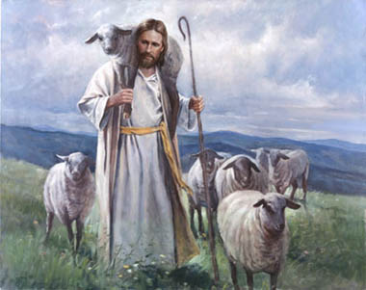
It’s A Jungle Out there

Slide 45
Hymn #408
CCLI# 245077

Slide 46
All to Jesus I surrender,
All to Him I freely give;
I will ever love and trust Him,
In His presence daily live.
I surrender all, I surrender all,
All to The, my blessed Savior,
I surrender all.

Slide 47
All to Jesus I surrender,
Humbly at His feet I bow,
Worldly pleasures all forsaken,
Take me, Jesus, take me now.
I surrender all, I surrender all,
All to Thee, my blessed Savior,
I surrender all.

Slide 48
All to Jesus I surrender,
Make me, Savior, wholly Thine.
Let me fell the Holy Spirit,
Truly know that Thou art mine.
I surrender all, I surrender all,
All to Thee, my blessed Savior,
I surrender all.

Slide 49
All to Jesus I surrender,
Lord, I gave myself to Thee;
Fill me with Thy love and power,
Let Thy blessing fall on me.
I surrender all, I surrender all,
All to Thee, my blessed Savior,
I surrender all.

Slide 50
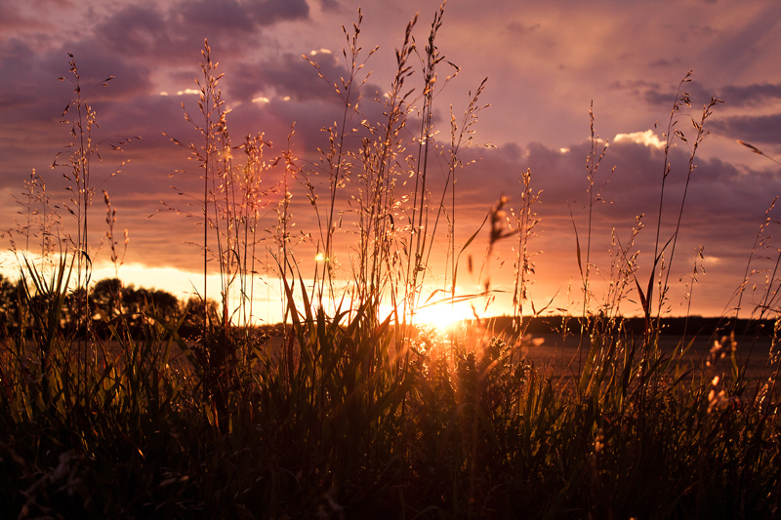
BENEDICTION

Slide 51
POSTLUDE
Have a
good week!

