Slide 1
Level Green Presbyterian Church
January 21, 2024

Slide 2
VIDEO

Slide 3
PRELUDE
A time to prepare
our hearts and minds
to worship the Lord.

Slide 4
CALL TO
WORSHIP

Slide 5
Leader:
Yes, my soul, find rest in God;
People:
My hope comes from Him.

Slide 6
Leader:
Truly He is my rock and my salvation;
People:
He is my fortress, I will not be shaken.

Slide 7
Leader:
He is my mighty rock, my refuge.
All:
Pour out your hearts to Him, for God is our refuge.

Slide 9
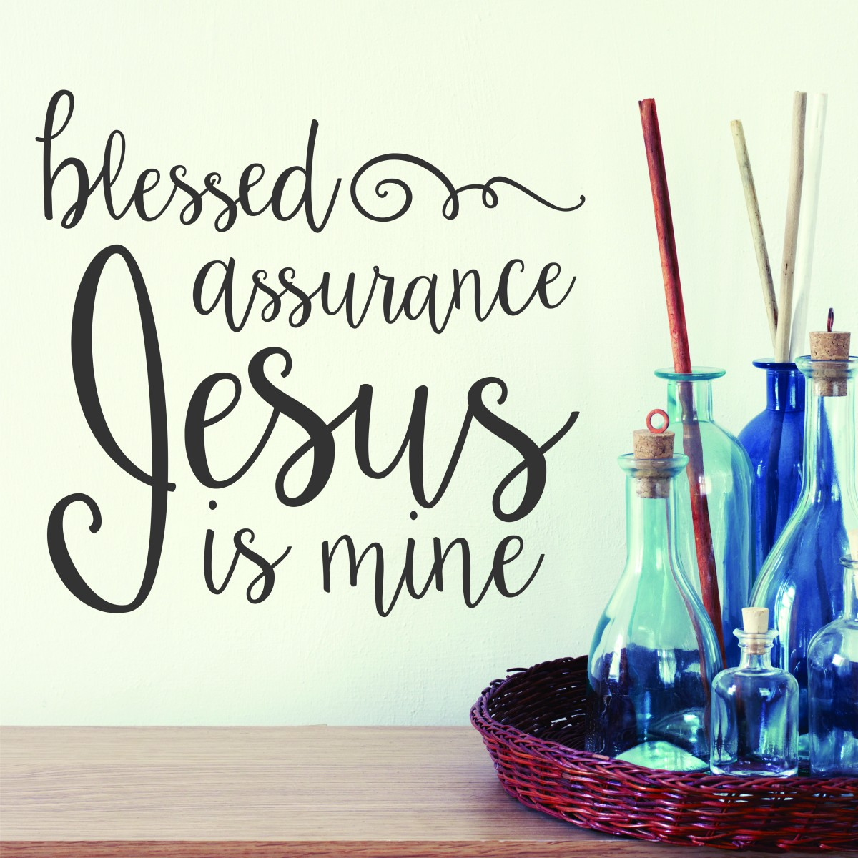
Hymn #67
CCLI# 245077

Slide 10
Blessed assurance, Jesus is mine!
O what a foretaste of glory divine!
Heir of salvation, purchase of God,
Born of His Spirit,
Washed in His blood.

Slide 11
This is my story, this is my song,
Praising my Savior all the day long;
This is my story, this is my song,
Praising my Savior all the day long.

Slide 12
Perfect submission, perfect delight,
Visions of rapture
Now burst on my sight;
Angels descending bring from above
Echoes of mercy, whispers of love.

Slide 13
This is my story, this is my song,
Praising my Savior all the day long;
This is my story, this is my song,
Praising my Savior all the day long.

Slide 14
Perfect submission, all is at rest,
I in my Savior am happy and blest;
Watching and waiting, looking above,
Filled with His goodness, lost in His love.

Slide 15
This is my story, this is my song,
Praising my Savior all the day long;
This is my story, this is my song,
Praising my Savior all the day long.

Slide 16
The Apostles’ Creed

Slide 17
I BELIEVE in God the Father Almighty, Maker of heaven and earth,
And in Jesus Christ
his only Son our Lord;
who was conceived by the Holy Ghost, born of the Virgin Mary,
suffered under Pontius Pilate,
was crucified, dead, and buried;
he descended into hell;

Slide 18
the third day
he rose again from the dead;
he ascended into heaven,
and sitteth on the right hand of God
the Father Almighty;
from thence he shall come to judge
the quick and the dead.

Slide 19
I believe in the Holy Ghost;
the holy catholic Church;
the communion of saints;
the forgiveness of sins;
the resurrection of the body;
and the life everlasting.
Amen.

Slide 20
Prayer of Confession

Slide 21
Lord God, how glad we are for Your unending mercies and grace! Because we are now in Christ, we have miraculously become a chosen and holy people. Yet, we confess that we often forget just how deeply loved we are in Jesus. Please forgive us for taking that love lightly. May we grow in spiritual maturity and faithfully forgive each other as the Lord has forgiven us. Dress us daily in the wardrobe of tenderhearted mercy, kindness, humility, gentleness and patience.

Slide 22
May we love consistently in the manner that You love. Help us to do so, all for Your glory, we pray in Jesus’ name. Amen.

Slide 24
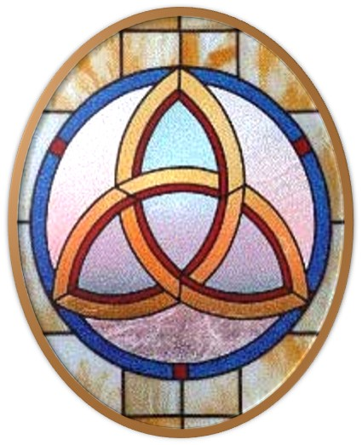
Gloria Patri
Hymn #142
CCLI #245077

Slide 25
Glory be to the Father
and to the Son
and to the Holy Ghost,
as it was in the beginning
is now and ever shall be,
world without end.
Amen, Amen.

Slide 28
Give Me Oil in My Lamp

Slide 29
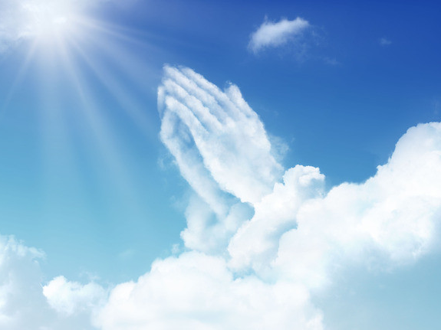

Slide 31
Hymn #382
CCLI #245077

Slide 32
Praise God,
From whom all blessings flow;
Praise Him,
All creatures here below;
Praise Him above,
Ye heavenly host;
Praise Father, Son,
And Holy Ghost. Amen

Slide 34
Step
By Step
Praise Book
CCLI# 245077

Slide 35
O God, You are my God,
And I will ever praise You.
O God, You are my God,
And I will ever praise You.
I will seek You in the morning,
And I will learn to walk in Your ways;
And step by step You’ll lead me,
And I will follow You all of my days.

Slide 36
O God, You are my God,
And I will ever praise You.
O God, You are my God,
And I will ever praise You.
I will seek You in the morning,
And I will learn to walk in Your ways;
And step by step You’ll lead me,
And I will follow You all of my days.

Slide 38
Isaiah 57:14-21 (NIV)

Slide 39
¹⁴And it will be said: “Build up, build up, prepare the road! Remove the obstacles out of the way of my people.” ¹⁵For this is what the high and exalted One says he who lives forever, whose name is holy: “I live in a high and holy place, but also with the one who is contrite and lowly in spirit, to revive the spirit of the lowly and to revive the heart of the contrite. ¹⁶I will not accuse them forever, nor will I always be angry, for then they would faint away because of me the very people I have created. ¹⁷I was enraged by their sinful greed; I punished them, and hid my face in anger, yet they kept on in

Slide 40
their willful ways. ¹⁸I have seen their ways, but I will heal them; I will guide them and restore comfort to Israel’s mourners, ¹⁹creating praise on their lips. Peace, peace, to those far and near,” says the Lord. “And I will heal them.” ²⁰But the wicked are like the tossing sea, which cannot rest, whose waves cast up mire and mud. ²¹“There is no peace,” says my God, “for the wicked.”

Slide 41
Ephesians 2:11-22 (NIV)

Slide 42
¹¹Therefore, remember that formerly you who are Gentiles by birth and called “uncircumcised” by those who call themselves “the circumcision” (which is done in the body by human hands)— ¹²remember that at that time you were separate from Christ, excluded from citizenship in Israel and foreigners to the covenants of the promise, without hope and without God in the world. ¹³But now in Christ Jesus you who once were far away have been brought near by the blood of Christ. ¹⁴For he himself is our peace, who has made the two

Slide 43
groups one and has destroyed the barrier, the dividing wall of hostility, ¹⁵by setting aside in his flesh the law with its commands and regulations. His purpose was to create in himself one new humanity out of the two, thus making peace, ¹⁶and in one body to reconcile both of them to God through the cross, by which he put to death their hostility. ¹⁷He came and preached peace to you who were far away and peace to those who were near. ¹⁸For through him we both have access to the Father by one Spirit. ¹⁹Consequently,

Slide 44
you are no longer foreigners and strangers, but fellow citizens with God’s people and also members of his household, ²⁰built on the foundation of the apostles and prophets, with Christ Jesus himself as the chief cornerstone. ²¹In him the whole building is joined together and rises to become a holy temple in the Lord. ²²And in him you too are being built together to become a dwelling in which God lives by his Spirit.

Slide 46
Living In Peace

Slide 47
Hymn #495
CCLI# 245077

Slide 48
When peace, like a river,
attendeth my way,
When sorrows like sea billows roll
Whatever my lot,
Thou hast taught me to say,
It is well, It is well with my soul.

Slide 49
It is well (It is well)
with my soul, (with my soul),
It is well, it is well with my soul.

Slide 50
My sin
O the joy of this glorious thought -
My sin, not in part, but the whole,
Is nailed to the cross,
and I bear it no more:
Praise the Lord, praise the Lord,
O my soul!

Slide 51
It is well (It is well)
with my soul, (with my soul),
It is well, it is well with my soul.

Slide 52
And, Lord, haste the day
when my faith shall be sight,
The clouds be rolled back as a scroll:
The trump shall resound
and the Lord shall descend,
“Even so” - it is well with my soul.

Slide 53
It is well (It is well)
with my soul, (with my soul),
It is well, it is well with my soul.

Slide 54
BENEDICTION

Slide 55
POSTLUDE
Have a
good week!

