Slide 1
Level Green Presbyterian Church
January 28, 2024

Slide 2
PRELUDE
A time to prepare
our hearts and minds
to worship the Lord.

Slide 3
CALL TO
WORSHIP

Slide 4
Leader:
Praise the Lord.
People:
I will extol the Lord with all my heart.

Slide 5
Leader:
Great are the works of the LORD;
People:
The fear of the Lord is the beginning of wisdom;

Slide 6
Leader:
All who follow His precepts have good understanding.
All:
To Him belongs eternal praise.

Slide 8
Hymn #92
CCLI# 245077

Slide 9
My hope is built on nothing less
Than Jesus’ blood and righteousness;
I dare not trust the sweetest frame,
But wholly lean on Jesus’ name.

Slide 10
On Christ, the solid Rock, I stand;
All other ground is sinking sand,
All other ground is sinking sand.

Slide 11
When darkness veils His lovely face,
I rest on His unchanging grace:
In every high and stormy gale,
My anchor holds within the veil.

Slide 12
On Christ, the solid Rock, I stand;
All other ground is sinking sand,
All other ground is sinking sand.

Slide 13
His oath, His covenant, His blood,
Support me in the whelming flood;
When all around my soul gives way,
He then is all my hope and stay.

Slide 14
On Christ, the solid Rock, I stand;
All other ground is sinking sand,
All other ground is sinking sand.

Slide 15
When He shall come with trumpet sound,
O may I then in Him be found;
Dressed in His righteousness alone,
Faultless to stand before the throne.

Slide 16
On Christ, the solid Rock, I stand;
All other ground is sinking sand,
All other ground is sinking sand.

Slide 17
The Apostles’ Creed

Slide 18
I BELIEVE in God the Father Almighty, Maker of heaven and earth,
And in Jesus Christ
his only Son our Lord;
who was conceived by the Holy Ghost, born of the Virgin Mary,
suffered under Pontius Pilate,
was crucified, dead, and buried;
he descended into hell;

Slide 19
the third day
he rose again from the dead;
he ascended into heaven,
and sitteth on the right hand of God
the Father Almighty;
from thence he shall come to judge
the quick and the dead.

Slide 20
I believe in the Holy Ghost;
the holy catholic Church;
the communion of saints;
the forgiveness of sins;
the resurrection of the body;
and the life everlasting.
Amen.

Slide 21
Prayer of Confession

Slide 22
Almighty God, You raised Jesus from death to life, and crowned Him Lord of All. We confess that we do not daily acknowledge Him as Lord of our lives, our families, our vocations, or our decisions. We have gone along with the ways of the world. We have failed to wait for Your advice, and to give You all the glory. Forgive us, and raise us from sin, that we may live as those who are faithful to You, through Christ our Lord we pray. Amen.

Slide 24
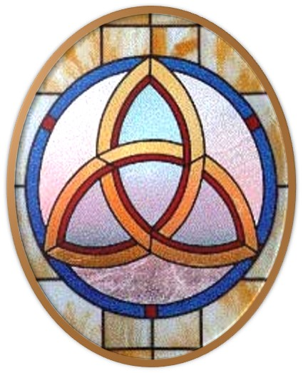
Gloria Patri
Hymn #142
CCLI #245077

Slide 25
Glory be to the Father
and to the Son
and to the Holy Ghost,
as it was in the beginning
is now and ever shall be,
world without end.
Amen, Amen.

Slide 28
United in Praise

Slide 29
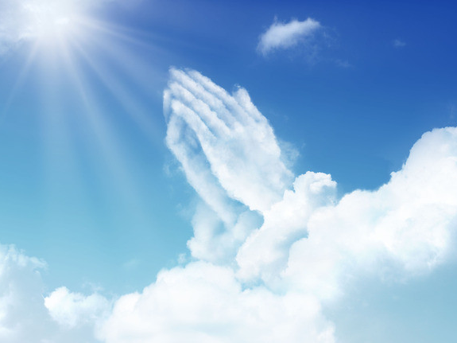

Slide 31
Hymn #382
CCLI #245077

Slide 32
Praise God,
From whom all blessings flow;
Praise Him,
All creatures here below;
Praise Him above,
Ye heavenly host;
Praise Father, Son,
And Holy Ghost. Amen

Slide 34
Praise Songs #
CCLI# 245077

Slide 35
In Christ alone my hope is found,
He is my light, my strength, my song;
This Cornerstone, this solid Ground,
Firm through the fiercest drought and storm.

Slide 36
What heights of love,
what depths of peace,
When fears are stilled,
when striving cease.
My Comforter, my All in All,
Here in the love of Christ I stand.

Slide 37
In Christ alone, who took on flesh,
Fullness of God in helpless babe!
This gift of love and righteousness,
Scorned by the ones He came to save.

Slide 38
Till on that cross as Jesus died,
The wrath of God was satisfied.
For ev’ry sin on Him was laid;
Here in the death of Christ I live.

Slide 39
There in the ground His body lay,
Light of the world by darkness slain;
Then, bursting forth in glorious Day,
Up from the grave He rose again!

Slide 40
And as He stands in victory,
Sin’s curse has lost its grip on me;
For I am His and He is mine,
Bought with the precious blood of Christ.

Slide 41
No guilt in life, no fear in death,
This is the pow’r of Christ in me;
From life’s first cry to final breath,
Jesus commands my destiny.

Slide 42
No pow’r of hell, no scheme of man,
Can ever pluck me from His hand;
Till He returns or calls me home,
Here in the pow’r of Christ I’ll stand!

Slide 44
Isaiah 6:1-7 (NIV)

Slide 45
In the year that King Uzziah died, I saw the Lord, high and exalted, seated on a throne; and the train of his robe filled the temple. ²Above him were seraphim, each with six wings: With two wings they covered their faces, with two they covered their feet, and with two they were flying. ³And they were calling to one another: “Holy, holy, holy is the Lord Almighty; the whole earth is full of his glory.” ⁴At the sound of their voices the doorposts and thresholds shook and the temple was filled with smoke. ⁵“Woe to me!” I cried. “I am ruined!

Slide 46
For I am a man of unclean lips, and I live among a people of unclean lips, and my eyes have seen the King, the Lord Almighty.” ⁶Then one of the seraphim flew to me with a live coal in his hand, which he had taken with tongs from the altar. ⁷With it he touched my mouth and said, “See, this has touched your lips; your guilt is taken away and your sin atoned for.”

Slide 47
Colossians
1:15-23 (NIV)

Slide 48
¹⁵The Son is the image of the invisible God, the firstborn over all creation. ¹⁶For in him all things were created: things in heaven and on earth, visible and invisible, whether thrones or powers or rulers or authorities; all things have been created through him and for him. ¹⁷He is before all things, and in him all things hold together. ¹⁸And he is the head of the body, the church; he is the beginning and the firstborn from among the dead, so that in everything he might have the supremacy. ¹⁹For God was pleased to have all his fullness

Slide 49
dwell in him, ²⁰and through him to reconcile to himself all things, whether things on earth or things in heaven, by making peace through his blood, shed on the cross. ²¹Once you were alienated from God and were enemies in your minds because of your evil behavior. ²²But now he has reconciled you by Christ’s physical body through death to present you holy in his sight, without blemish and free from accusation— ²³if you continue in your faith, established and firm, and do not move from the hope held out in the gospel.

Slide 50
This is the gospel that you heard and that has been proclaimed to every creature under heaven, and of which I, Paul, have become a servant.

Slide 52
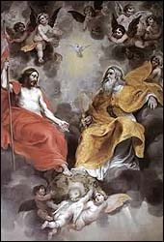
The Supreme Head of the Church

Slide 53
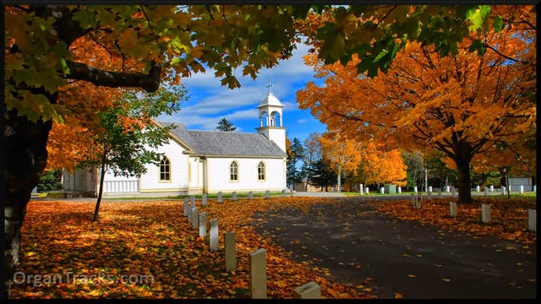
Christ Is Made the Sure Foundation
Hymn #557
CCLI# 245077

Slide 54
Christ is made the sure foundation,
Christ the head and cornerstone,
Chosen of the Lord and precious,
Binding all the Church in one,
Holy Zion’s help forever,
And her confidence alone.

Slide 55
To this temple, where we call Thee,
Come, O Lord of hosts, today;
With accustomed loving kindness,
Hear Thy people as they pray,
And Thy fullest benediction
Shed within its walls alway.

Slide 56
Here vouch safe to all Thy servants
What they ask of Thee to gain,
What they gain from Thee forever
With the blessed to retain,
And here after in Thy glory,
Evermore with Thee to reign.

Slide 57
Laud and honor to the Father,
Laud and honor to the Son,
Laud and honor to the Spirit,
Ever three and ever one,
One in might and one in glory,
While unending ages run.

Slide 58
BENEDICTION

Slide 59
POSTLUDE
Have a
good week!

