Slide 1
Level Green Presbyterian Church

Slide 2
PRELUDE
A time to prepare
our hearts and minds
to worship the Lord.

Slide 3
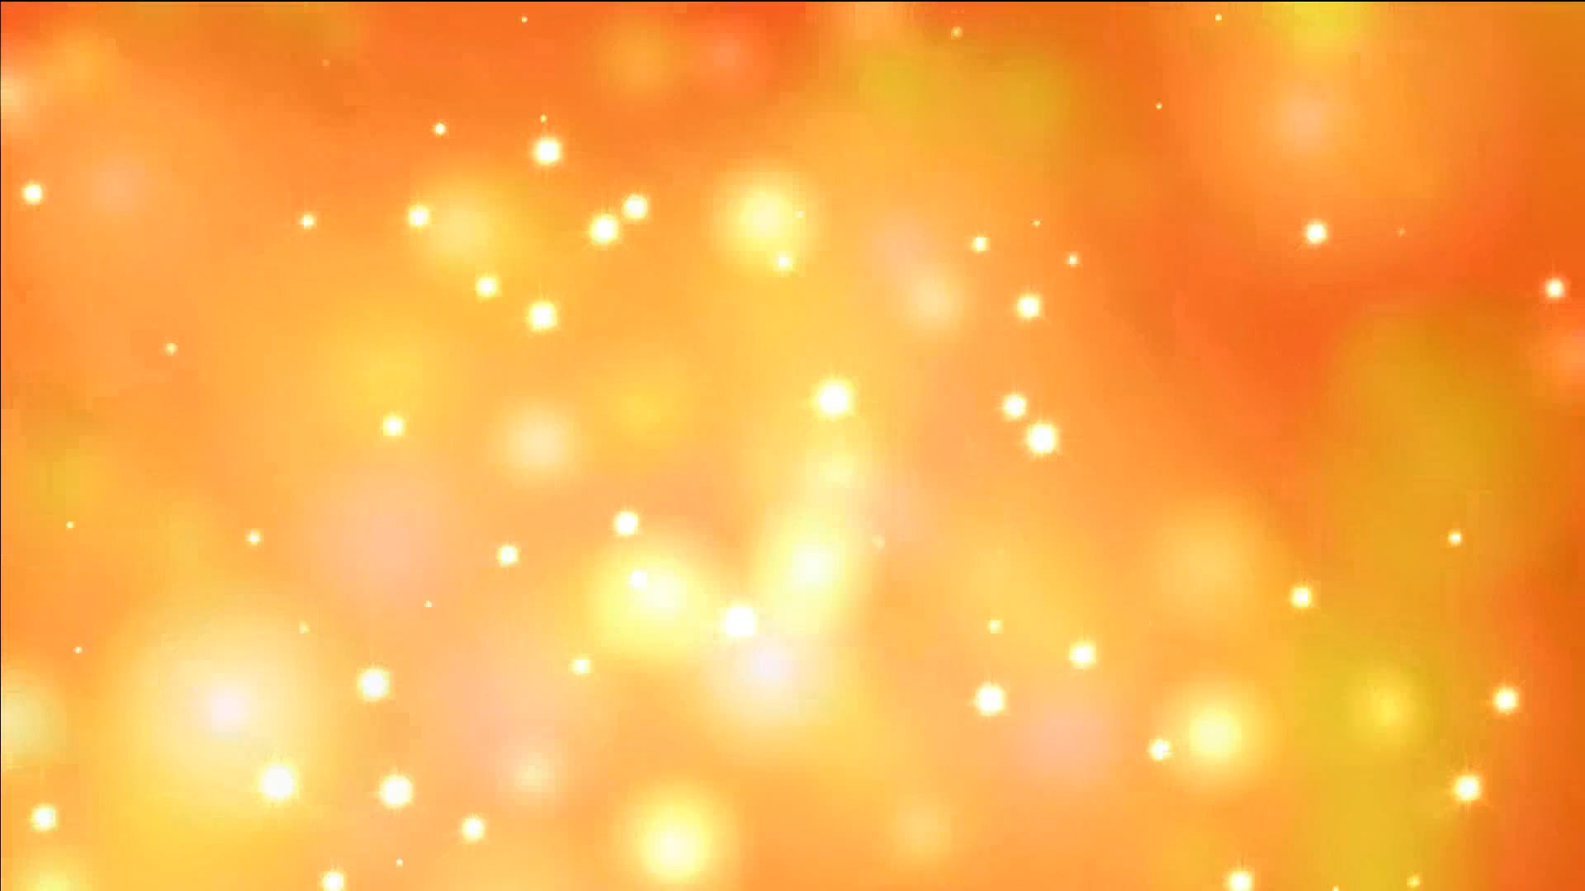
CALL TO
WORSHIP

Slide 4
Leader:
The Lord is gracious and righteous;
People:
Our God is full of compassion.

Slide 5
Leader:
For you, Lord, have delivered me from death,
People:
My eyes from tears, my feet from stumbling,

Slide 6
Leader:
That I may walk before the Lord in the land of the living.
All:
Praise the Lord.

Slide 8
Hymn #254
CCLI# 245077

Slide 9
Jesus, keep me near the cross,
There a precious fountain,
Free to all, a healing steam,
Flows from Calvary’s mountain.

Slide 10
In the cross, in the cross,
Be my glory ever,
‘Til my raptured soul shall find,
Rest beyond the river.

Slide 11
At the cross I stood one day,
Love and mercy found me;
There the bright and morning star,
Shed its beams around me.

Slide 12
In the cross, in the cross,
Be my glory ever,
‘Til my raptured soul shall find,
Rest beyond the river.

Slide 13
Near the cross! O Lamb of God,
Bring its scenes before me;
Help me walk from day to day,
With its shadow o’er me.

Slide 14
In the cross, in the cross,
Be my glory ever,
‘Til my raptured soul shall find,
Rest beyond the river.

Slide 15
Near the cross I’ll watch and wait,
Hoping, trusting ever,
‘Til I reach the golden strand,
Just beyond the river.

Slide 16
In the cross, in the cross,
Be my glory ever,
‘Til my raptured soul shall find,
Rest beyond the river.

Slide 17
Prayer of Confession

Slide 18
Merciful God, we confess that so often our discipleship has been weak. We have failed to serve as Jesus served; forgive us. When we have failed to love one another as Jesus loves us; forgive us. When we have been happy to proclaim our devotion to Jesus with our lips and then denied him by our actions; forgive us. Merciful God, empower us by Your Spirit to be steady and true to You in every time of trial; through Jesus Christ our Lord we pray. Amen.

Slide 21
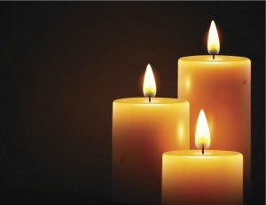
THE PASSION OF OUR LORD JESUS CHRIST

Slide 22
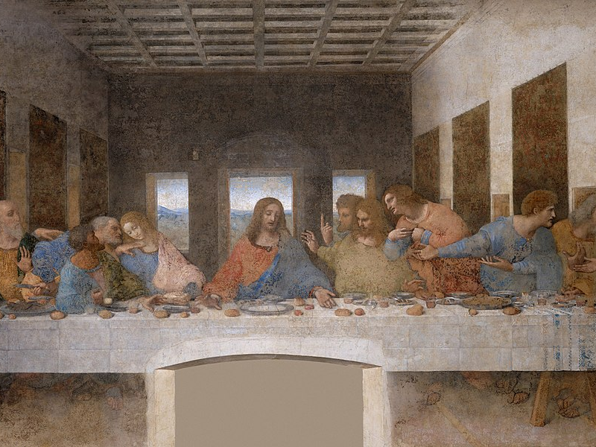
The Supper of Our Lord
Mark 14:22-25

Slide 23
²² While they were eating, Jesus took bread, and when he had given thanks, he broke it and gave it to his disciples, saying, “Take it; this is my body.” ²³ Then he took a cup, and when he had given thanks, he gave it to them, and they all drank from it. ²⁴ “This is my blood of the covenant, which is poured out for many,” he said to them. ²⁵ “Truly I tell you, I will not drink again from the fruit of the vine until that day when I drink it new in the kingdom of God.”

Slide 24
Hymn #564
CCLI# 245077

Slide 25
Let us break bread together
On our knees;
Let us break bread together
On our knees;
When I fall on my knees,
With my face rising sun,
O Lord, have mercy on me.

Slide 26
Let us drink wine together
On our knees;
Let us drink wine together
On our knees;
When I fall on my knees,
With my face rising sun,
O Lord, have mercy on me.

Slide 27
Let us praise God together
On our knees;
Let us praise God together
On our knees;
When I fall on my knees,
With my face rising sun,
O Lord, have mercy on me.

Slide 28
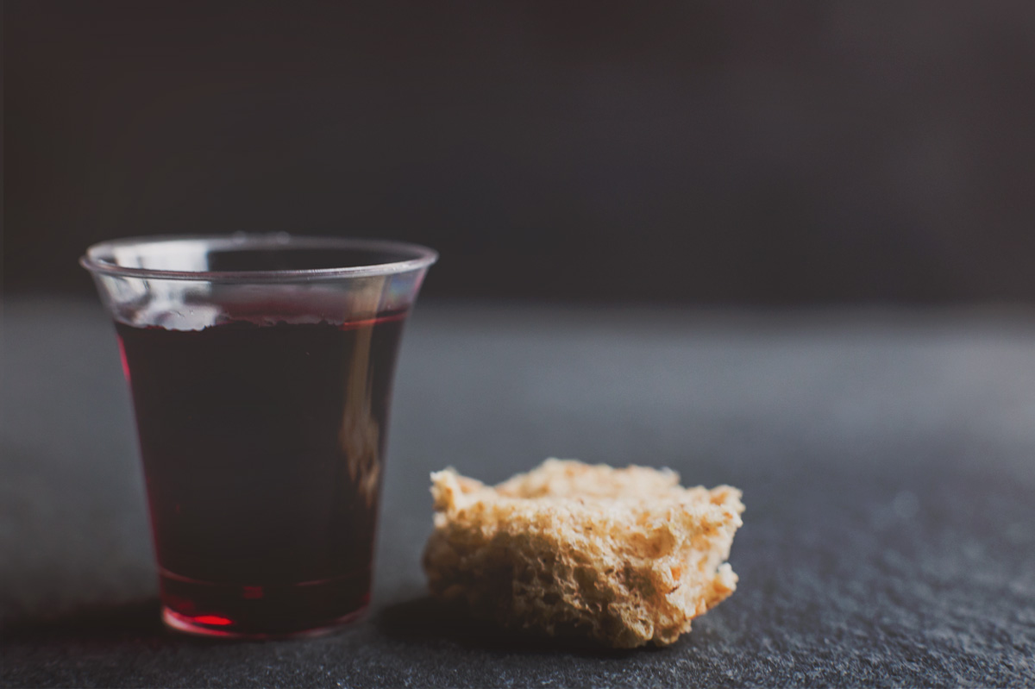
THE SACRAMENT OF THE LORD’S SUPPER
Just As I AM, Without One Plea
CCLI# 245077

Slide 29
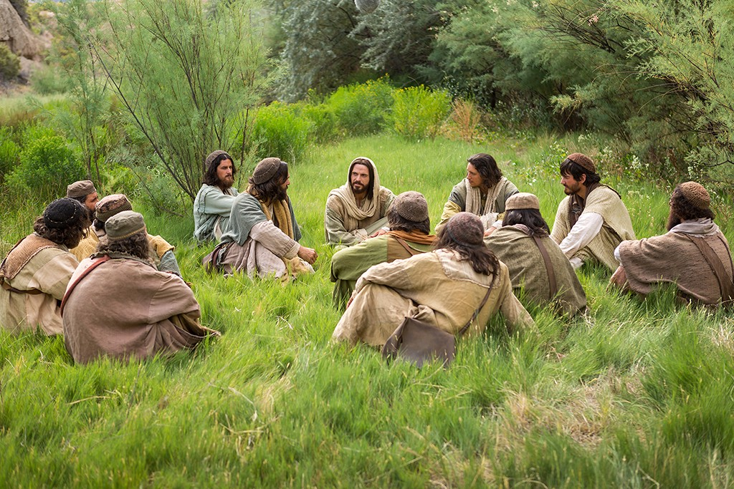
Jesus’ Prediction
Mark 14:26-31

Slide 30
²⁶ When they had sung a hymn, they went out to the Mount of Olives. ²⁷ “You will all fall away,” Jesus told them, “for it is written: “‘I will strike the shepherd, and the sheep will be scattered.’ ²⁸ But after I have risen, I will go ahead of you into Galilee.” ²⁹ Peter declared, “Even if all fall away, I will not.” ³⁰ “Truly I tell you,” Jesus answered, “today—yes, tonight—before the rooster crows twice you yourself will disown me three times.” ³¹ But Peter insisted emphatically, “Even if I have to die with you, I will never disown you.” And all the others said the same.

Slide 31
Tears Slowly Fall

Slide 32
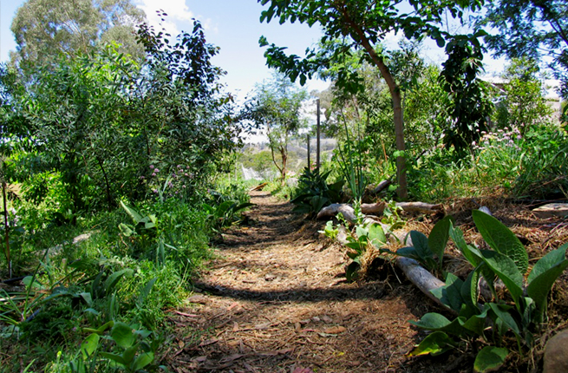
The Garden, Betrayal and Arrest
Mark 14:32-42

Slide 33
³² They went to a place called Gethsemane, and Jesus said to his disciples, “Sit here while I pray.” ³³ He took Peter, James and John along with him, and he began to be deeply distressed and troubled. ³⁴ “My soul is overwhelmed with sorrow to the point of death,” he said to them. “Stay here and keep watch.” ³⁵ Going a little farther, he fell to the ground and prayed that if possible the hour might pass from him. ³⁶ “Abba, Father,” he said, “everything is possible for you. Take this cup from me. Yet not what I will, but what you will.”

Slide 34
³⁷ Then he returned to his disciples and found them sleeping. “Simon,” he said to Peter, “are you asleep? Couldn’t you keep watch for one hour? ³⁸ Watch and pray so that you will not fall into temptation. The spirit is willing, but the flesh is weak.” ³⁹ Once more he went away and prayed the same thing. ⁴⁰ When he came back, he again found them sleeping, because their eyes were heavy. They did not know what to say to him. ⁴¹ Returning the third time, he said to them, “Are you still sleeping and resting? Enough! The hour has come. Look, the Son of Man is delivered into the hands of sinners. ⁴² Rise! Let us go! Here comes my betrayer!”

Slide 35
Hymn #283
CCLI# 245077

Slide 36
What wondrous love is this,
O my soul, O my soul,
What wondrous love is this, O my soul!
What wondrous love is this
that caused the Lord of bliss
To bear the dreadful curse for my soul,
For my soul, To bear the dreadful curse for my soul!

Slide 37
To God and to the Lamb
I will sing, I will sing,
To God and to the Lamb
I will sing;
To God and to the Lamb,
Who is the great “I Am,”
While millions join the theme,
I will sing, I will sing,
While millions join the theme, I will sing!

Slide 38
And when from death I’m free,
I’ll sing on, I’ll sing on,
And when from death I’m free,
I’ll sing on;
And when from death I’m free,
I’ll sing and joyful be,
And through eternity I’ll sing on,
I’ll sing on,
And through eternity I’ll sing on!

Slide 39
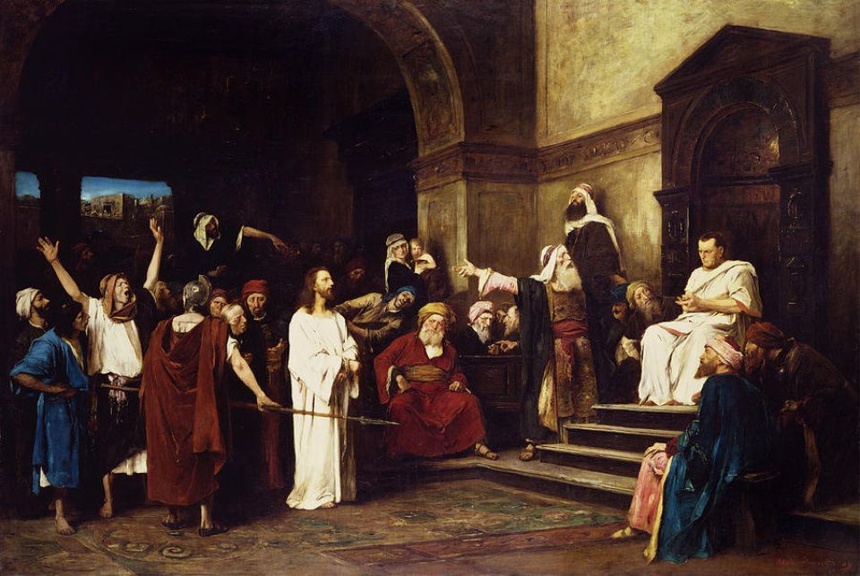
The First Trial
Mark 14:53-65
Luke 22:39-53

Slide 40
⁵³ They took Jesus to the high priest, and all the chief priests, the elders and the teachers of the law came together. ⁵⁴ Peter followed him at a distance, right into the courtyard of the high priest. There he sat with the guards and warmed himself at the fire. ⁵⁵ The chief priests and the whole Sanhedrin were looking for evidence against Jesus so that they could put him to death, but they did not find any. ⁵⁶ Many testified falsely against him, but their statements did not agree. ⁵⁷ Then some stood up and gave this false testimony against him:

Slide 41
⁵⁸ “We heard him say, ‘I will destroy this temple made with human hands and in three days will build another, not made with hands.’” ⁵⁹ Yet even then their testimony did not agree. ⁶⁰ Then the high priest stood up before them and asked Jesus, “Are you not going to answer? What is this testimony that these men are bringing against you?” ⁶¹But Jesus remained silent and gave no answer. Again the high priest asked him, “Are you the Messiah, the Son of the Blessed One?”

Slide 42
⁶² “I am,” said Jesus. “And you will see the Son of Man sitting at the right hand of the Mighty One and coming on the clouds of heaven.” ⁶³ The high priest tore his clothes. “Why do we need any more witnesses?” he asked. ⁶⁴ “You have heard the blasphemy. What do you think?” They all condemned him as worthy of death. ⁶⁵ Then some began to spit at him; they blindfolded him, struck him with their fists, and said, “Prophesy!” And the guards took him and beat him.

Slide 43
When You Prayed Beneath the Trees

Slide 44
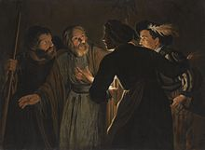
The Denial
Luke 22:39-53
Mark 14:66-72

Slide 45
⁶⁶ While Peter was below in the courtyard, one of the servant girls of the high priest came by. ⁶⁷ When she saw Peter warming himself, she looked closely at him. “You also were with that Nazarene, Jesus,” she said. ⁶⁸ But he denied it. “I don’t know or understand what you’re talking about,” he said, and went out into the entryway. ⁶⁹ When the servant girl saw him there, she said again to those standing around, “This fellow is one of them.” ⁷⁰ Again he denied it. After a little while, those standing near said to Peter, “Surely you are one of them,

Slide 46
for you are a Galilean.” ⁷¹ He began to call down curses, and he swore to them, “I don’t know this man you’re talking about.” ⁷²Immediately the rooster crowed the second time. Then Peter remembered the word Jesus had spoken to him: “Before the rooster crows twice you will disown me three times.” And he broke down and wept.

Slide 47
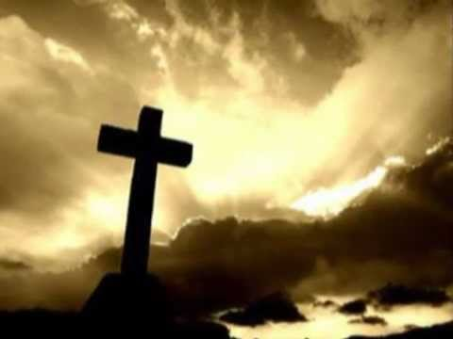
Beneath the Cross of Jesus
Hymn #253
CCLI# 245077

Slide 48
Beneath the cross of Jesus
I gladly take my stand:
The shadow of a mighty rock
Within a weary land,
A home within the wilderness,
A rest upon the way,
From the burning of noontide heat
And the burden of the day.

Slide 49
Upon that cross of Jesus
My eyes at times can see
The very dying form of One
Who suffered there for me;
And from my smitten heart, with tears,
Two wonders I confess
The wonders of His glorious love
And my unworthiness.

Slide 50
I take, O cross, thy shadow
For my abiding place;
I ask no other sunshine than
The sunshine of His face,
Content to let the world go by,
To know no gain or loss,
My sinful self my only shame,
My glory all the cross.

Slide 51
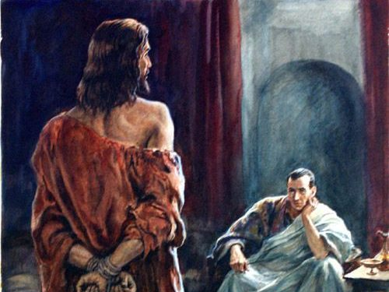
The Trial Before Pilate
Mark 15:1-20

Slide 52
Very early in the morning, the chief priests, with the elders, the teachers of the law and the whole Sanhedrin, made their plans. So they bound Jesus, led him away and handed him over to Pilate. ² “Are you the king of the Jews?” asked Pilate. “You have said so,” Jesus replied. ³The chief priests accused him of many things. ⁴So again Pilate asked him, “Aren’t you going to answer? See how many things they are accusing you of.” ⁵ But Jesus still made no reply, and Pilate was amazed. ⁶ Now it was the custom at the festival to release a prisoner whom the

Slide 53
people requested. ⁷ A man called Barabbas was in prison with the insurrectionists who had committed murder in the uprising. ⁸ The crowd came up and asked Pilate to do for them what he usually did. ⁹ “Do you want me to release to you the king of the Jews?” asked Pilate, ¹⁰ knowing it was out of self-interest that the chief priests had handed Jesus over to him. ¹¹But the chief priests stirred up the crowd to have Pilate release Barabbas instead. ¹² “What shall I do, then, with the one you call the king of the Jews?” Pilate asked them.

Slide 54
¹³ “Crucify him!” they shouted. ¹⁴ “Why? What crime has he committed?” asked Pilate. But they shouted all the louder, “Crucify him!” ¹⁵Wanting to satisfy the crowd, Pilate released Barabbas to them. He had Jesus flogged, and handed him over to be crucified. ¹⁶ The soldiers led Jesus away into the palace (that is, the Praetorium) and called together the whole company of soldiers. ¹⁷ They put a purple robe on him, then twisted together a crown of thorns and set it on him.

Slide 55
¹⁸ And they began to call out to him, “Hail, king of the Jews!” ¹⁹ Again and again they struck him on the head with a staff and spit on him. Falling on their knees, they paid homage to him. ²⁰ And when they had mocked him, they took off the purple robe and put his own clothes on him. Then they led him out to crucify him.

Slide 56
Surely He Loves

Slide 57
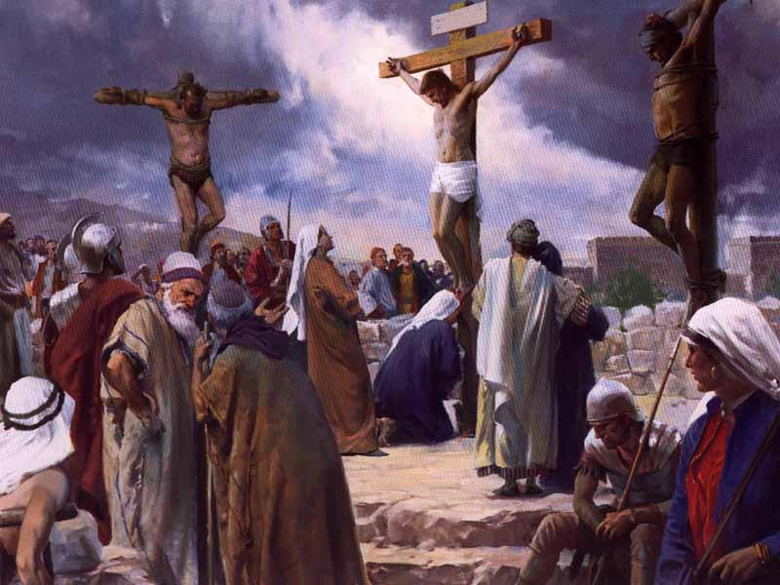
The Crucifixion
Mark 15:21-32

Slide 58
²¹ A certain man from Cyrene, Simon, the father of Alexander and Rufus, was passing by on his way in from the country, and they forced him to carry the cross. ²² They brought Jesus to the place called Golgotha (which means “the place of the skull”). ²³ Then they offered him wine mixed with myrrh, but he did not take it. ²⁴ And they crucified him. Dividing up his clothes, they cast lots to see what each would get. ²⁵ It was nine in the morning when they crucified him. ²⁶ The written notice of the charge against him read: The King of the Jews.

Slide 59
²⁷ They crucified two rebels with him, one on his right and one on his left. [²⁸] ²⁹ Those who passed by hurled insults at him, shaking their heads and saying, “So! You who are going to destroy the temple and build it in three days, ³⁰ come down from the cross and save yourself!”
³¹ In the same way the chief priests and the teachers of the law mocked him among themselves. “He saved others,” they said, “but he can’t save himself! ³² Let this Messiah, this king of Israel, come down now from the cross, that we may see and believe.” Those crucified with him also heaped insults on him.

Slide 60
Hymn # 287
CCLI# 245077

Slide 61
Were you there when they crucified my Lord?
Were you there when they crucified my Lord?
O! Sometimes it causes me to tremble, tremble, tremble.
Were you there when they crucified my Lord?

Slide 62
Were you there when they nailed Him to the tree?
Were you there when they nailed him to the tree?
O! Sometimes it causes me to tremble, tremble, tremble.
Were you there when they nailed Him to the tree?

Slide 63
Were you there when they laid Him in the tomb?
Were you there when they laid Him in the Tomb?
O! Sometimes it causes me to tremble, tremble, tremble.
Were you there when they laid Him in the tomb?

Slide 64
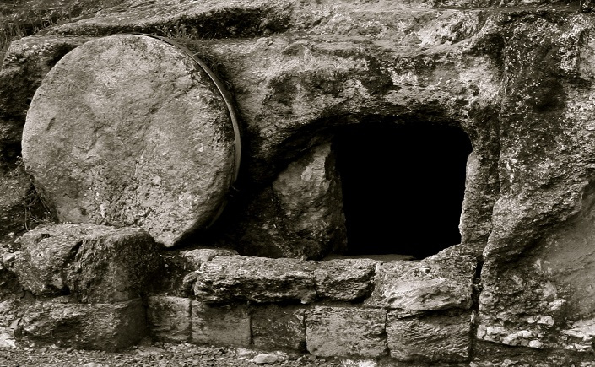
The Death of Jesus
Mark 15:33-39

Slide 65
³³ At noon, darkness came over the whole land until three in the afternoon. ³⁴ And at three in the afternoon Jesus cried out in a loud voice, “Eloi, Eloi, lema sabachthani?” (which means “My God, my God, why have you forsaken me?”).³⁵ When some of those standing near heard this, they said, “Listen, he’s calling Elijah.” ³⁶ Someone ran, filled a sponge with wine vinegar, put it on a staff, and offered it to Jesus to drink. “Now leave him alone. Let’s see if Elijah comes to take him down,” he said.

Slide 66
³⁷ With a loud cry, Jesus breathed his last. ³⁸ The curtain of the temple was torn in two from top to bottom. ³⁹ And when the centurion, who stood there in front of Jesus, saw how he died, he said, “Surely this man was the Son of God!”

Slide 68
