Slide 1
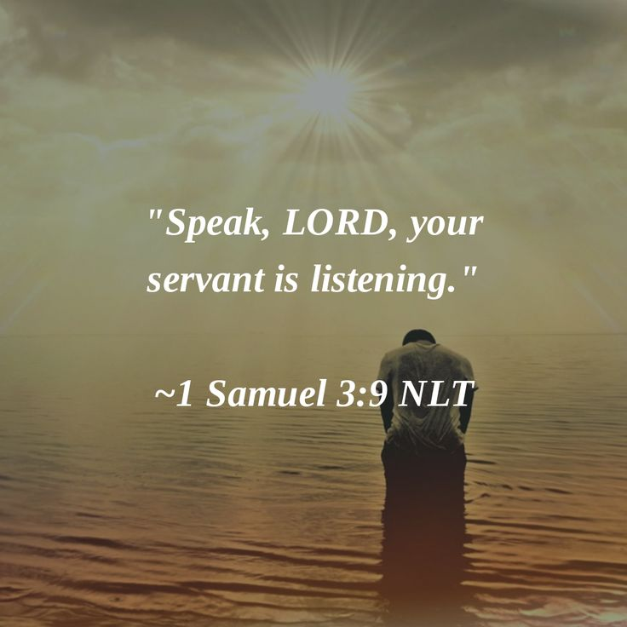
Level Green Presbyterian Church
January 14, 2024

Slide 2
PRELUDE
A time to prepare
our hearts and minds
to worship the Lord.

Slide 3
CALL TO
WORSHIP

Slide 4
Leader:
You have searched me, LORD, and You know me.
People:
You know when I sit and when I rise;

Slide 5
Leader:
You perceive my thoughts from afar.
People:
You discern my going out and my lying down;

Slide 6
Leader:
You are familiar with all my ways.
All:
Such knowledge is too wonderful for me, too lofty for me to attain.

Slide 8
Hymn #343
CCLI# 245077

Slide 9
Sing praise to God who reigns above,
The God of all creation,
The God of pow’r, the God of love,
The God of our salvation;
With healing balm my soul He fills,
And every faithless murmer stills:
To God all praise and glory.

Slide 10
What God’s almighty power hath made,
His gracious mercy keepeth;
By morning glow or evening shade
His watchful eye ne’er sleepeth;
Within the kingdom of His might,
Lo! all is just and all is right:
To God all praise and glory.

Slide 11
The Lord is never far away,
But, through all grief distressing,
An ever present help and stay,
Our peace, and joy, and blessing;
As with a mother’s tender hand,
He leads His own, His chosen band:
To God all praise and glory.

Slide 12
Thus, all my gladsome way along,
I sing aloud His praises,
That men may hear the graceful song
My voice unwearied raises,
Be joyful in the Lord, my heart,
Both soul and body bear your part:
To God all praise and glory.

Slide 13
The Apostles’ Creed

Slide 14
I BELIEVE in God the Father Almighty, Maker of heaven and earth,
And in Jesus Christ
his only Son our Lord;
who was conceived by the Holy Ghost, born of the Virgin Mary,
suffered under Pontius Pilate,
was crucified, dead, and buried;
he descended into hell;

Slide 15
the third day
he rose again from the dead;
he ascended into heaven,
and sitteth on the right hand of God
the Father Almighty;
from thence he shall come to judge
the quick and the dead.

Slide 16
I believe in the Holy Ghost;
the holy catholic Church;
the communion of saints;
the forgiveness of sins;
the resurrection of the body;
and the life everlasting.
Amen.

Slide 17
Prayer of Confession

Slide 18
O Lord, You know us inside and out. We pretend that You see us from far away, that we can hide our selfishness from You. Yet You alone know the fickleness of our hearts; You know even our words of repentance before we can form them. Forgive us, and make us whole. Fill us with gratitude for our very being; lay Your hand upon us and bless us. Give us words to tell the world of Your wonderful works. We pray in the name of Jesus Christ who calls us by name to follow Him. Amen.

Slide 20
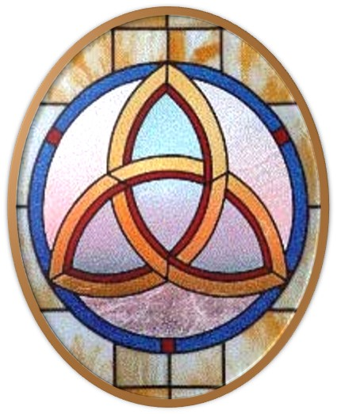
Gloria Patri
Hymn #142
CCLI #245077

Slide 21
Glory be to the Father
and to the Son
and to the Holy Ghost,
as it was in the beginning
is now and ever shall be,
world without end.
Amen, Amen.

Slide 24
By His Grace

Slide 25
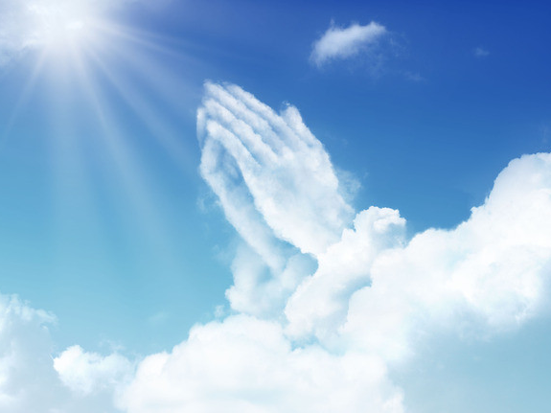

Slide 27
Hymn #382
CCLI #245077

Slide 28
Praise God,
From whom all blessings flow;
Praise Him,
All creatures here below;
Praise Him above,
Ye heavenly host;
Praise Father, Son,
And Holy Ghost. Amen

Slide 30
Praise Book
CCLI# 245077

Slide 31
The splendor of the King,
Clothed in majesty;
Let all the earth rejoice,
All the earth rejoice.
He wraps Himself in light,
And darkness tries to hide,
And trembles at His voice,
And trembles at His voice.

Slide 32
How great is our God!
Sing with me: How great is our God!
And all will see how great,
how great is our God!

Slide 33
And age to age He stands,
And time is in His Hands;
Beginning and the End,
Beginning and the End.
The God head, three in one,
Father, Spirit, Son,
The Lion and the Lamb,
The Lion and the Lamb.

Slide 34
How great is our God!
Sing with me: How great is our God!
And all will see how great,
how great is our God!

Slide 35
Name above all names,
Worthy of all praise. My heart will sing:
How great is our God!
Name above all names,
Worthy of all praise. My heart will sing:
How great is our God!

Slide 36
How great is our God!
Sing with me: How great is our God!
And all will see how great,
how great is our God!

Slide 38
1 Samuel 3:1-10 (NIV)

Slide 39
The boy Samuel ministered before the Lord under Eli. In those days the word of the Lord was rare; there were not many visions. ²One night Eli, whose eyes were becoming so weak that he could barely see, was lying down in his usual place. ³The lamp of God had not yet gone out, and Samuel was lying down in the house of the Lord, where the ark of God was. ⁴Then the Lord called Samuel. Samuel answered, “Here I am.” ⁵And he ran to Eli and said, “Here I am; you called me.” But Eli said, “I did not call; go back and lie down.” So he went and lay down.

Slide 40
⁶Again the Lord called, “Samuel!” And Samuel got up and went to Eli and said, “Here I am; you called me.” “My son,” Eli said, “I did not call; go back and lie down.” ⁷Now Samuel did not yet know the Lord: The word of the Lord had not yet been revealed to him. ⁸A third time the Lord called, “Samuel!” And Samuel got up and went to Eli and said, “Here I am; you called me.” Then Eli realized that the Lord was calling the boy. ⁹So Eli told Samuel, “Go and lie down, and if he calls you, say, ‘Speak, Lord, for your servant is listening.’” So Samuel went and lay down in his place.

Slide 41
¹⁰The Lord came and stood there, calling as at the other times, “Samuel! Samuel!” Then Samuel said, “Speak, for your servant is listening.”

Slide 42
John 1:43-51 (NIV)

Slide 43
⁴³The next day Jesus decided to leave for Galilee. Finding Philip, he said to him, “Follow me.” ⁴⁴Philip, like Andrew and Peter, was from the town of Bethsaida. ⁴⁵Philip found Nathanael and told him, “We have found the one Moses wrote about in the Law, and about whom the prophets also wrote—Jesus of Nazareth, the son of Joseph.” ⁴⁶“Nazareth! Can anything good come from there?” Nathanael asked. “Come and see,” said Philip. ⁴⁷When Jesus saw Nathanael approaching, he said of him, “Here truly is an Israelite in whom

Slide 44
there is no deceit.” ⁴⁸“How do you know me?” Nathanael asked. Jesus answered, “I saw you while you were still under the fig tree before Philip called you.” ⁴⁹Then Nathanael declared, “Rabbi, you are the Son of God; you are the king of Israel.” ⁵⁰Jesus said, “You believe because I told you I saw you under the fig tree. You will see greater things than that.” ⁵¹He then added, “Very truly I tell you, you will see ‘heaven open, and the angels of God ascending and descending on’ the Son of Man.”

Slide 46
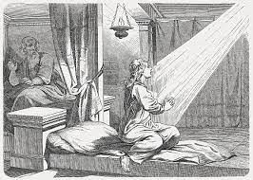
God Will Keep Calling You

Slide 47
Hymn #399
CCLI# 245077

Slide 48
Jesus calls us o’er the tumult
Of our life’s wild, restless sea;
Day by day
I hear Him saying,
“Christian, come and follow me.”

Slide 49
As, of old, disciples heard it
By the Galilean lake,
Turned from home
and work and leisure,
Leaving all for His dear sake:

Slide 50
In our joys and in our sorrows,
Days of toil and hours of ease,
Still He calls in cares and pleasures,
“Christian, love me
more than these.”

Slide 51
Jesus calls us: by Thy mercies,
Savior, may we hear Thy call,
Give our hearts to Thine obedience,
Serve and love Thee best of all.

Slide 53
BENEDICTION

Slide 54
POSTLUDE
Have a
good week!

