Slide 1
Level Green Presbyterian Church
March 3, 2024

Slide 2
PRELUDE
A time to prepare
our hearts and minds
to worship the Lord.

Slide 3
CALL TO
WORSHIP

Slide 4
Leader:
In the heavens God has pitched a tent for the sun.
People:
It is like a bridegroom coming out of his chamber,

Slide 5
Leader:
Like a champion rejoicing to run his course.
People:
It rises at one end of the heavens

Slide 6
Leader:
And makes its circuit to the other;
All:
Nothing is deprived of its warmth.

Slide 8
Hymn #258
CCLI# 245077

Slide 9
When I survey the wondrous cross
On which the Prince of glory died,
My richest gain
I count but loss,
And pour contempt on all my pride.

Slide 10
Forbid it, Lord, that I should boast,
Save in the death of Christ my God;
All the vain things
That charm me most,
I sacrifice them to His blood.

Slide 11
See, from His head, His hands, His feet,
Sorrow and love flow mingled down;
Did e’ver such love
And sorrow meet,
Or thorns compose so rich a crown?

Slide 12
Were the whole realm of nature mine,
That were a present far too small;
Love so amazing,
So divine,
Demands my soul, my life, my all.

Slide 13
The Apostles’ Creed

Slide 14
I BELIEVE in God the Father Almighty, Maker of heaven and earth,
And in Jesus Christ
his only Son our Lord;
who was conceived by the Holy Ghost, born of the Virgin Mary,
suffered under Pontius Pilate,
was crucified, dead, and buried;
he descended into hell;

Slide 15
the third day
he rose again from the dead;
he ascended into heaven,
and sitteth on the right hand of God
the Father Almighty;
from thence he shall come to judge
the quick and the dead.

Slide 16
I believe in the Holy Ghost;
the holy catholic Church;
the communion of saints;
the forgiveness of sins;
the resurrection of the body;
and the life everlasting.
Amen.

Slide 17
Prayer of Confession

Slide 18
Heavenly Father, Your counsel is perfect. You invite us to live with singular devotion to You, to trust that you will work all things out in time. Yet we are afraid You won’t take care of us. We fear You will forget or abandon or punish us. We haven’t known You for who You truly are: Our loving Father, our Savior, our Healer. Forgive us for not getting to know You, for assuming the worst about You, for writing You off. Help us to bravely risk the unknown to renew our faith in You. For Your glory, and our good. In the name of Jesus Christ we pray. Amen.

Slide 20
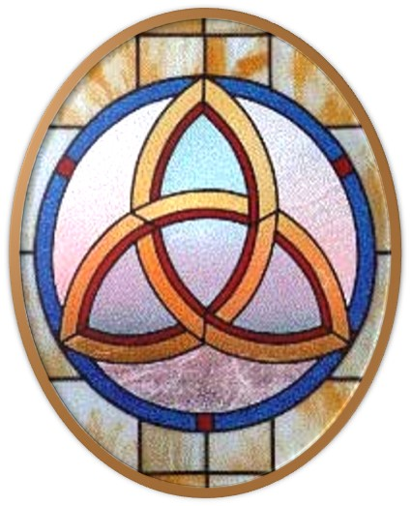
Gloria Patri
Hymn #142
CCLI #245077

Slide 21
Glory be to the Father
and to the Son
and to the Holy Ghost,
as it was in the beginning
is now and ever shall be,
world without end.
Amen, Amen.

Slide 24
He Loved Them To The End

Slide 27
Hymn #382
CCLI #245077

Slide 28
Praise God,
From whom all blessings flow;
Praise Him,
All creatures here below;
Praise Him above,
Ye heavenly host;
Praise Father, Son,
And Holy Ghost. Amen

Slide 30
Exodus 34:1-7 (NIV)

Slide 31
The Lord said to Moses, “Chisel out two stone tablets like the first ones, and I will write on them the words that were on the first tablets, which you broke. ²Be ready in the morning, and then come up on Mount Sinai. Present yourself to me there on top of the mountain. ³No one is to come with you or be seen anywhere on the mountain; not even the flocks and herds may graze in front of the mountain.” ⁴So Moses chiseled out two stone tablets like the first ones and went up Mount Sinai early in the morning, as the Lord had

Slide 32
commanded him; and he carried the two stone tablets in his hands. ⁵Then the Lord came down in the cloud and stood there with him and proclaimed his name, the Lord. ⁶And he passed in front of Moses, proclaiming, “The Lord, the Lord, the compassionate and gracious God, slow to anger, abounding in love and faithfulness, ⁷maintaining love to thousands, and forgiving wickedness, rebellion and sin. Yet he does not leave the guilty unpunished; he punishes the children and their children for the sin of the parents to the third and fourth generation.”

Slide 33
1 John
4:7-21 (NIV)

Slide 34
⁷Dear friends, let us love one another, for love comes from God. Everyone who loves has been born of God and knows God. ⁸Whoever does not love does not know God, because God is love. ⁹This is how God showed his love among us: He sent his one and only Son into the world that we might live through him. ¹⁰This is love: not that we loved God, but that he loved us and sent his Son as an atoning sacrifice for our sins. ¹¹Dear friends, since God so loved us, we also ought to love one another. ¹²No one has ever seen God; but if

Slide 35
we love one another, God lives in us and his love is made complete in us. ¹³This is how we know that we live in him and he in us: He has given us of his Spirit. ¹⁴And we have seen and testify that the Father has sent his Son to be the Savior of the world. ¹⁵If anyone acknowledges that Jesus is the Son of God, God lives in them and they in God. ¹⁶And so we know and rely on the love God has for us. God is love. Whoever lives in love lives in God, and God in them. ¹⁷This is how love is made complete among us so that we will have

Slide 36
confidence on the day of judgment: In this world we are like Jesus. ¹⁸There is no fear in love. But perfect love drives out fear, because fear has to do with punishment. The one who fears is not made perfect in love. ¹⁹We love because he first loved us. ²⁰Whoever claims to love God yet hates a brother or sister is a liar. For whoever does not love their brother and sister, whom they have seen, cannot love God, whom they have not seen. ²¹And he has given us this command: Anyone who loves God must also love their brother and sister.

Slide 38
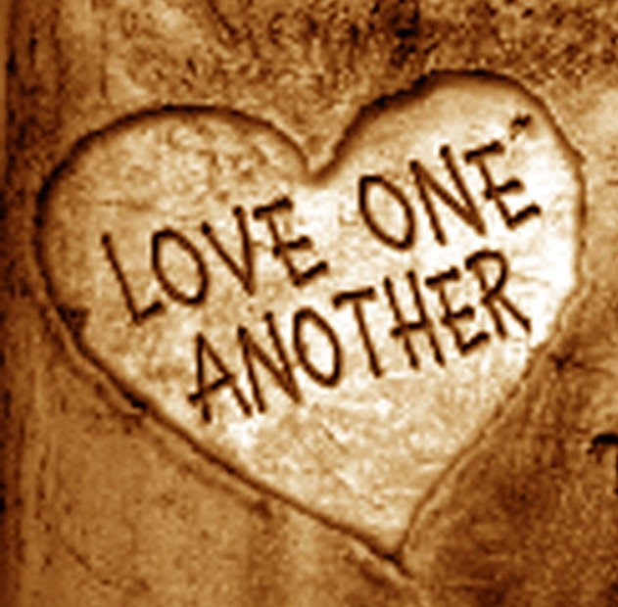
Loving One Another

Slide 39
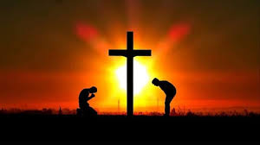
I Come To The Cross
Praise Book
CCLI# 245077

Slide 40
I come to the cross
Seeking mercy and grace,
I come to the cross
Where You died in my place.
Out of my weakness
and into Your strength,
Humbly, I come to the cross.

Slide 41
Your arms are open,
You call me by name.
You welcome this child that was lost.
You paid the price
for my guilt and my shame.
Jesus, I come, Jesus, I come,
Jesus, I come to the cross.

Slide 42
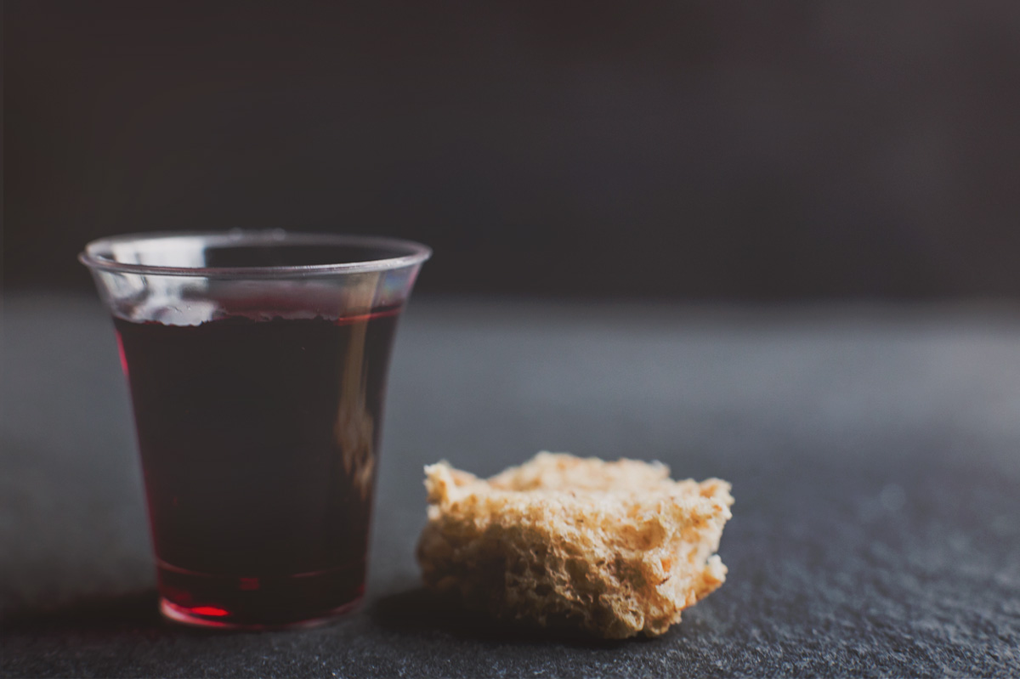
THE SACRAMENT OF THE LORD’S SUPPER
Just As I AM, Without One Plea
CCLI# 245077

Slide 43
Hymn #2
CCLI# 245077

Slide 44
O Lord my God!
When I in awesome wonder
Consider all
the worlds Thy hands have made,
I see the stars,
I hear the rolling thunder,
Thy power throughout
the universe displayed:

Slide 45
Then sings my soul,
my Savior God, to Thee:
How great Thou art,
how great Thou art!
Then sings my soul,
my Savior God, to Thee:
How great Thou art,
how great Thou art!

Slide 46
When through the woods
and forests glades I wander
And hear the birds
sing sweetly in the trees;
When I look down
from lofty mountains grandeur,
And hear the brook
and feel the gentle breeze:

Slide 47
Then sings my soul,
my Savior God, to Thee:
How great Thou art,
how great Thou art!
Then sings my soul,
my Savior God, to Thee:
How great Thou art,
how great Thou art!

Slide 48
And when I think
that God, His Son not sparing,
Sent Him to die, I scarce can take it in;
That on the cross,
my burden gladly bearing,
He bled and died to take away my sin:

Slide 49
Then sings my soul,
my Savior God, to Thee:
How great Thou art,
how great Thou art!
Then sings my soul,
my Savior God, to Thee:
How great Thou art,
how great Thou art!

Slide 50
When Christ shall come
with shout of acclamation
And take me home,
what joy shall fill my heart!
Then I shall bow in humble adoration,
And there proclaim,
my God, how great Thou art!

Slide 51
Then sings my soul,
my Savior God, to Thee:
How great Thou art,
how great Thou art!
Then sings my soul,
my Savior God, to Thee:
How great Thou art,
how great Thou art!

Slide 52
BENEDICTION

Slide 53
POSTLUDE
Have a
good week!

